Slide 1

Realtor.com Market Outlook
Realtor.com Economics
January 2019

Slide 2
AGENDA
Economic and housing data and insights from realtor.com®
National Forecast – How well did we predict 2018? Looking forward to 2019
U.S. Economic Trends – GDP, Jobs
U.S. Housing Trends – Ownership Up, EHS Struggle
  Supply: Inventory, Prices, Affordability
  Demand: Aging Millennials, Rents
  How Shoppers React
How realtor.com® data highlights U.S. trends
  California, Cross Market Demand
  Hot Markets, Generational Shopping
Local Data – Denver Inventory, Sales & Hot Markets

Slide 3
National Forecast

Slide 4
2019 Forecast
Key economic and housing metrics from NAR and realtor.com
National Association of REALTORS® Macro Forecast:
  Real GDP grows 1.9% in 2019 (vs. 3.1% in 2018, 2.2% in 2017)
  Nonfarm payroll employment grows 1.0% in 2019 (vs. 1.6% in 2018, 1.6% in 2017)
  Unemployment rises to 4.1% in 2019 (vs to 3.9% in 2018, 4.4% in 2017)
realtor.com® 2019 Housing Forecast:
  Existing home prices appreciate 2.2%
  Existing home sales down 2.0%
  Single family housing starts increase 8%
  30-year fixed conforming rate averages 5.3%
  Homeownership rate increases to 64.6%

Slide 5
2018 Forecast
Key economic and housing metrics from realtor.com
Variable | 2018 Forecast | Year to Date Actual | Tracking So Far?
Existing Home Sales | 3.2% | -2.9% | Lower
Existing Home Prices | 2.5% | 4.7% | Higher
New Home Sales | 7% | 2.7% | Lower
Housing Starts | 3% | 5% | Higher
SF Housing Starts | 7% | 3% | Lower
Mortgage Rates | 4.6% | 4.6% | As Expected
Notes:
On track to undershoot on price and overshoot on existing home sales;
EHS→-1.6% YTD
New home sales—roughly on track with forecast +7.2% YTD
Housing starts—roughly on track with forecast → +8% b/c MF +10%; SF up 7%
Mortgage rates—roughly on track with forecast→ approach 5% by end of year, fed moves
Implications of higher mortgage rates for affordability;
Turnover in homes slowing?
Local Market Angle – where are Californians going?

Slide 6
2018 Inventory Projection
…Based on this pattern, realtor.com® projects U.S. year-over-year inventory growth to tick up into positive territory by fall 2018, for the first time since 2015…
https://www.realtor.com/research/2018-national-housing-forecast/

Slide 7
2018 Inventory trends
Month | Inventory Y/Y
June | -4.3%
July | -3.7%
August | -1.9%
September | -0.0%
October | +1.6%
November | +3.9%
December | +5.3%

Slide 8
2019 Forecast
Key economic and housing metrics from realtor.com
Variable | 2019 Forecast
Existing Home Sales | -2.0%
Existing Home Prices | 2.2%
SF Housing Starts | 8%
Mortgage Rates | 5.3/5.5%
Homeownership | 64.6%

Slide 9
Four Key Housing Trends in 2019
Modest inventory gains continue; high-end inventory growth spreads
Soft home sales continue
Millennials purchase the most homes
Tax plan still a wild card for housing

Slide 10
U.S. Economic Trends

Slide 11
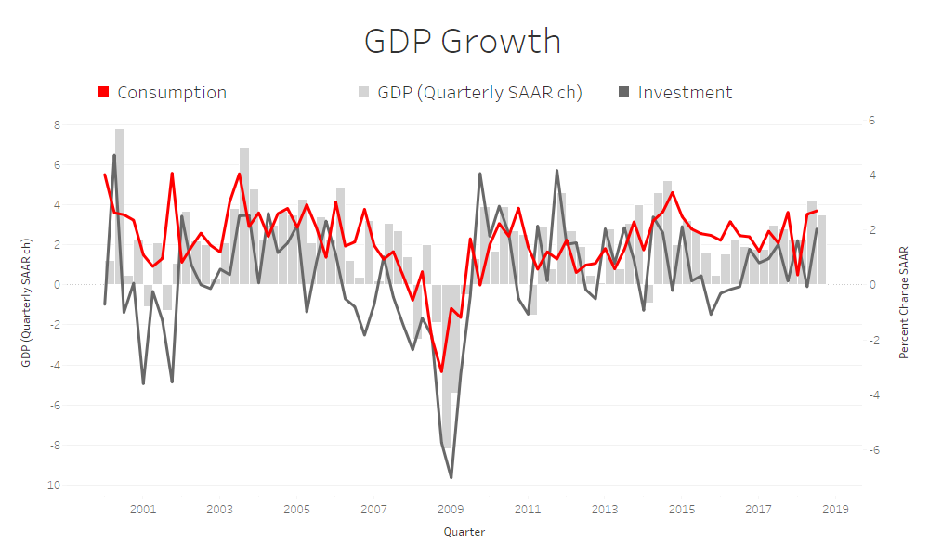
Economic Growth is STrong
Consumption drives strong growth, Investment improves
Source: Bureau of Labor Statistics, Realtor.com® Analysis

Slide 12
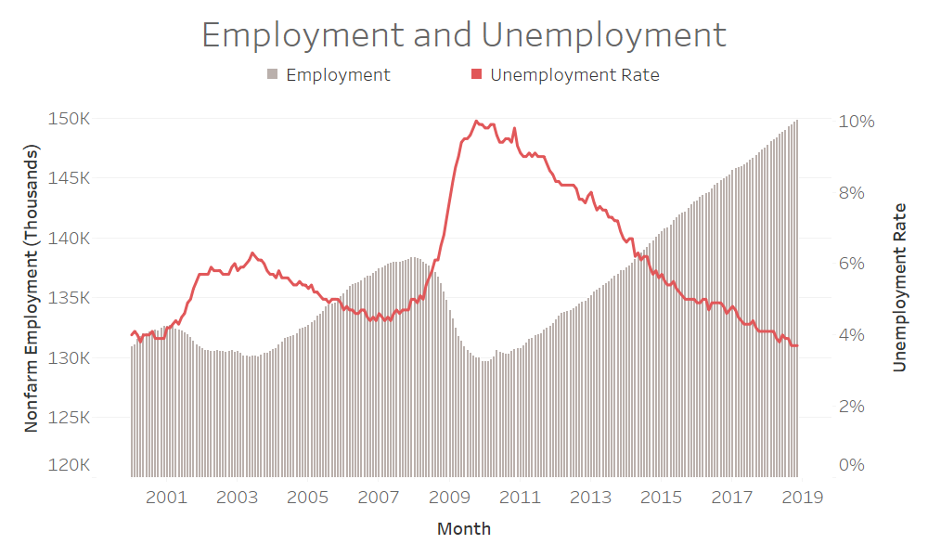
Job creation generally slowing
220,000 monthly average in past 12 months, Dec saw 312,000
Source: Bureau of Labor Statistics

Slide 13
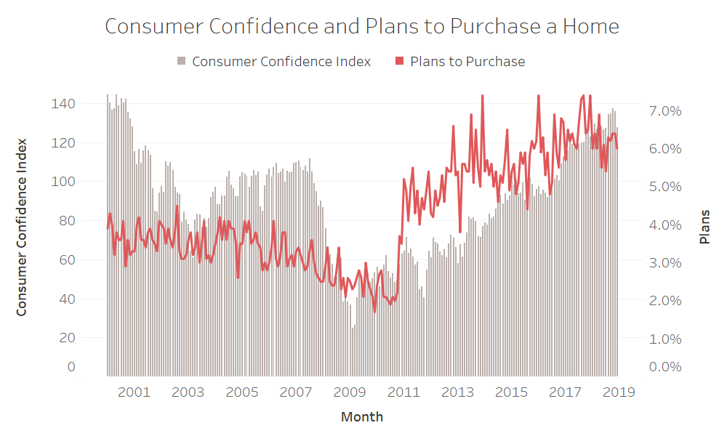
Consumer Confidence
Plans to purchase a home dip in December
Source: The Conference Board, Moody’s Analytics

Slide 14

U.S. Housing Trends
Notes:
SLIDE EDITING INSTRUCTIONS:
ICON: Right-click on icon to Change Picture.
Icons can be downloaded from the Brand Library: https://sites.google.com/a/move.com/brand-assets-library/home/app-and-presentation-icons

Slide 15
2018 Most competitive season on record
What are the hallmarks and drivers of the most competitive season?
Supply: Not Keeping Pace
  Inventory - at record lows and continuing to decline
  Prices - at record highs and still increasing
  Affordability - least affordable since 2008/09, but more affordable than most of early 2000s and 1990s
Demand: More Buyers in the Market
  Aging Millennials want to own – ‘peak millennial’ coming to the housing market in 2020
  Rents - rising in 73% of counties
Existing Home Sales Struggle to Break Out
Notes:
EHS Essentially Flat since mid-2015

Slide 16
2019 market shifts
Supply comes back for some; affordability challenge reduces buyer competition
Supply: Not Keeping Pace Coming back in some markets/price-levels
  Inventory - at record lows and continuing to decline (now up 5.3% in Dec)
  Prices - at record highs and still increasing (up 7.1% in Dec)
  Affordability - least affordable since 2008/09, but more affordable than most of early 2000s and 1990s
Demand: More Buyers in the Market
  Aging Millennials want to own – ‘peak millennial’ coming to the housing market in 2020
  Rents - rising in 73% of counties
Existing Home Sales Struggle to Break Out
Notes:
EHS Essentially Flat since mid-2015

Slide 17
How Home Shoppers React - 2018
Survey of March home shoppers
Sticking Around: Nearly three-quarters of shoppers started their search in 2017
Know It’s Tough: 35 percent of shoppers anticipate “a lot of competition” and 94 percent are actively employing strategies to compete
  Key Strategy Categories:
  (1) Stay Informed and (2) Use Cash
Remain Optimistic: More than 70 percent expect to close in 2018

Slide 18
How Home Shoppers React - 2018
Survey of March home shoppers
Rising Rents a Trigger: Millennials cited rising rent as a reason for home purchase
Adjusting to Market Conditions: Roughly 4 in 5 shoppers have adapted their home search to cope with rising interest rates and home prices
  Key Adjustments:
  (1) Smaller home
  (2) Less expensive home
  (3) Different neighborhood
  (4) Larger Down Payment
  (5) Increase monthly budget

Slide 19
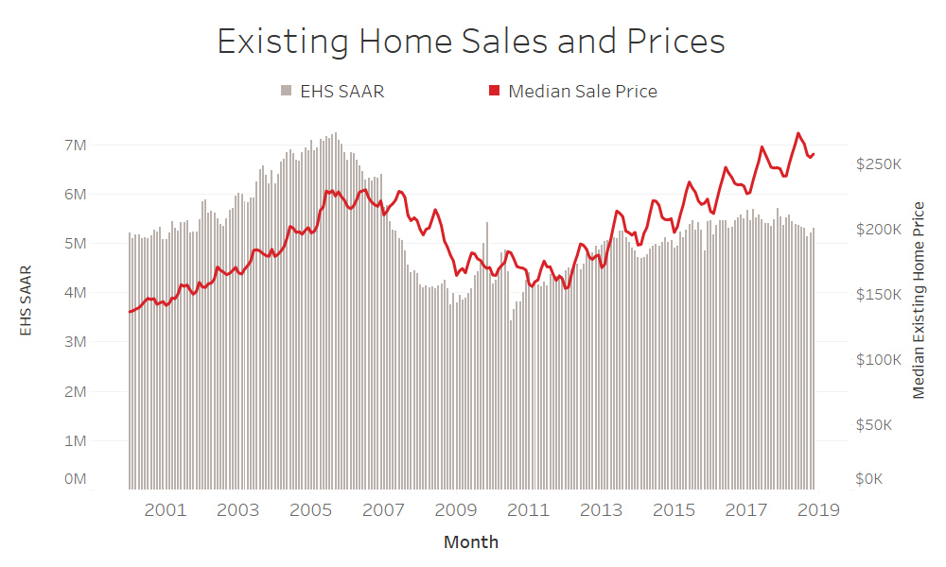
SALES Up in Oct & Nov, but still down y/y
EHS down 7.0% Y/Y in November
Source: National Association of REALTORS® Existing Home Sales Report

Slide 20
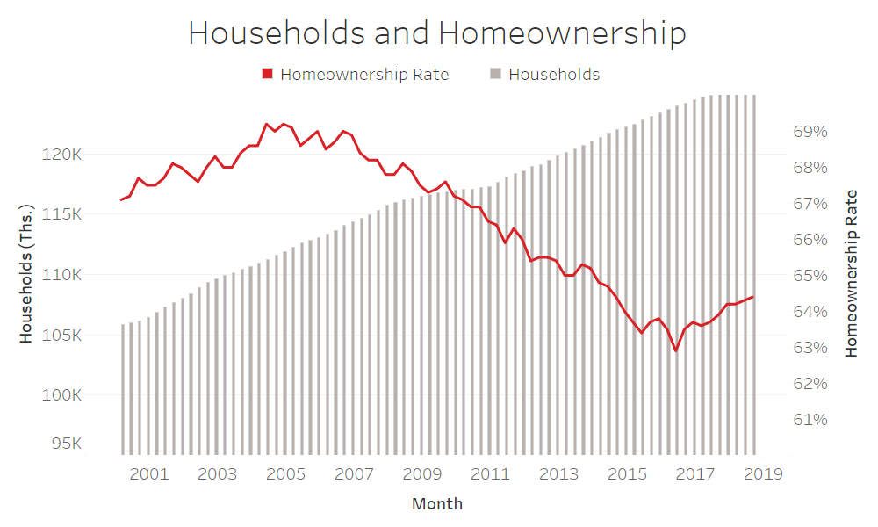
ownership Recovering
64.4% home ownership rate off low; 1.4 M households last 4 quarters
Source: Census Bureau

Slide 21

Supply Side

Slide 22
Modest inventory gains continue

Slide 23
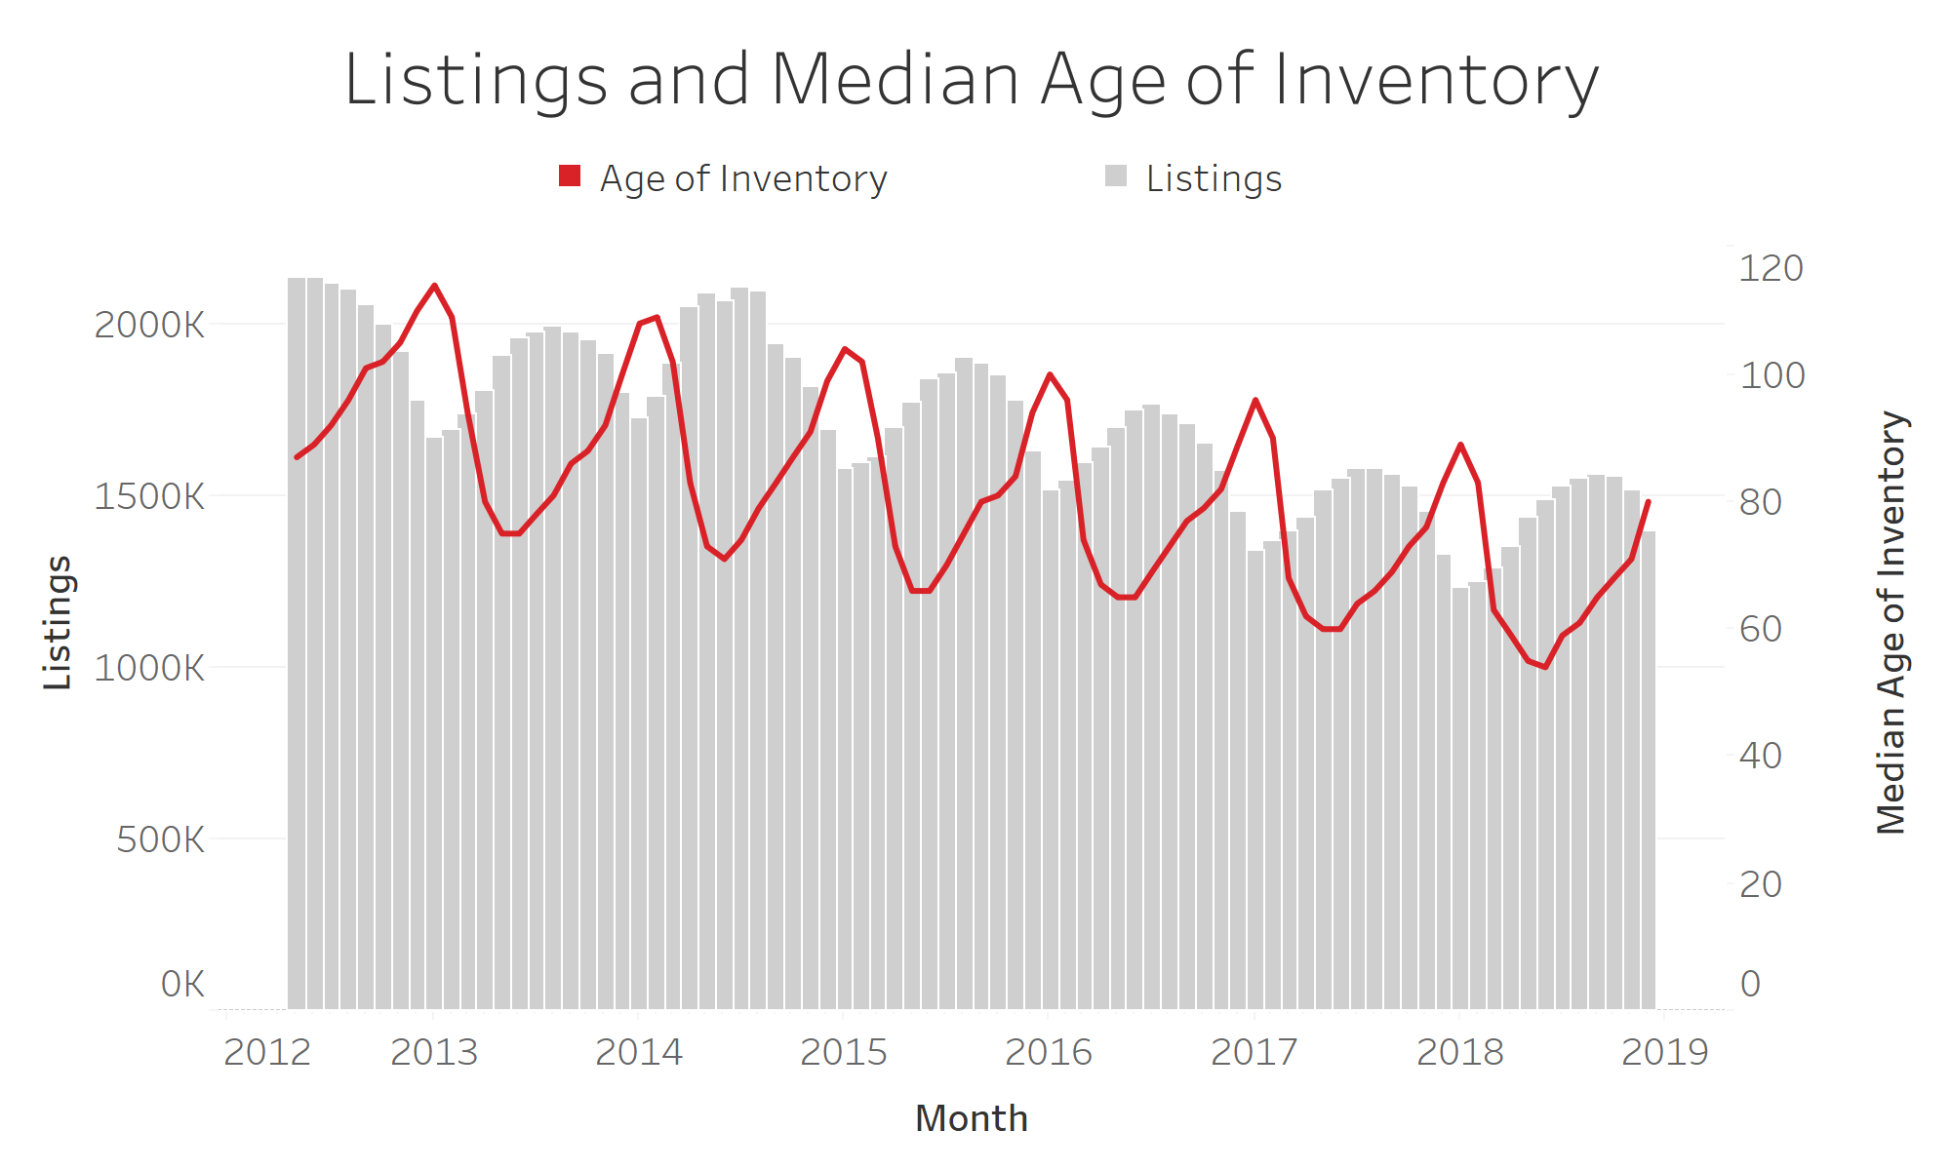
Inventory up
Inventory Increased 5% Y/Y in December
Source: Realtor.com®

Slide 24
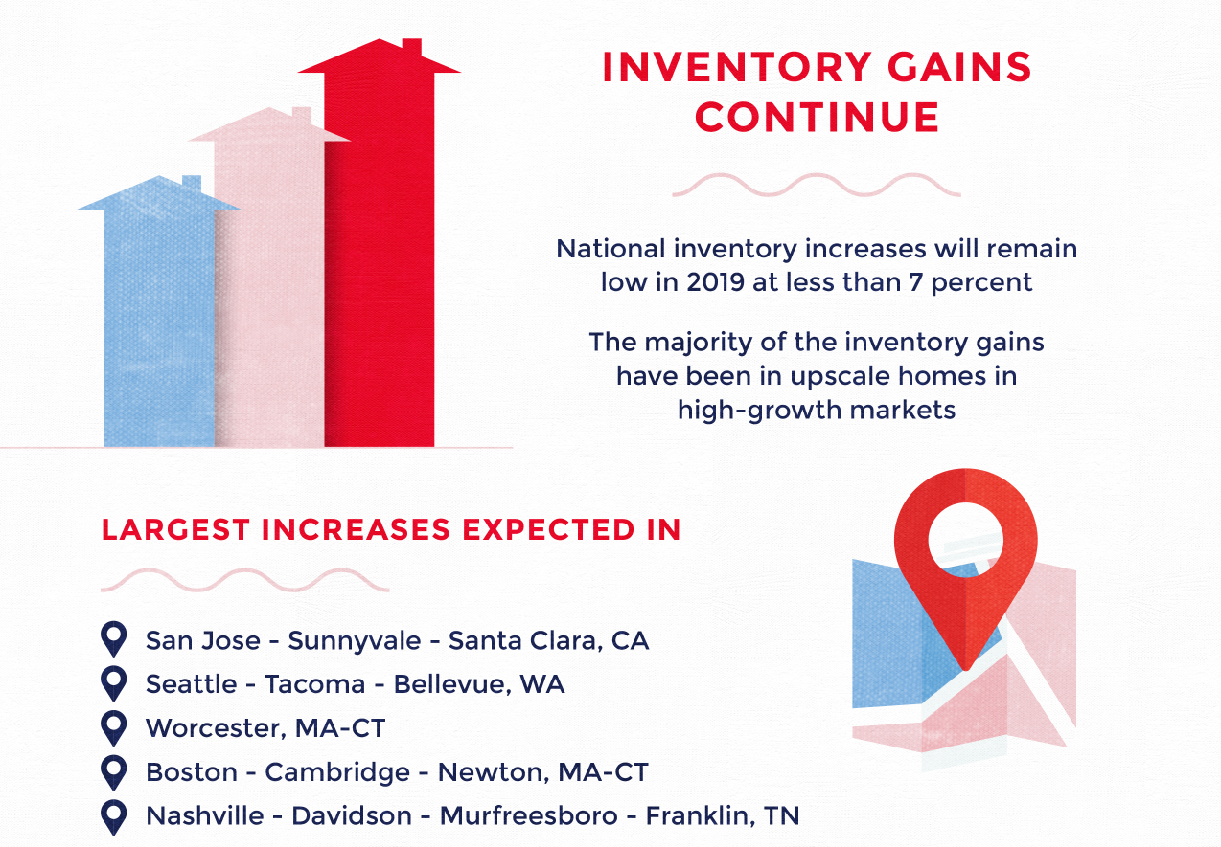
High-cost markets lead inventory gains

Slide 25
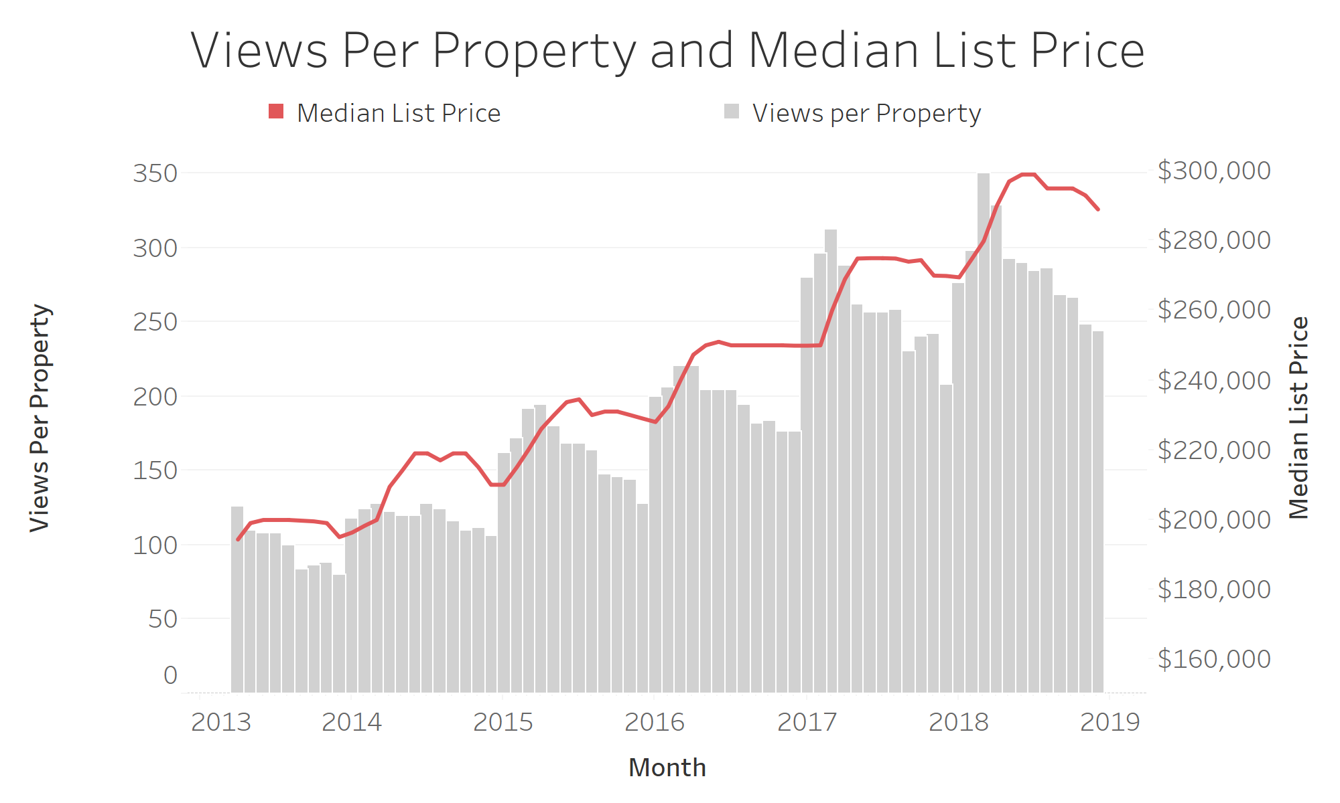
Prices continue to rise
Median List Price at $289,000, Up 7.1% Y/Y in December
Source: Realtor.com®

Slide 26
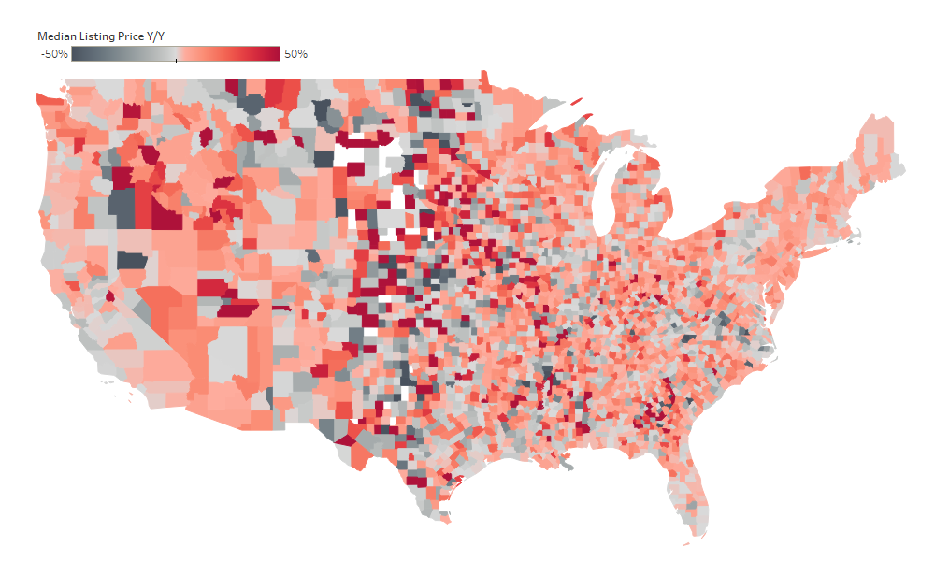
Listing prices up 7.1% y/y in Dec
Median list price increases are widespread
December 2018
Source: Realtor.com®

Slide 27
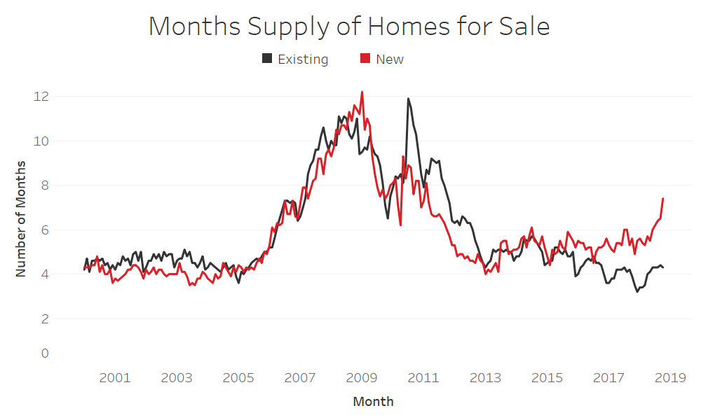
Inventory divergence
4.3 months supply for existing and 7.4 months for new
Source: National Association of REALTORS®, Commerce Department

Slide 28
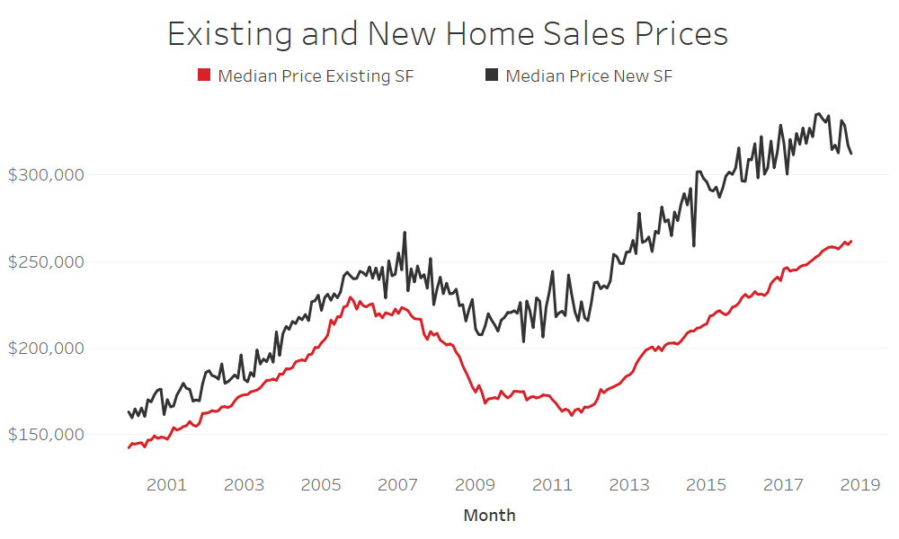
Crisis shifted new home market
Average spread 2000-2008: 12%; 2009-2018: 33%
Source: National Association of REALTORS®, Commerce Department

Slide 29
Soft Home Sales continue

Slide 30
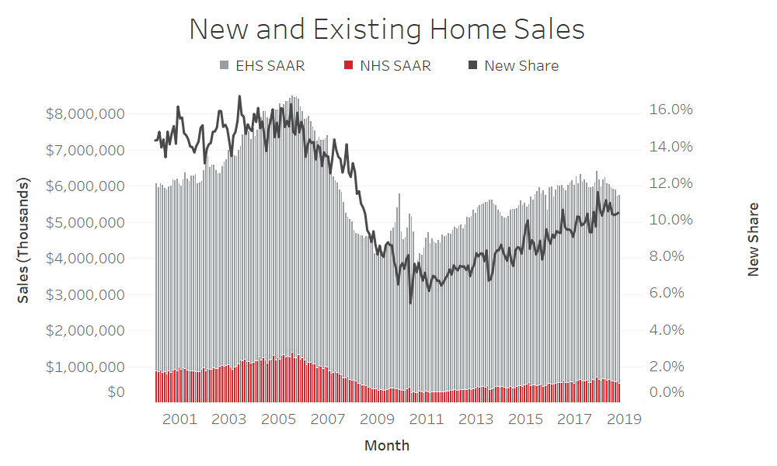
New & Existing sales down
Sales down 5.1% for existing and 12.0% for new Y/Y in October
Source: National Association of REALTORS®, Commerce Department

Slide 31
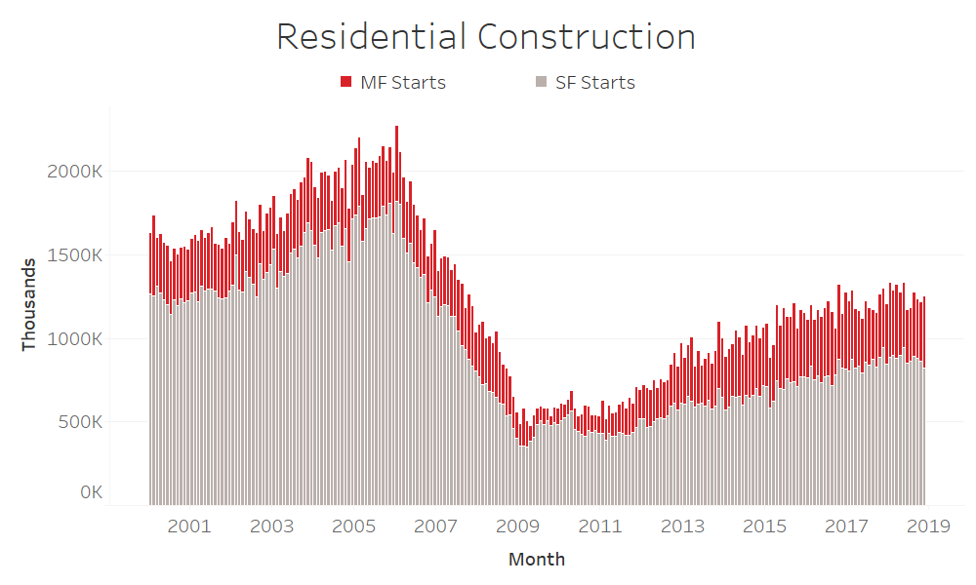
HOUSING Starts Down
Down 3.6% Y/Y with SF down 13.1% and MF up 21.7% in November
Source: Commerce Department

Slide 32
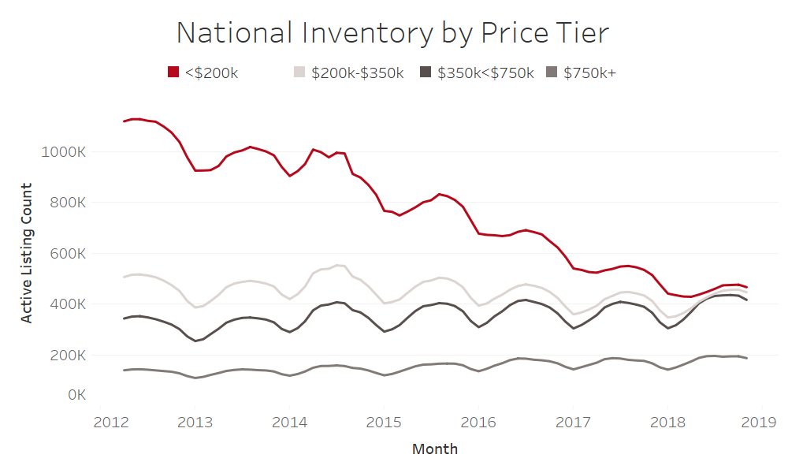
Affordable Home shortage
290,000 fewer ‘starter’ homes (<$200k) now vs December 2015
Source: realtor.com®

Slide 33

Demand drivers

Slide 34
Millennials purchase the most homes

Slide 35

millennials: 45% of mortgage buyers

Slide 36
Demographics set the table
When viewed by age, importance of Millennials becomes clearer
Z
65 million
Millennial
88 million
X
61 million
Boomer
78 million
29 million
Source: Realtor.com® Analysis of US Census Bureau Population Estimates (2016)
Notes:
Can be updated every time the census. Moody’s basket is best source.

Slide 37
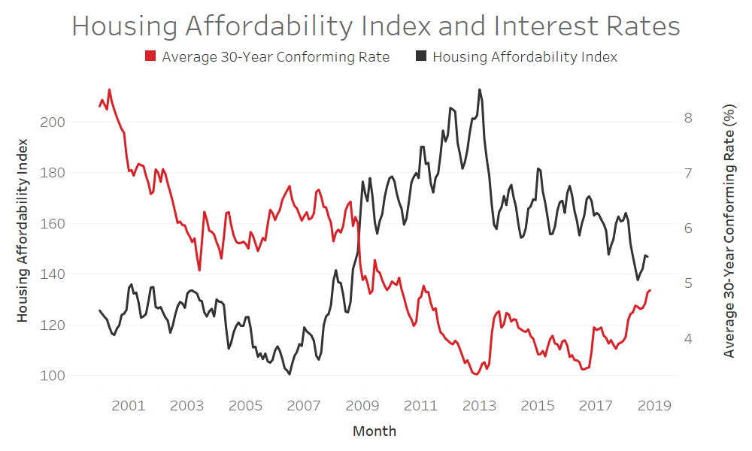
Historic Affordability declining
30-year conforming rate averaged 4.6% in past 12 months
Source: Moody’s Analytics, Freddie Mac, and National Association of REALTORS®

Slide 38
Affordability
A Different Measure: Pros and Cons
NAR Affordability Index
  Sales Prices
    Backward Looking (Con)
    Actual Market Price (Pro)
  Median Price Point
  Median Income Family
  Easy to interpret
REALTORS® Affordability Distribution
  Listing Prices
    Forward Looking (Pro)
    May sell for more/less (Con)
  Prices of All Listings
  Income of All Families
  More work to interpret
Notes:
The Realtor® Affordability Distribution Curve and Score is a monthly NAR and realtor.com® data series designed to examine affordability conditions at different income percentiles for all active inventory on the market. The Affordability Distribution Curve examines how many listings are affordable to those in a particular income percentile. The Affordability Score varies between zero and two and is a calculation that is equal to twice the area below the Affordability Distribution Curve on a graph. A score of one or higher generally suggests a market where homes for sale are more affordable to households in proportion to their income distribution.

Slide 39
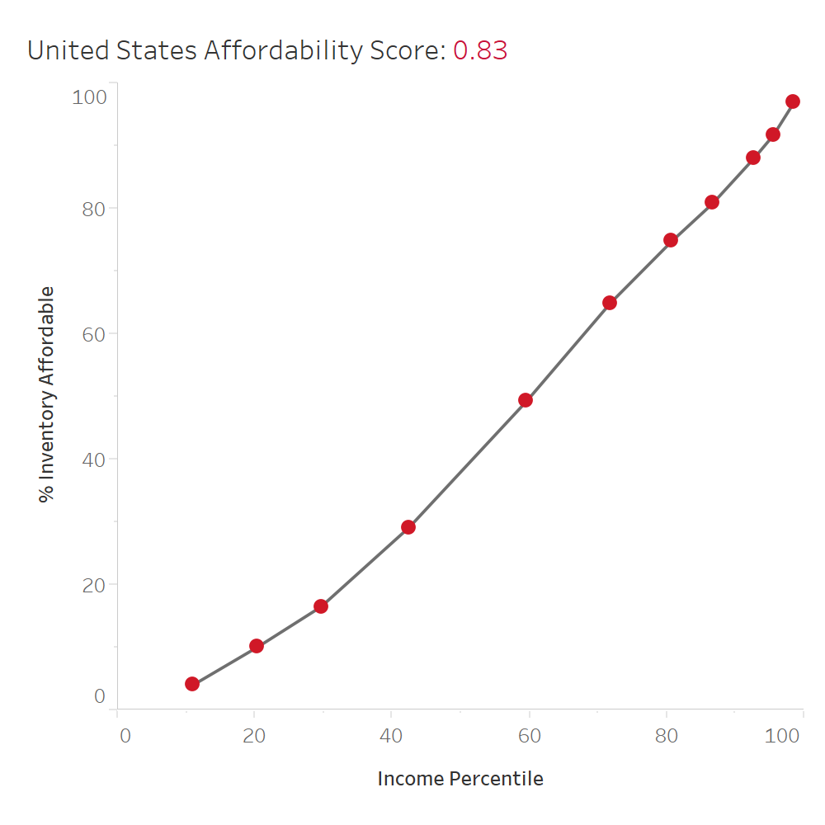
Affordability is relative
Higher income households have more access to available inventory
Source: realtor.com and National Association of REALTORS®
Notes:
The Realtor® Affordability Distribution Curve and Score is a monthly NAR and realtor.com® data series designed to examine affordability conditions at different income percentiles for all active inventory on the market. The Affordability Distribution Curve examines how many listings are affordable to those in a particular income percentile. The Affordability Score varies between zero and two and is a calculation that is equal to twice the area below the Affordability Distribution Curve on a graph. A score of one or higher generally suggests a market where homes for sale are more affordable to households in proportion to their income distribution.

Slide 40
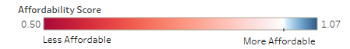
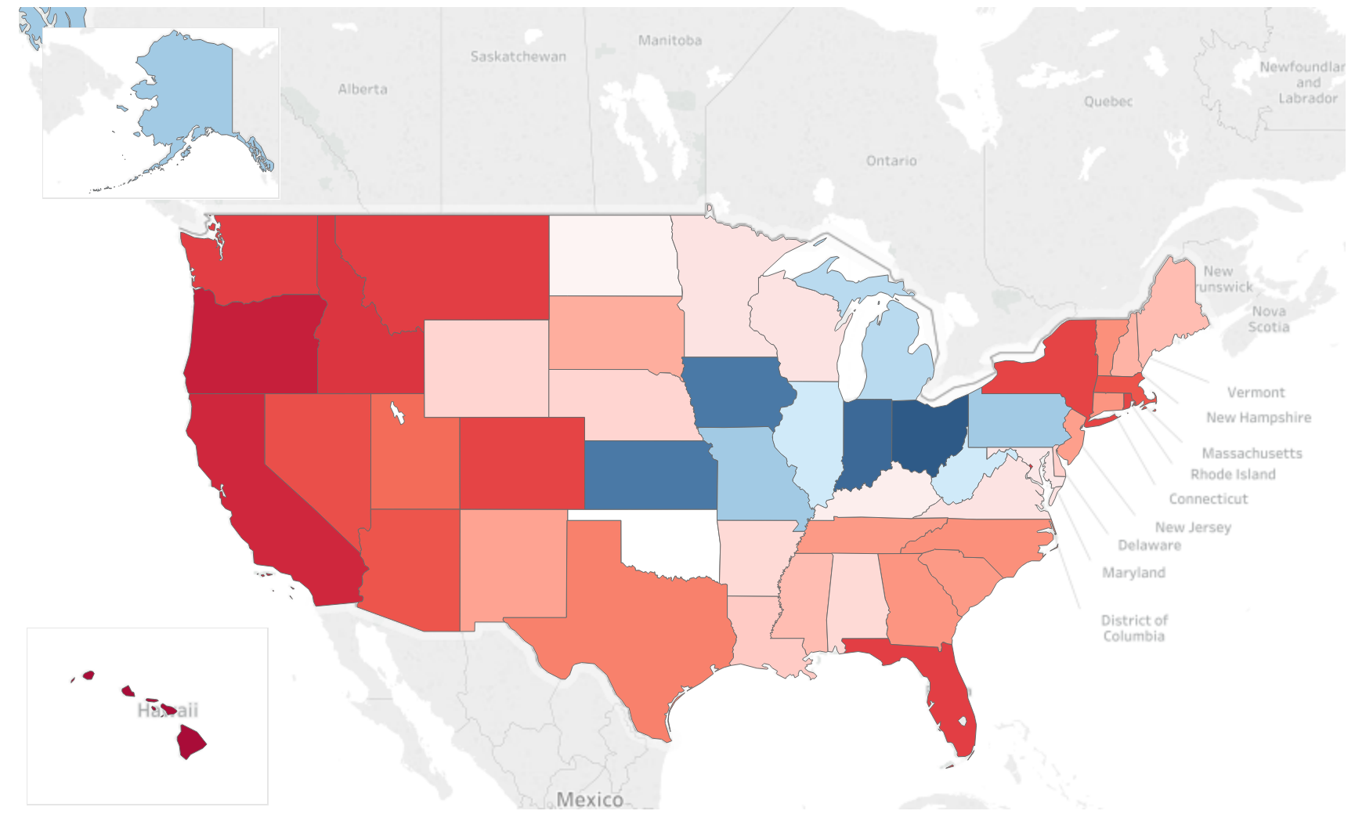
Affordability Heatmap
U.S. Score is 0.83 – in general homes are less affordable
Source: realtor.com® and National Association of REALTORS®

Slide 41
Top Affordable States
30th Percentile vs. 60th Percentile Income
State | 30th %ile Affordability
Kansas | 38%
Ohio | 37%
Indiana | 35%
Iowa | 33%
Michigan | 32%
Pennsylvania | 31%
Missouri | 30%
State | 60th %ile Affordability
Ohio | 71%
Indiana | 69%
Alaska | 68%
Iowa | 68%
Kansas | 66%
Missouri | 66%
North Dakota | 66%
Source: realtor.com® and National Association of REALTORS®

Slide 42
Least Affordable States
30th Percentile vs. 60th Percentile Income
State | 30th %tile Affordability
Rhode Island | 1%
D.C. | 3%
California | 3%
Oregon | 4%
Arizona | 4%
Nevada | 6%
Washington | 6%
State | 60th %ile Affordability
Oregon | 25%
Hawaii | 26%
California | 30%
Idaho | 31%
D.C. | 32%
Washington | 32%
Montana | 33%
Source: realtor.com® and National Association of REALTORS®

Slide 43
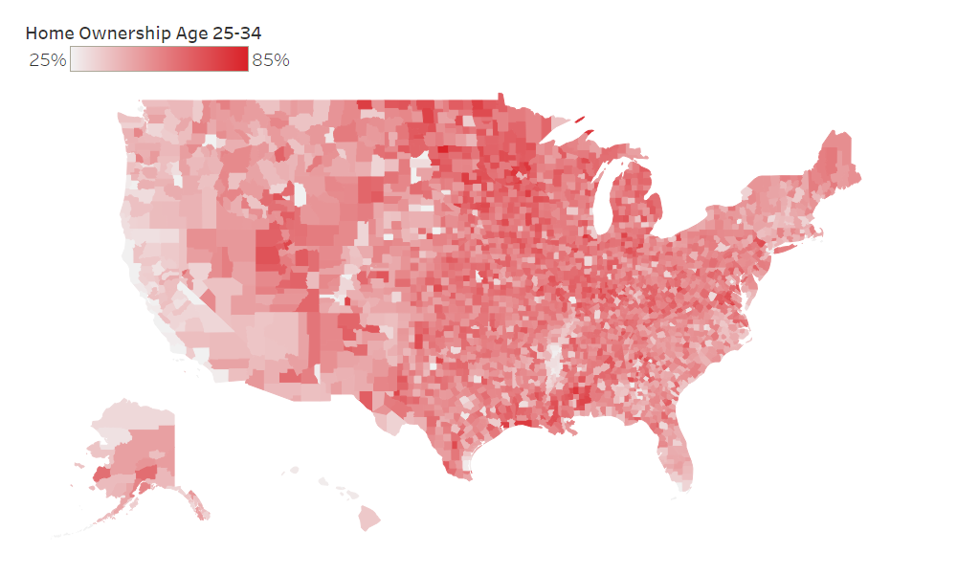
Millennial ownership varies
Strong correlation with affordable markets
Source: Realtor.com® Analysis of Nielsen Demographics PopFacts 2018

Slide 44
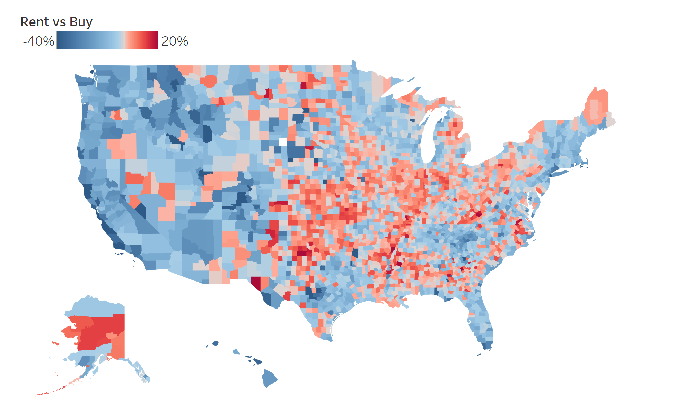
Cheaper to buy in 39% of counties
Simple monthly cost analysis favors renting now in more places
December 2018
Source: Realtor.com® Analysis of HUD Median Rents,
Nielsen Pop-Facts Demographics and Realtor.com® Data

Slide 45
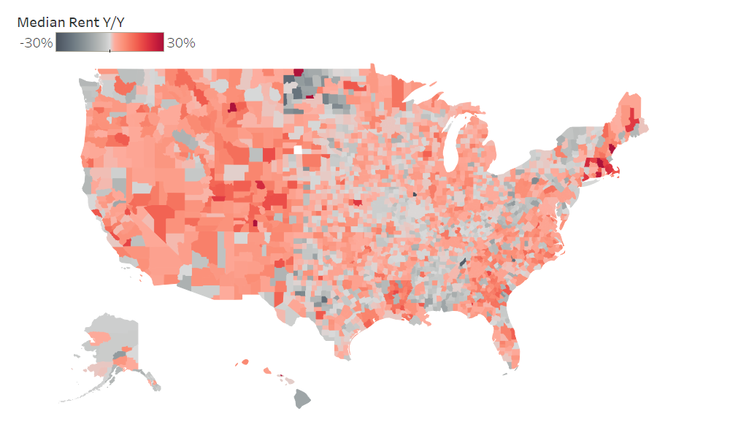
Rents rising y/y in 73% of counties
Rent increases adding to demand for buying
2018
Source: Realtor.com® Analysis of HUD Median Market Rents

Slide 46
Life drives housing demand
Everyone’s tired of waiting and Millennials are building families
13%
Source: realtor.com Active Home Shopper Survey, September 2016

Slide 47
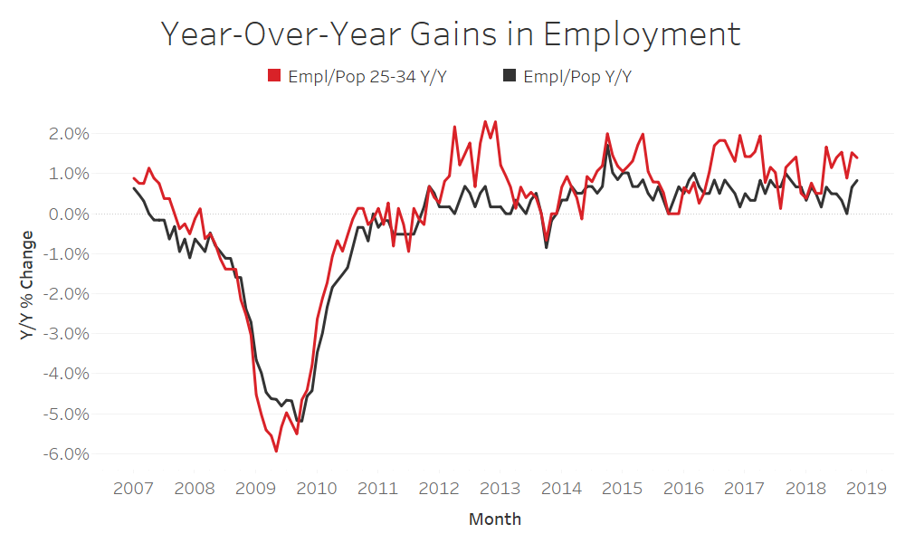
Job creation
25-34 growth outpacing overall rate
25%
Source: Bureau of Labor Statistics, Realtor.com® Analysis

Slide 48
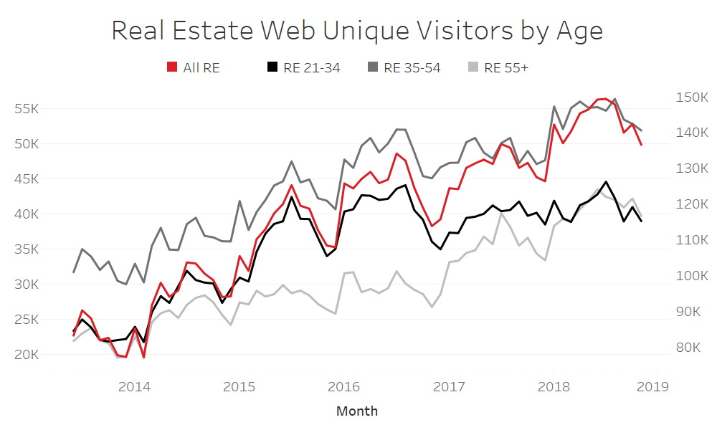
TOTAL REAL ESTATE TRAFFIC
Up 7.2% Y/Y November
Source: Realtor.com® Analysis of comScore Media Metrix® Real Estate Category Unique Visitor Data

Slide 49

Current Conditions
Notes:
SLIDE EDITING INSTRUCTIONS:
ICON: Right-click on icon to Change Picture.
Icons can be downloaded from the Brand Library: https://sites.google.com/a/move.com/brand-assets-library/home/app-and-presentation-icons

Slide 50
Counties to leave in California
Areas Have 1.3 to 6.1 Times More Outbound Traffic
County | Outbound/Inbound Views Ratio | Median List Price (March 2018)
Santa Clara, CA | 6.1 | 1,299,000
Alameda, CA | 4.8 | 799,000
San Mateo, CA | 4.4 | 1,504,000
San Francisco, CA | 3.0 | 1,298,000
Los Angeles, CA | 2.0 | 690,000
Orange, CA | 1.7 | 849,000
Marin, CA | 1.4 | 1,344,000
Sonoma, CA | 1.3 | 713,000
Source: Realtor.com®

Slide 51
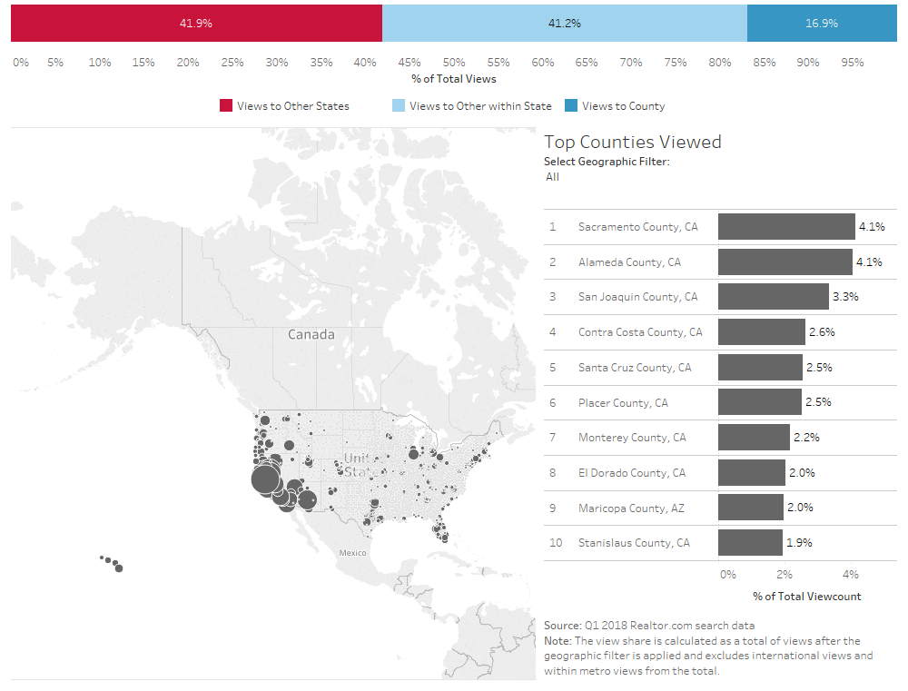
Cross market demand
Shoppers From Santa Clara Look to Sacramento

Slide 52
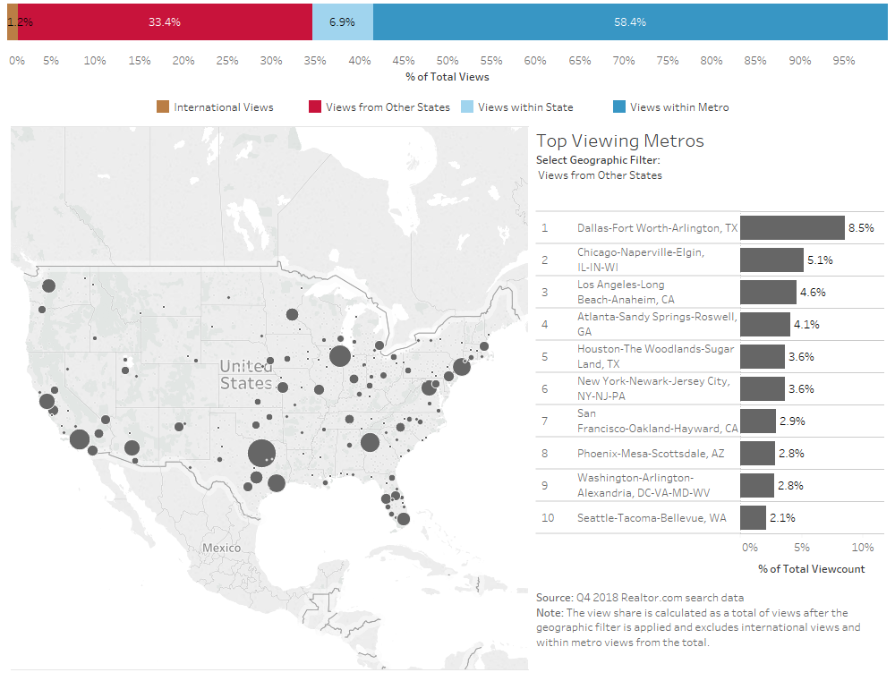
Cross market demand – Incoming Views
Denver Draws Buyers From Dallas (Q4 2018)
Notes:
Views coming from other states

Slide 53
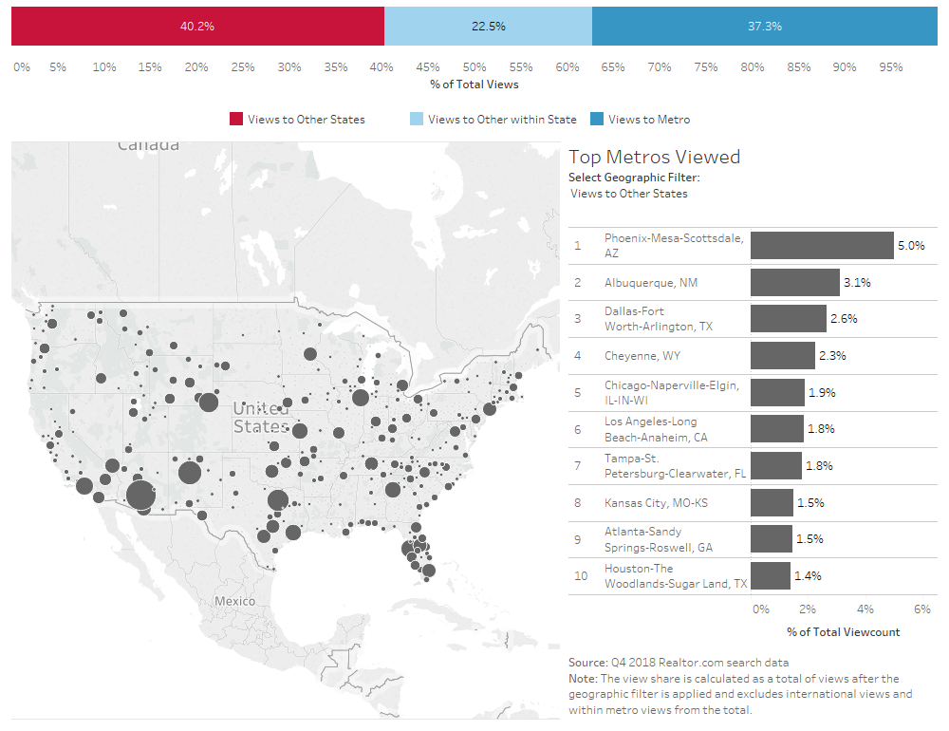
Cross market demand – Outgoing Views
Denver Buyers Looking Toward Phoenix (Q4 2018)
Notes:
Views going to other states

Slide 54
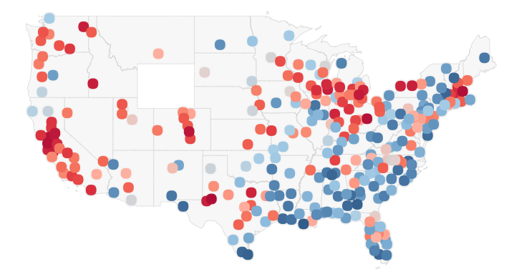
Hottest Markets
West Coast, Rocky Mountains, and Midwest are Hottest

Slide 55
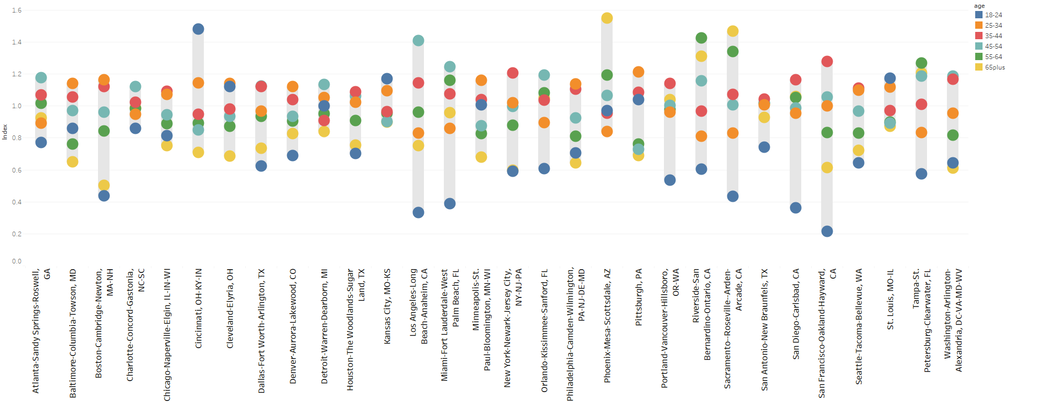
Denver Draws Younger Buyers
Age Group Interest Relative to National Average
Notes:
30 largest metros shown here
Denver pulls in a higher proportion of younger buyers, skewing toward 25-45 (Millennials + GenX), whereas many other metros skew toward 35-55 or even 45-65+

Slide 56
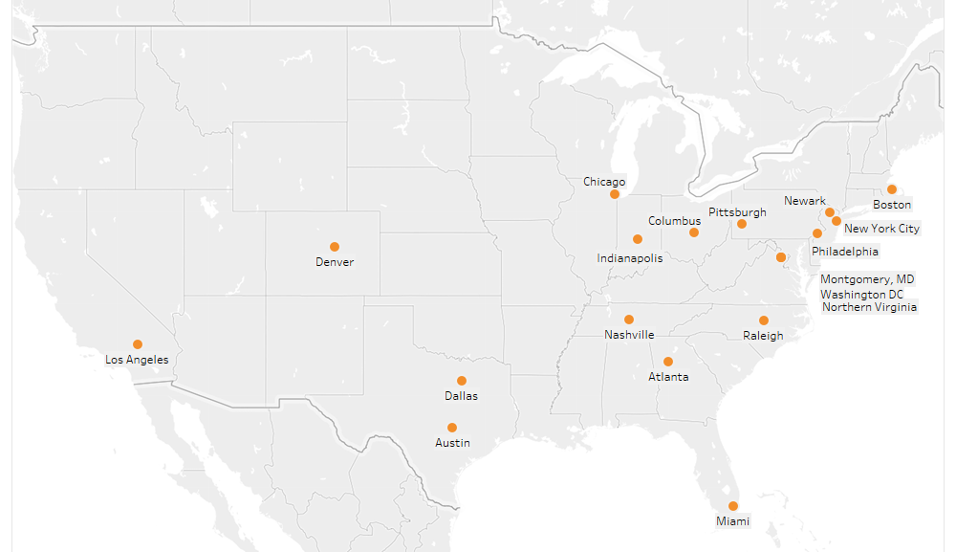
Amazon HQ2 Cities
19 U.S. candidate ‘cities’ plus Toronto

Slide 57
Jeff Bezos VS. HQ2 City Housing
Bezos’ $112 Billion net worth could purchase all active listings in each city
Area | Multiple
Atlanta | 7.1
Austin | 25.4
Boston | 13.6
Chicago | 5.1
Columbus | 57.8
Dallas | 11.0
Denver | 15.3
Indianapolis | 72.7
Los Angeles | 3.5
Miami | 2.4
Area | Multiple
Nashville | 24.8
Philadelphia | 13.9
Pittsburgh | 39.2
Raleigh | 41.6
Washington, DC | 70.7
Newark | 87.6
Montgomery, MD | 47.2
New York City | 3.0
Northern Virginia | 14.7
COMBINED | 0.51
Source: Realtor.com® For Sale Listings Database (April 2018)

Slide 58
Local DAta
Notes:
SLIDE EDITING INSTRUCTIONS:
ICON: Right-click on icon to Change Picture.
Icons can be downloaded from the Brand Library: https://sites.google.com/a/move.com/brand-assets-library/home/app-and-presentation-icons

Slide 59
Home Ownership
Notes:
SLIDE EDITING INSTRUCTIONS:
ICON: Right-click on icon to Change Picture.
Icons can be downloaded from the Brand Library: https://sites.google.com/a/move.com/brand-assets-library/home/app-and-presentation-icons

Slide 60
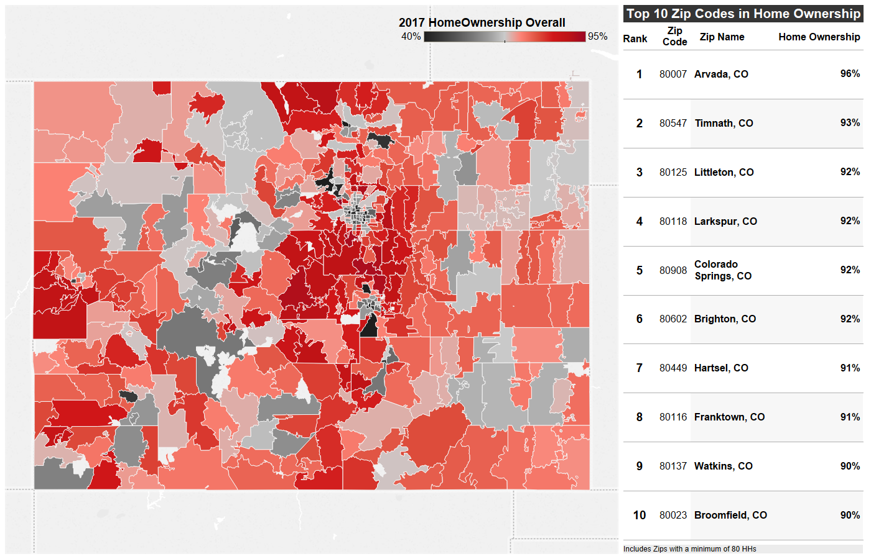
Home ownership In Colorado
Overall Ownership Rate in Region is 65% vs 65% Nationally
Source: Nielsen Demographics Pop-Facts 2018

Slide 61
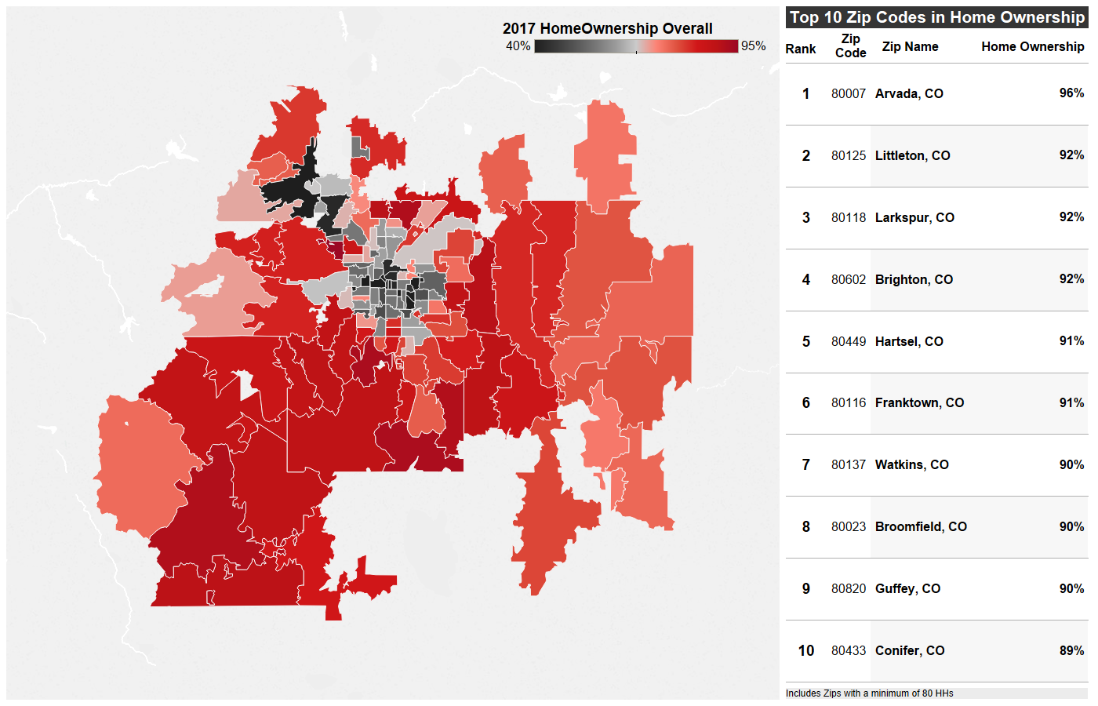
Home ownership In Denver
Overall Ownership Rate in Region is 64% vs 65% Nationally
Source: Nielsen Demographics Pop-Facts 2018

Slide 62
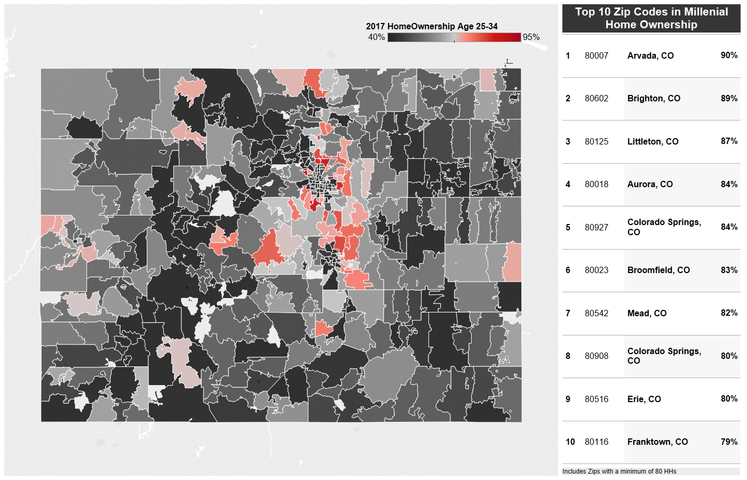
Millennial Home ownership In Colorado
Overall Ownership Rate in Region is 42% vs 41% Nationally
Source: Nielsen Demographics Pop-Facts 2018

Slide 63
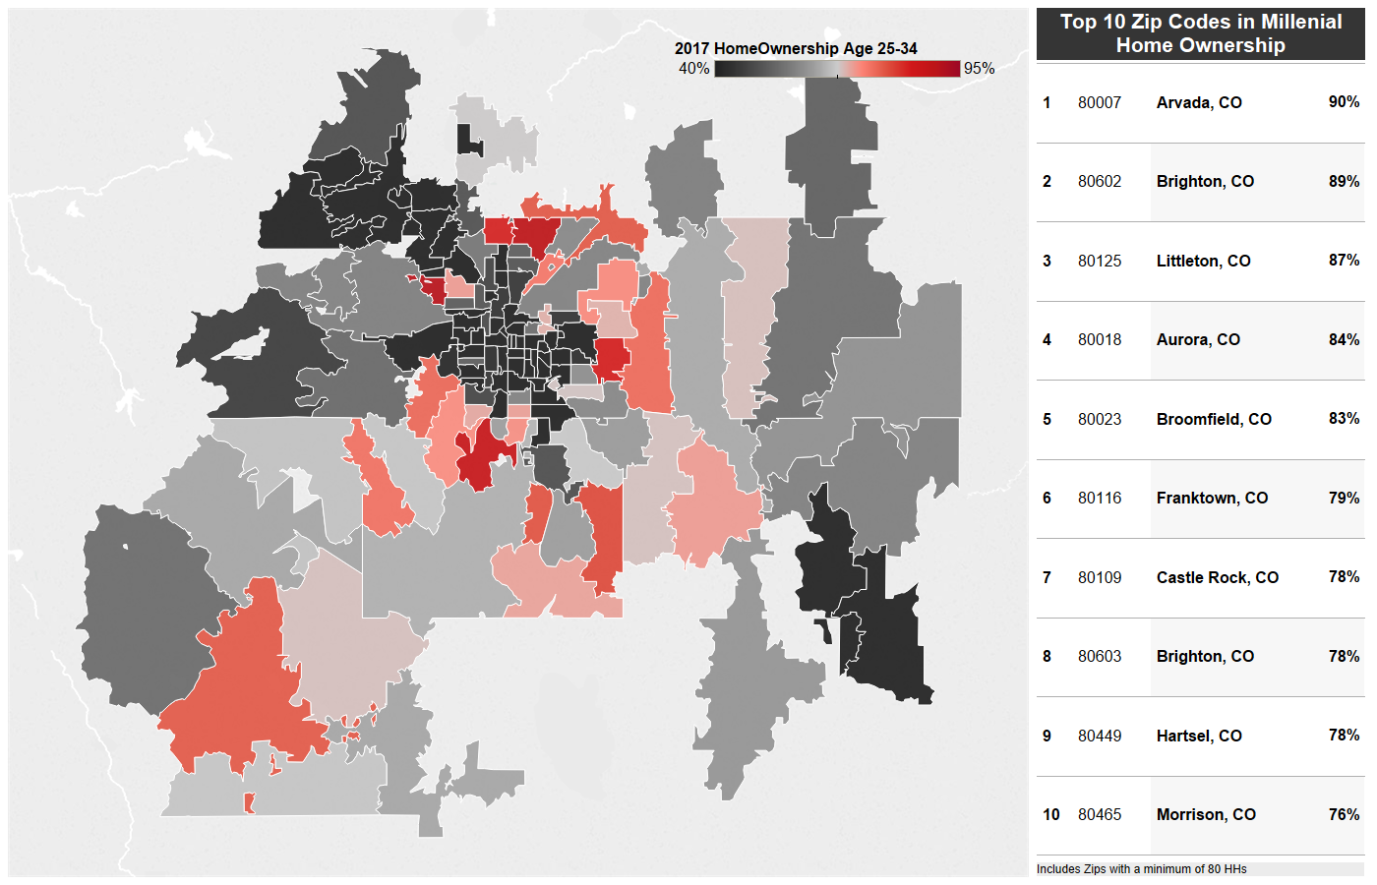
Millennial Home ownership In Denver
Overall Ownership Rate in Region is 40% vs 41% Nationally
Source: Nielsen Demographics Pop-Facts 2018

Slide 64
Listing and sale Prices
Notes:
SLIDE EDITING INSTRUCTIONS:
ICON: Right-click on icon to Change Picture.
Icons can be downloaded from the Brand Library: https://sites.google.com/a/move.com/brand-assets-library/home/app-and-presentation-icons

Slide 65
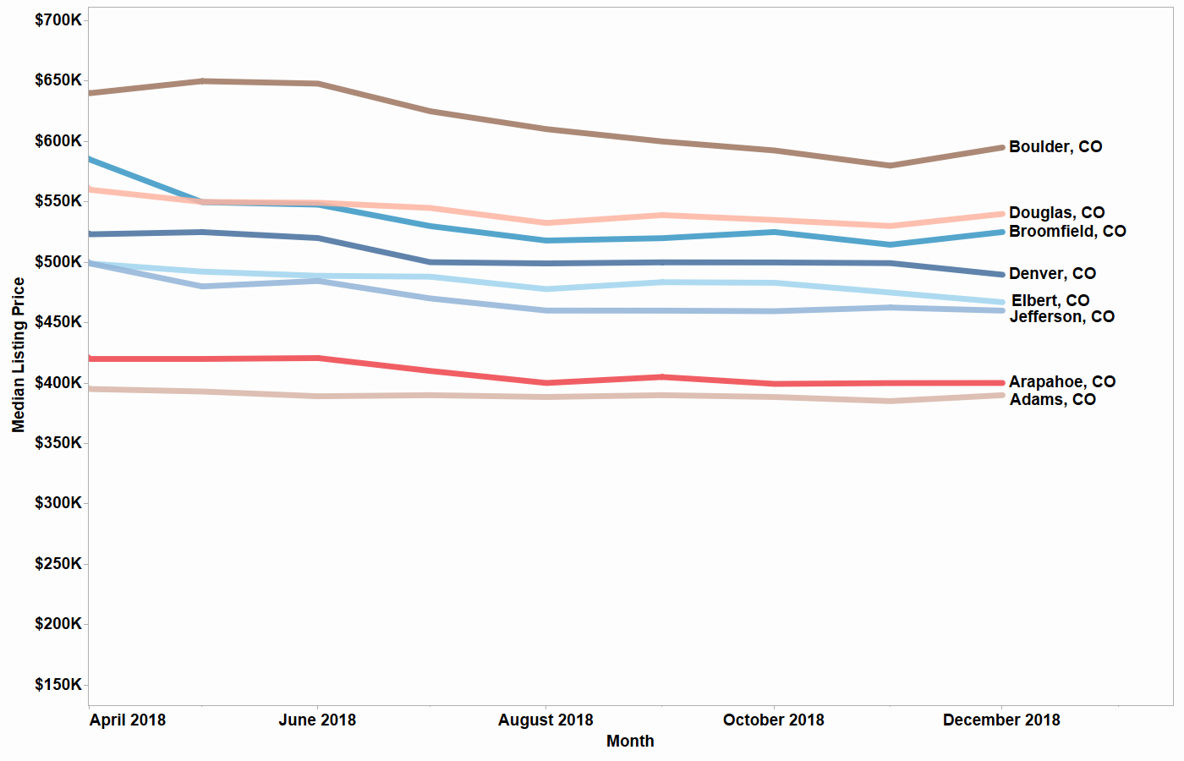
List prices in Denver AREA
Boulder County Has Highest Median List Price at $595,000 (Dec 2018)

Slide 66
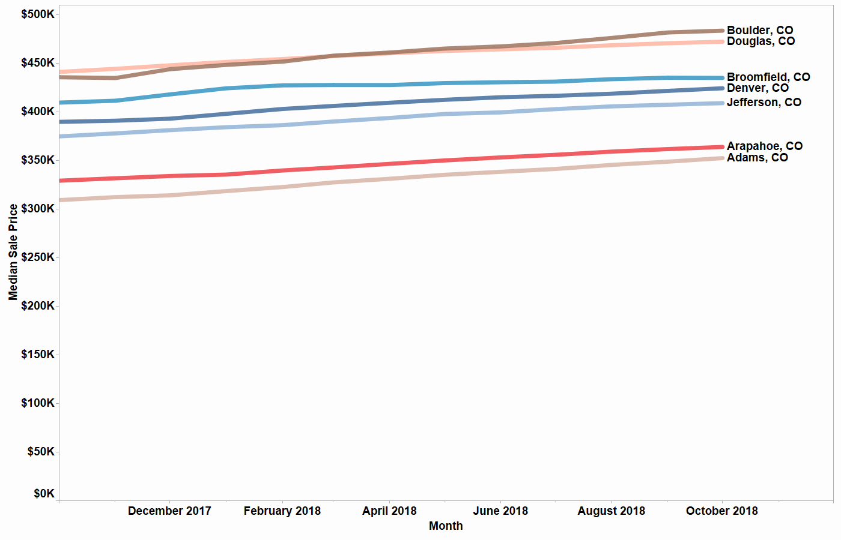
Sale prices in Denver Area
Boulder County Has Highest Median Sale Price at $483,000 (Oct 2018, Annl.)
Notes:
12 month moving avg

Slide 67
Price Growth
Notes:
SLIDE EDITING INSTRUCTIONS:
ICON: Right-click on icon to Change Picture.
Icons can be downloaded from the Brand Library: https://sites.google.com/a/move.com/brand-assets-library/home/app-and-presentation-icons

Slide 68
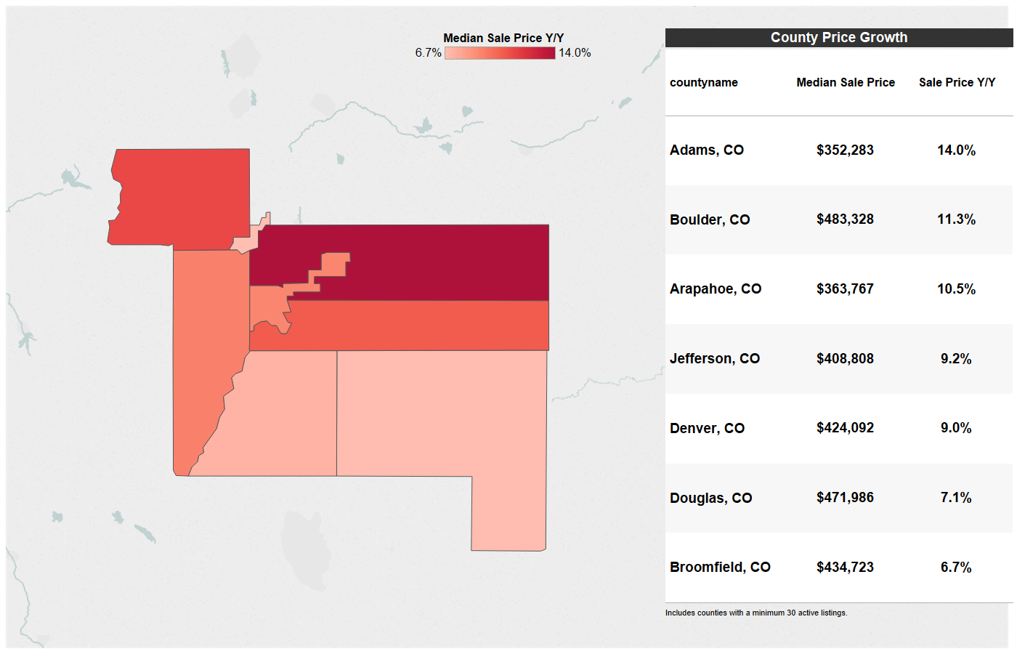
Sale price growth in Denver Area
Adams County Seeing Largest Yearly Price Growth (Oct 2018, Annl.)
Notes:
12 month moving avg

Slide 69
Sale prices in Denver area
Price Breakdown by County (Oct 2018, Annl.)
County Name | Median Sale Price | Median Sale Price Y/Y
Adams, CO | $352,283 | 14.0%
Arapahoe, CO | $363,767 | 10.5%
Boulder, CO | $483,328 | 11.3%
Broomfield, CO | $434,723 | 6.7%
Denver, CO | $424,092 | 9.0%
Douglas, CO | $471,986 | 7.1%
Jefferson, CO | $408,808 | 9.2%
Notes:
12 month moving avg

Slide 70
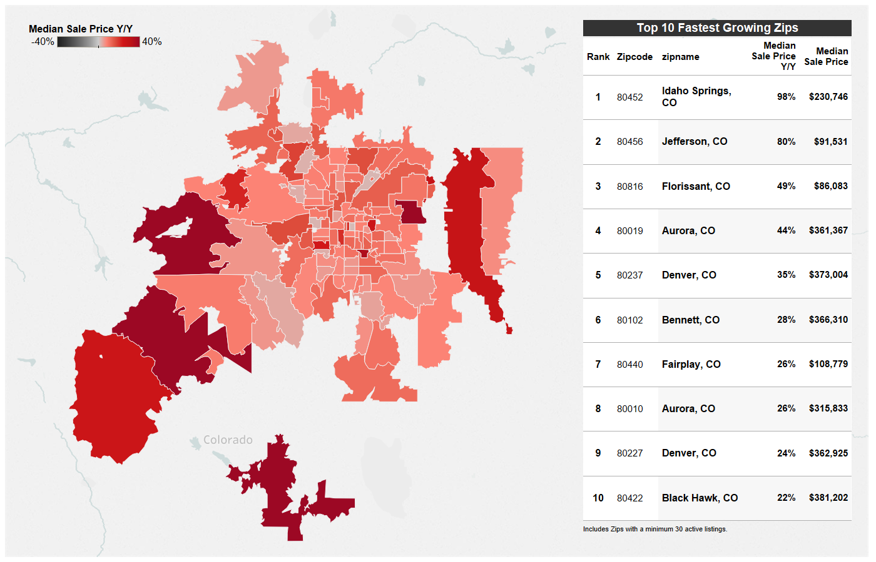
Sale price growth in Denver area
100% of Zips Experienced Price Growth Y/Y (Oct 2018, Annl.)
Notes:
12 month moving avg

Slide 71
Sale prices in denver
Fastest Growing Zip Codes in Denver Area (Oct 2018, Annl.)
Rank | Zip Code | Zip Name | Median Sale Price | Median Sale Price Y/Y
1 | 80452 | Idaho Springs, CO | $230,746 | 98%
2 | 80456 | Jefferson, CO | $91,531 | 80%
3 | 80816 | Florissant, CO | $86,083 | 49%
4 | 80019 | Aurora, CO | $361,367 | 44%
5 | 80237 | Denver, CO | $373,004 | 35%
6 | 80102 | Bennett, CO | $366,310 | 28%
7 | 80440 | Fairplay, CO | $108,779 | 26%
8 | 80010 | Aurora, CO | $315,833 | 26%
9 | 80227 | Denver, CO | $362,925 | 24%
10 | 80422 | Black Hawk, CO | $381,202 | 22%
Notes:
12 month moving avg

Slide 72
Closed Sales
Notes:
SLIDE EDITING INSTRUCTIONS:
ICON: Right-click on icon to Change Picture.
Icons can be downloaded from the Brand Library: https://sites.google.com/a/move.com/brand-assets-library/home/app-and-presentation-icons

Slide 73
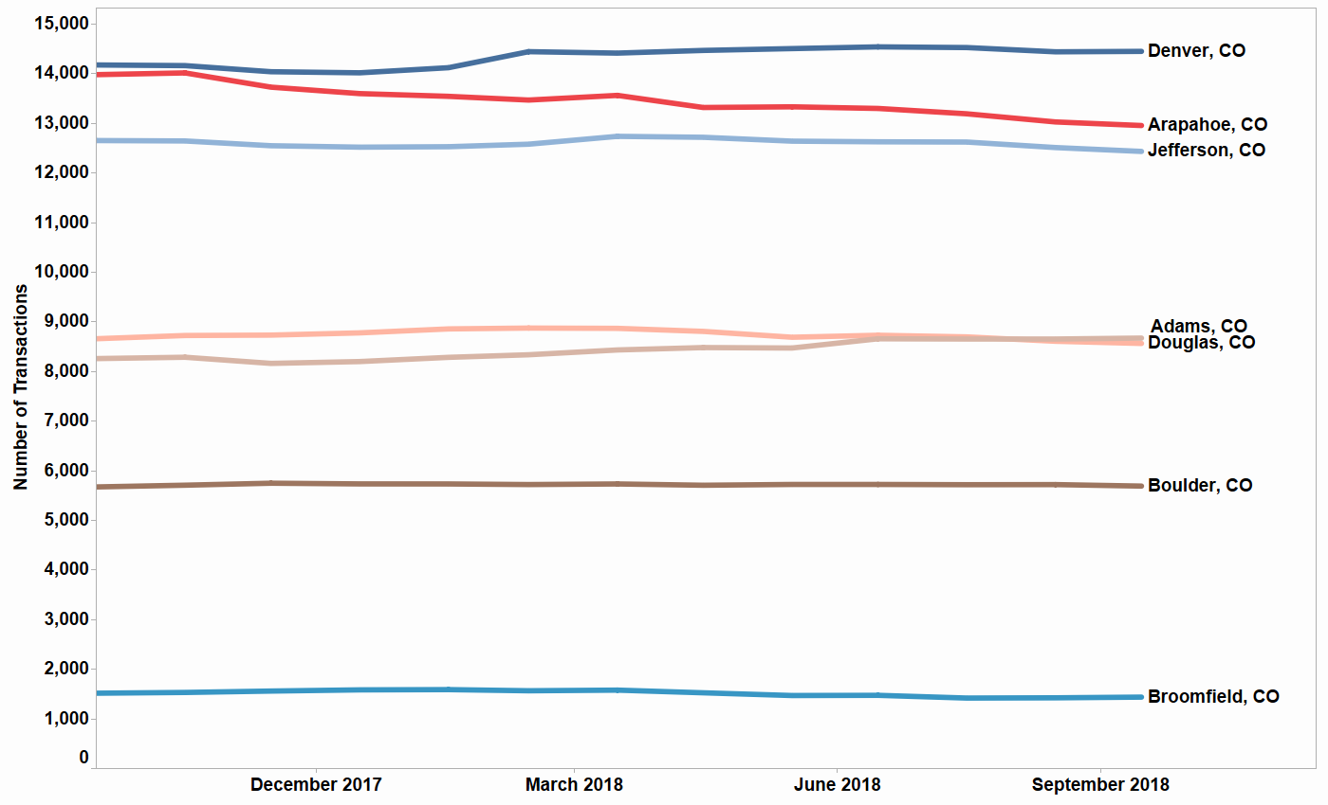
Closed sales in denver
Number of transactions (Oct 2018, Annl.)
Notes:
Annualized (12 month moving sum)

Slide 74
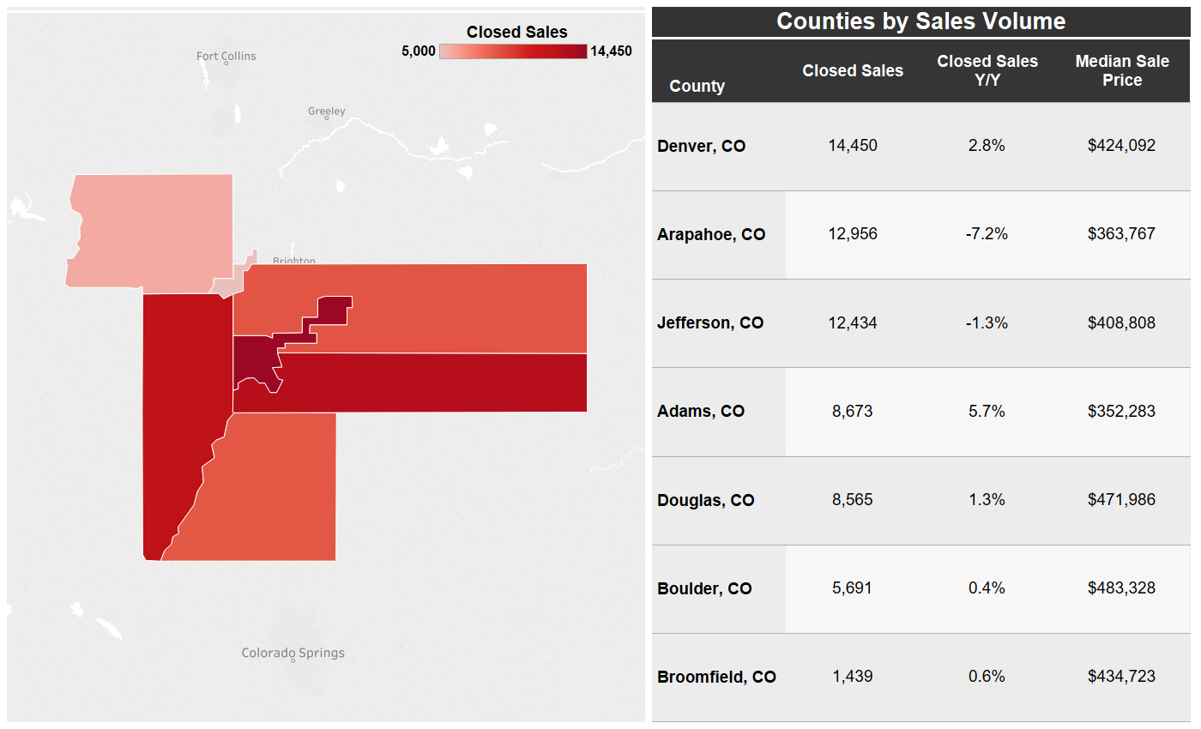
Closed Sales in Denver area
Single Family and Condo Sales (Oct 2018, Annl.)
Notes:
Sales = Annualized (12 month moving sum)
Sales YY = 12 month moving avg of YY

Slide 75
Closed Sales in denver
Single Family and Condo Sales By Sales Volume (Oct 2018, Annl.)
Rank | Zip Code | Zip Name | Closed Sales | Closed Sales Y/Y
1 | 80134 | Parker, CO | 2,206 | 4%
2 | 80016 | Aurora, CO | 1,817 | 6%
3 | 80015 | Aurora, CO | 1,619 | -9%
4 | 80013 | Aurora, CO | 1,517 | -19%
5 | 80504 | Longmont, CO | 1,344 | -4%
6 | 80602 | Brighton, CO | 1,339 | 61%
7 | 80211 | Denver, CO | 1,184 | 11%
8 | 80022 | Commerce City, CO | 1,124 | 9%
9 | 80104 | Castle Rock, CO | 1,078 | 4%
10 | 80249 | Denver, CO | 1,057 | 2%
Notes:
Sales = Annualized (12 month moving sum)
Sales YY = 12 month moving avg of YY

Slide 76
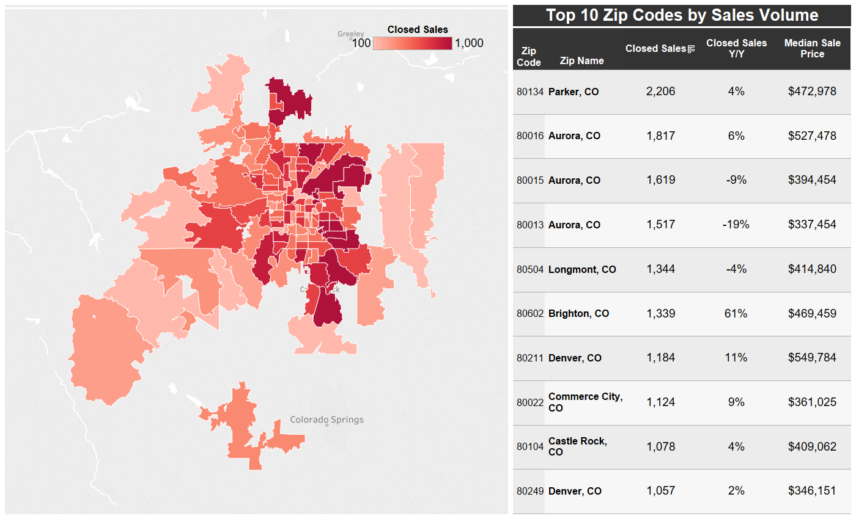
Closed sales in denver
Single Family and Condo Sales by Sales Volume (Oct 2018, Annl.)
Notes:
Sales = Annualized (12 month moving sum)
Sales YY = 12 month moving avg of YY

Slide 77
Change in Sales
Notes:
SLIDE EDITING INSTRUCTIONS:
ICON: Right-click on icon to Change Picture.
Icons can be downloaded from the Brand Library: https://sites.google.com/a/move.com/brand-assets-library/home/app-and-presentation-icons

Slide 78
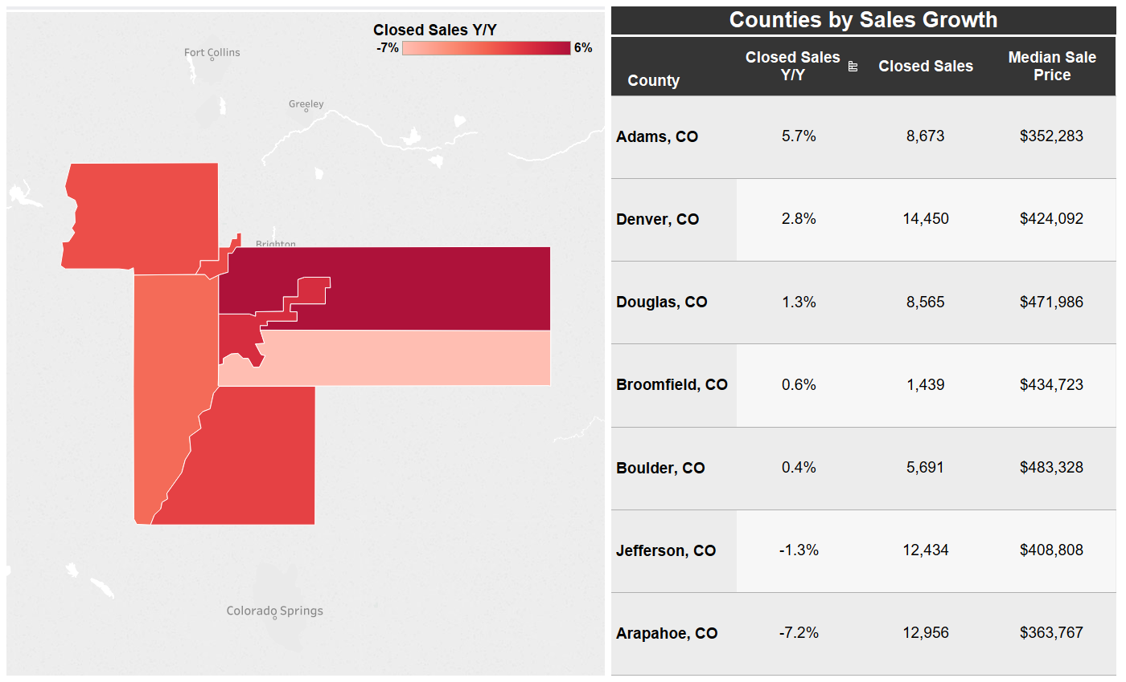
Closed Sales Growth in Denver Area
Single Family and Condo Sales by Y/Y % Change (Oct 2018, Annl.)
Notes:
Sales = Annualized (12 month moving sum)
Sales YY = 12 month moving avg of YY

Slide 79
Closed Sales Growth in denver
Single Family and Condo Sales by Y/Y % Change (Oct 2018, Annl.)
Rank | Zip Code | Zip Name | Closed Sales Y/Y | Closed Sales
1 | 80007 | Arvada, CO | 115% | 778
2 | 80602 | Brighton, CO | 61% | 1,339
3 | 80019 | Aurora, CO | 58% | 147
4 | 80440 | Fairplay, CO | 37% | 265
5 | 80422 | Black Hawk, CO | 36% | 112
6 | 80239 | Denver, CO | 36% | 642
7 | 80816 | Florissant, CO | 32% | 370
8 | 80238 | Denver, CO | 30% | 1,054
9 | 80010 | Aurora, CO | 22% | 618
10 | 80603 | Brighton, CO | 20% | 420
Notes:
Sales = Annualized (12 month moving sum)
Sales YY = 12 month moving avg of YY

Slide 80
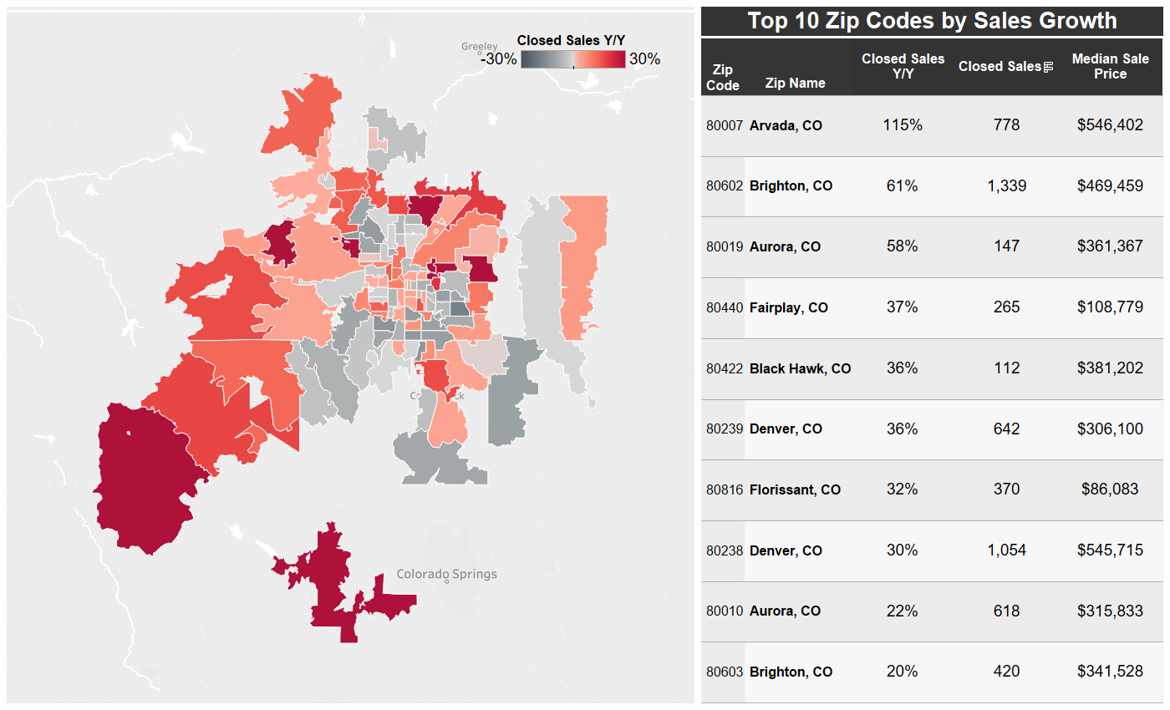
Closed sales Growth in denver
Single Family and Condo Sales by Y/Y % Change (Oct 2018, Annl.)
Notes:
Sales = Annualized (12 month moving sum)
Sales YY = 12 month moving avg of YY

Slide 81
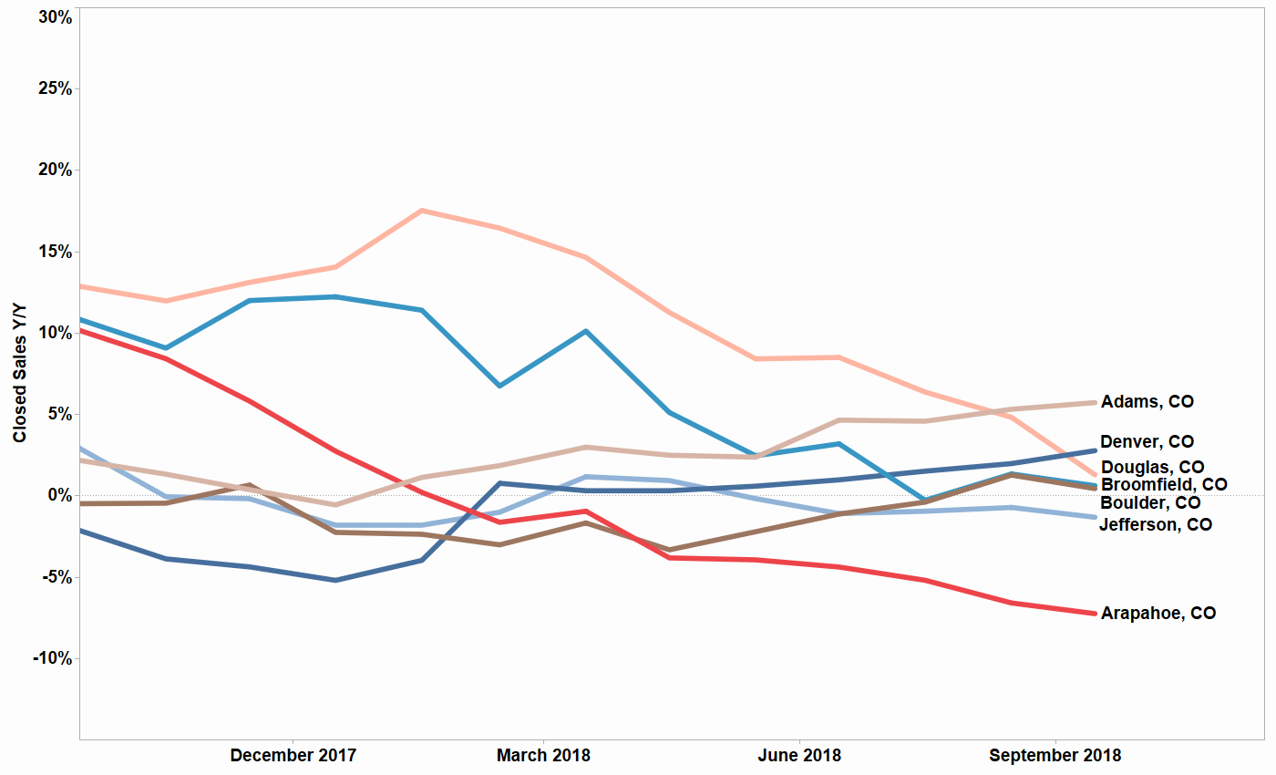
Closed Sales in denver
Closed Sales Y/Y% for the Past 12 Months (Annl.)
Notes:
Sales YY = 12 month moving avg of YY

Slide 82
Age of Inventory
Notes:
SLIDE EDITING INSTRUCTIONS:
ICON: Right-click on icon to Change Picture.
Icons can be downloaded from the Brand Library: https://sites.google.com/a/move.com/brand-assets-library/home/app-and-presentation-icons

Slide 83
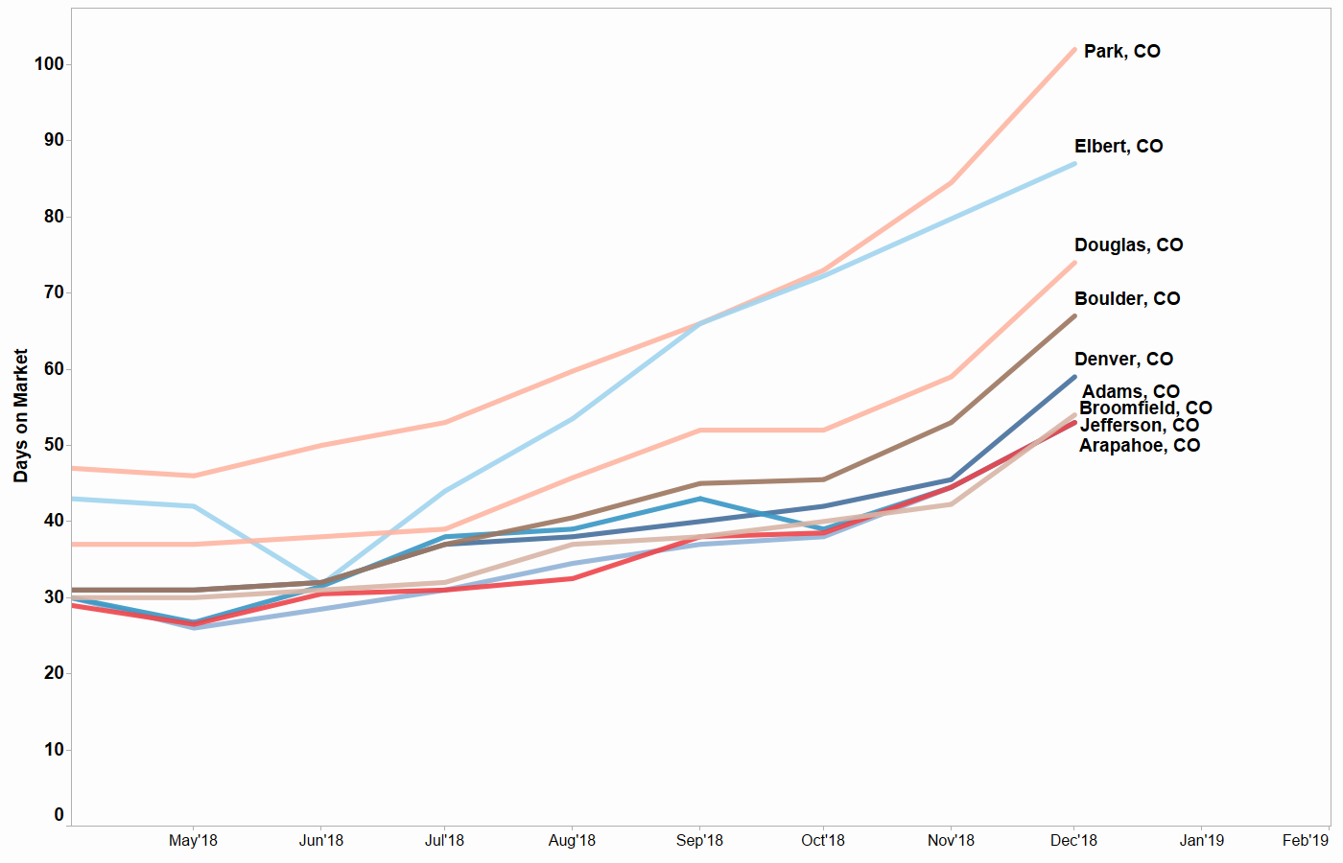
Age of Inventory in denver
Age of inventory in fastest-moving markets is 53-54 days (Dec 2018)
Notes:
Increase expected for season – don’t have data for proper Y/Y %

Slide 84
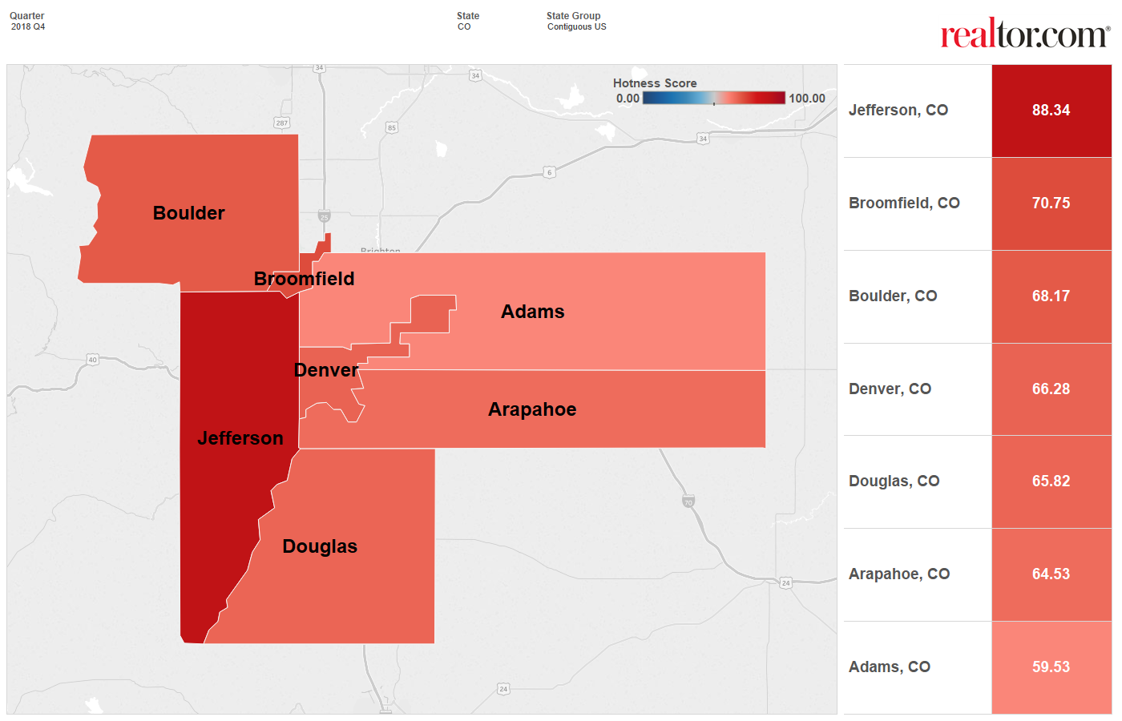
Hottest Counties in Denver Area
Jefferson Claims Top Performing County (Q4 2018)
Source: Realtor.com
Notes:
Note: Counties with insufficient data are excluded. Hotness is based on listing page views and days on market.

Slide 85
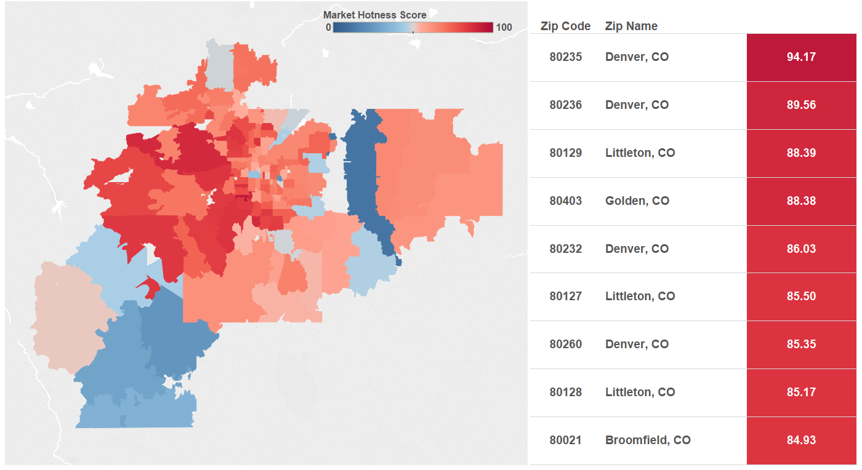
Hottest Zip Codes in Denver Area
Top 10 Performing Zip Codes (Q4 2018)
Source: Realtor.com
Notes:
Note: Zips with insufficient data are excluded. Hotness is based on listing page views and days on market.

Slide 86
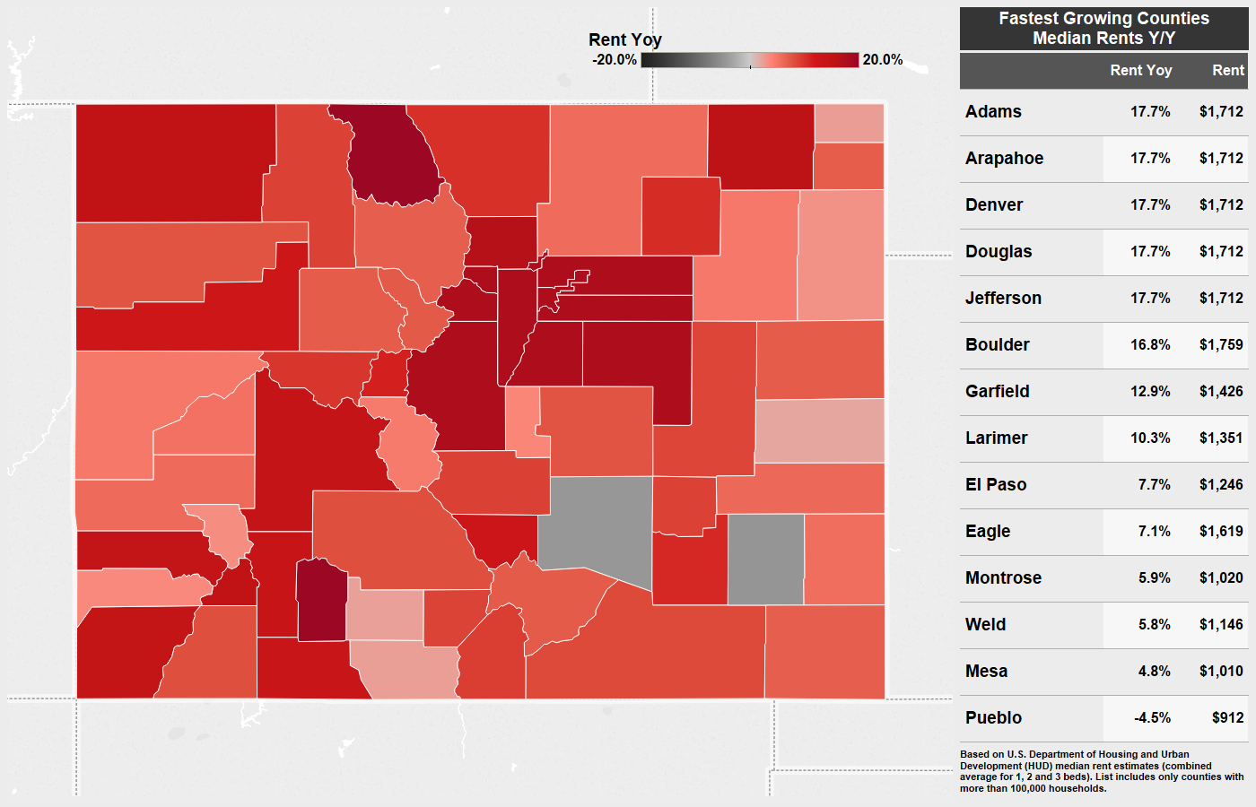
Rent Prices in Colorado
Denver Area Seeing 17.7% Rent Growth Year-on-Year
Source: Realtor.com® Analysis of HUD Fair Market Rents

Slide 87
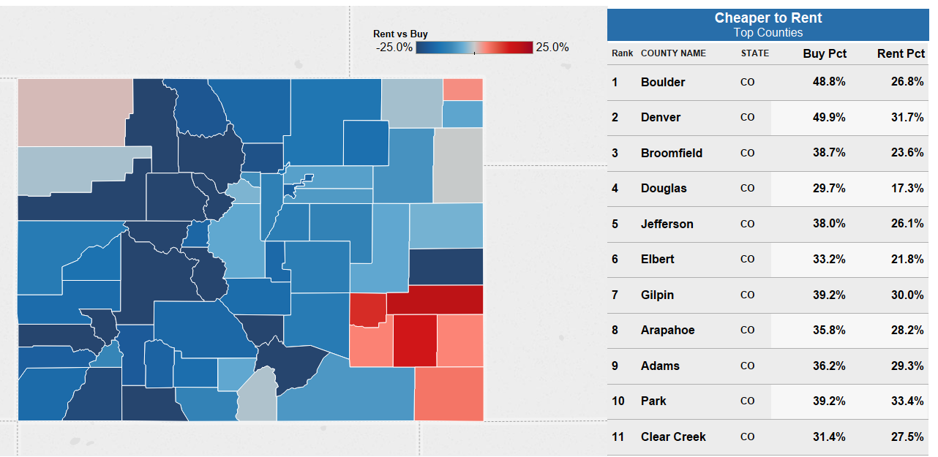
Rent Vs Buy
Cheaper to Rent in 88% of Colorado Counties (Dec 2018)
Source: Realtor.com® Analysis of Nielsen Pop-Facts Demographics,
HUD Fair Market Rents and Realtor.com Data
Notes:
Boulder has the largest difference between the % of income needed to Buy vs Rent

Slide 88
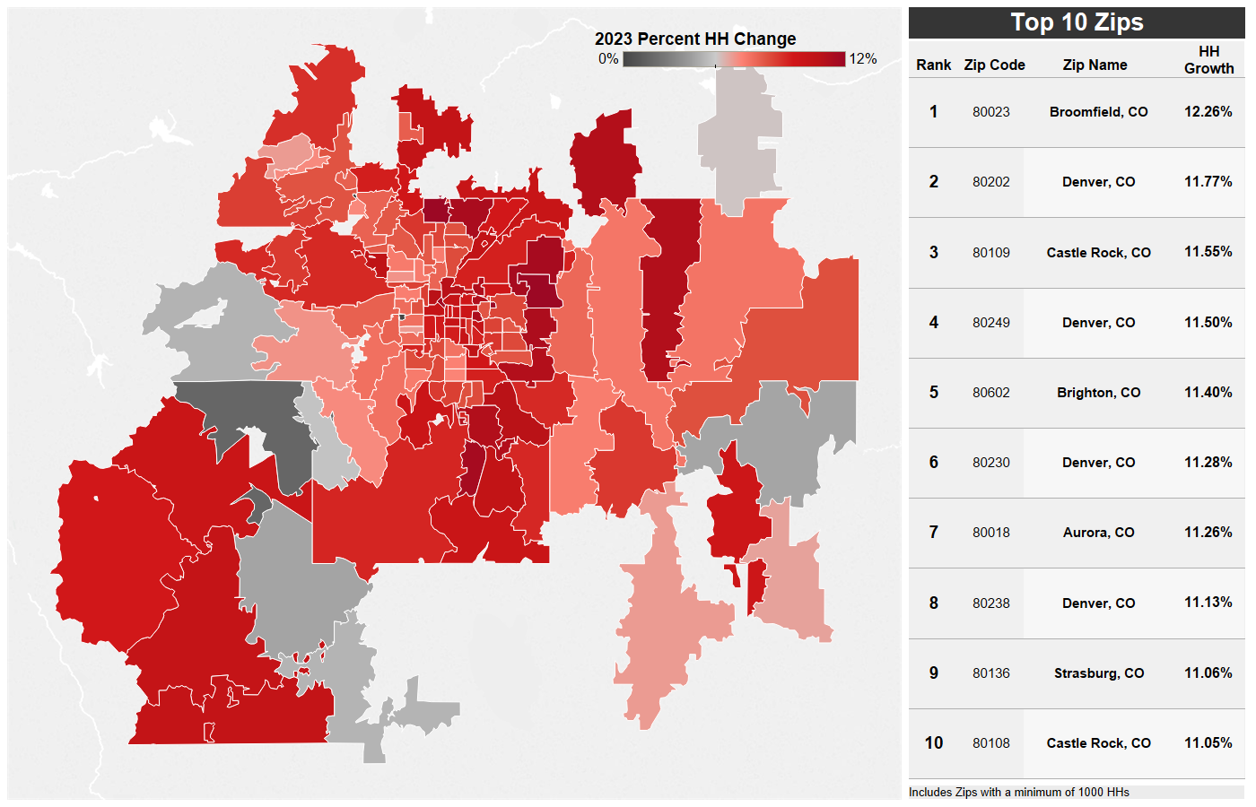
Household Growth 2018-2023
100% of Zips Seeing Growth
Source: Nielsen Demographics Pop-Facts 2018
Notes:
All but one zip code projected to see 4%+ growth
The outlier is Baily, CO (80421) at 1.5% growth

Slide 89

Economic Research
realtor.com®
@RDC_Economics
Access market data, research, and presentations at realtor.com/research

Slide 90
THANK YOU

