Slide 1

THE ECONOMY IN 2019:
TERRIFIC, TURBULENT OR TEPID?
Presented by:
Elliot F. Eisenberg, Ph.D.
President: GraphsandLaughs, LLC
January 10, 2019
Denver, CO

Slide 2
The Economy is OK!
GDP = C+I+G+(X-M)

Slide 3
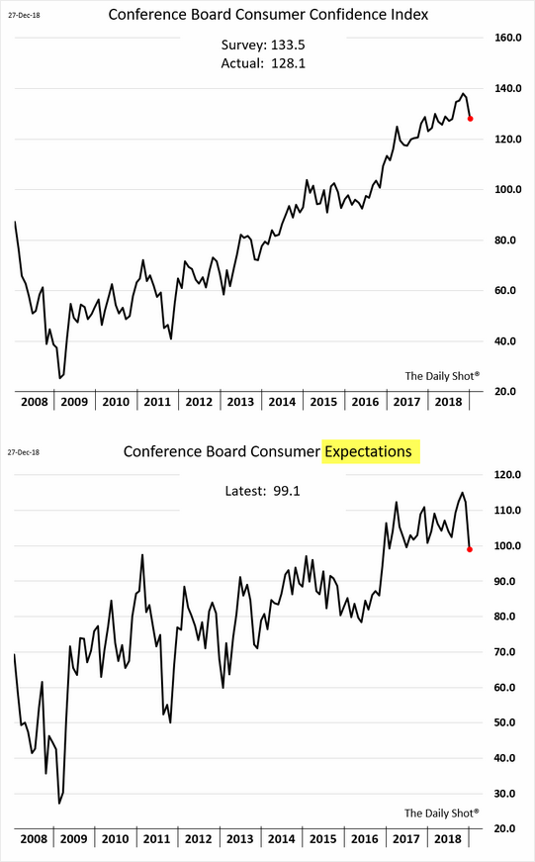
Conference Board Consumer Confidence is High
But off their best levels
Notes:
Updated 1-2-19. The WSJ’s Daily Shot.

Slide 4
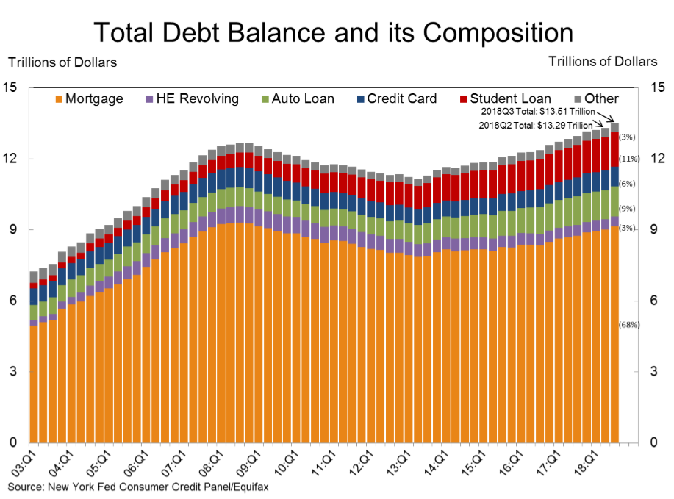
Households Are Re-leveraging
Mortgage debt remains slightly below the 2008 peak. Total debt is 6.5% higher
Notes:
Updated 11-16-18. Quarterly data. NY Fed. Quarterly Report on Household Debt and Credit November 2018
https://www.newyorkfed.org/microeconomics/hhdc.html
https://www.newyorkfed.org/newsevents/news/research/2018/rp181116

Slide 5
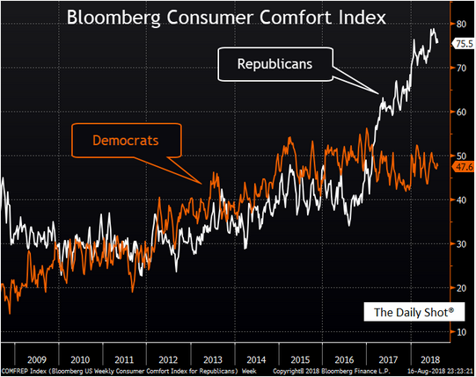
Republicans are Much Happier than Democrats
The political gap is very large
Notes:
Updated 8-17-18 WSJ’s The Daily Shot

Slide 6
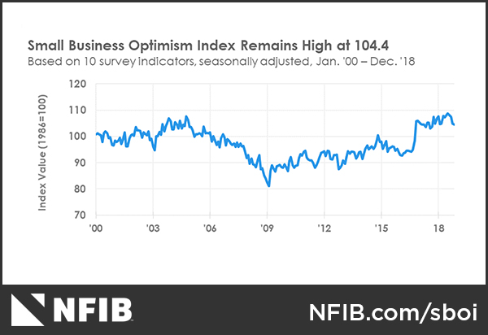
Small Business Confidence Remains Strong
Spectacular rise since election. But, declines of late
Notes:
Updated 1-8-19. Monthly Data. http://www.nfib.com/surveys/small-business-economic-trends/
Comment 1-8-19.
January 2016 sample size n=10,799, responses = 1,438, 13% response rate.

Slide 7
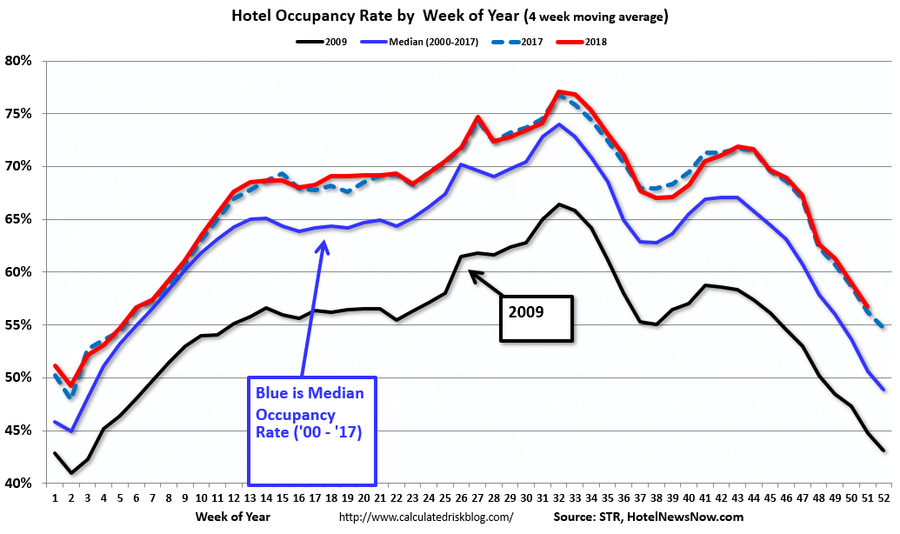
Hotel Occupancy Rates are Excellent!
Occupancy is superb as are ADR and RevPAR
Notes:
Updated 12-28-18. Updated monthly. Smith Travel Research, Courtesy of HotelNewsNow.com
See also
http://www.hotelnewsnow.com

Slide 8
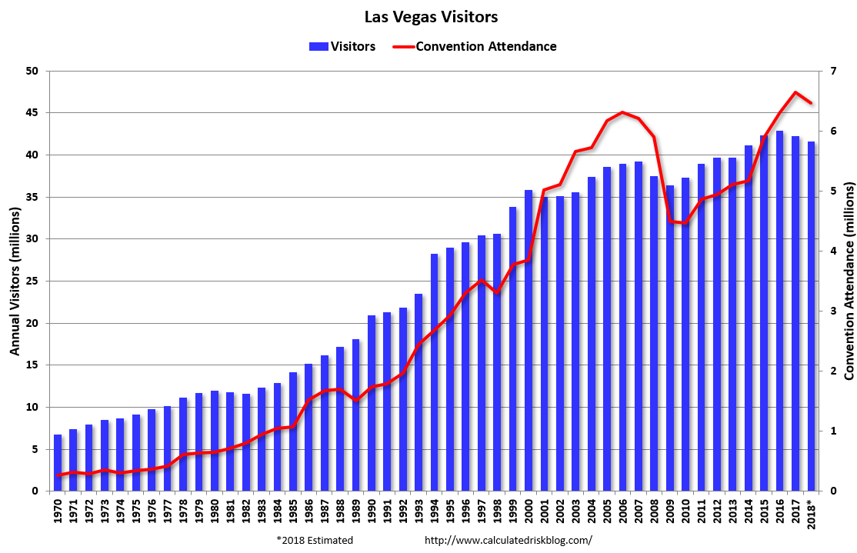
Las Vegas Attendance Is good
The gamblers are generally back along with the conventioneers
Notes:
Updated 11-12-18 Las Vegas Visitors and Convention Authority. http://www.lvcva.com/stats-and-facts/visitor-statistics/

Slide 9
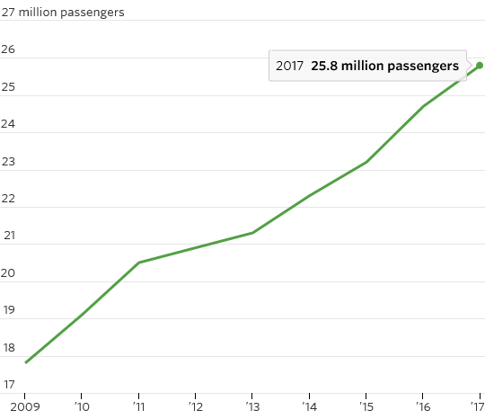
Cruise-Passenger Growth is Rising Globally
Notes:
WSJ 7-5-17 By Amrith Ramkumar Hotels, Cruise Lines, Casinos Among Top U.S. Stocks So Far This Year
https://www.wsj.com/articles/hotels-cruise-lines-casinos-among-top-u-s-stocks-so-far-this-year-1499266801?mg=prod/accounts-wsj

Slide 10
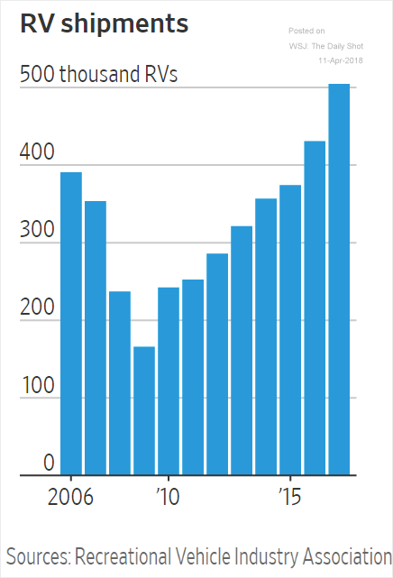
Let’s Buy an RV!
Sales were higher than ever, but……
Notes:
Updated 4-11-18 The Daily Shot. WSJ article 4-6-18
https://www.wsj.com/articles/the-future-of-americas-economy-looks-a-lot-like-elkhart-indiana-1522942393?mod=djemDailyShot&mod=djemDailyShot

Slide 11
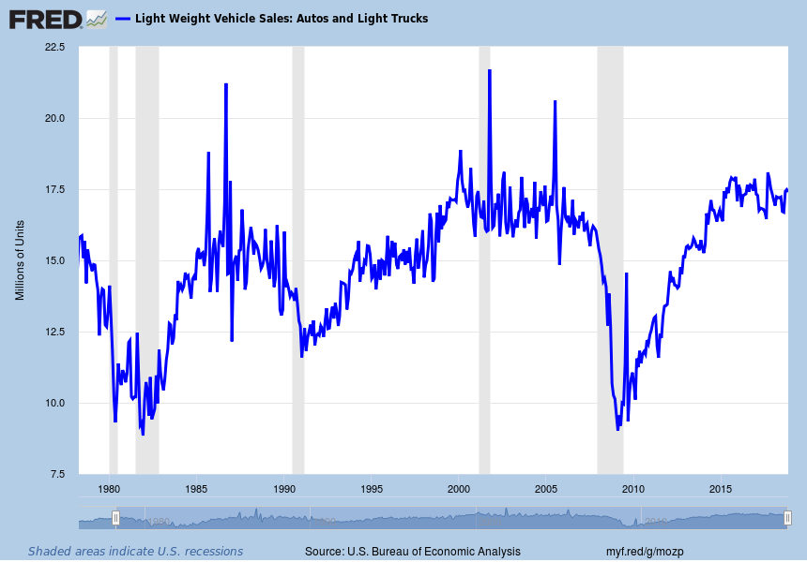
US Light Vehicle Sales Slow
But, no records will be set
Notes:
Updated 12-7-18. Monthly data. ALTSALES (PERMANENT) TOTALSA = all car sales.
Comes out 5 days after carmakers report results.

Slide 12
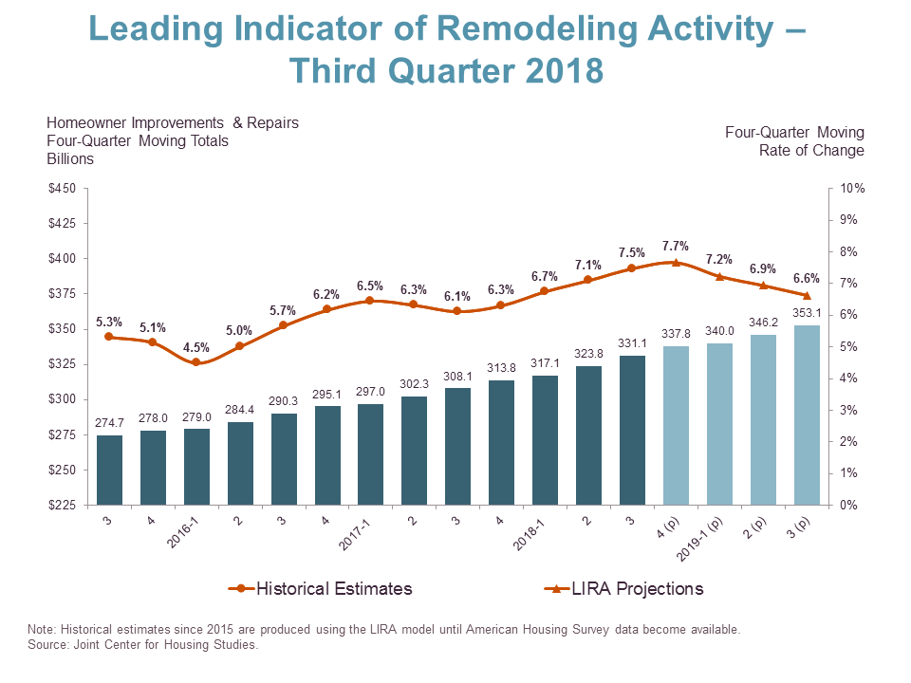
Housing Improvements & Repairs Keep Rising
Homes are aging, rates are low, home equity is good, and a lack of inventory
Notes:
10/18/18 http://www.jchs.harvard.edu/press-releases/slower-growth-anticipated-home-remodeling
Kerry Donahue, (617) 495-7640, kerry_donahue@harvard.edu

Slide 13
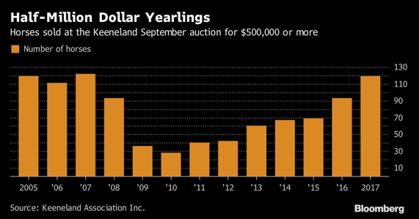
Let’s Buy a Horse
Notes:
Updated 9-29-17. The WSJ’s Daily Shot.
https://www.bloomberg.com/news/articles/2017-09-28/risk-on-trade-reaches-horse-market-as-500-000-colts-sell-fast?cmpid=socialflow-twitter-business&utm_content=business&utm_campaign=socialflow-organic&utm_source=twitter&utm_medium=social

Slide 14
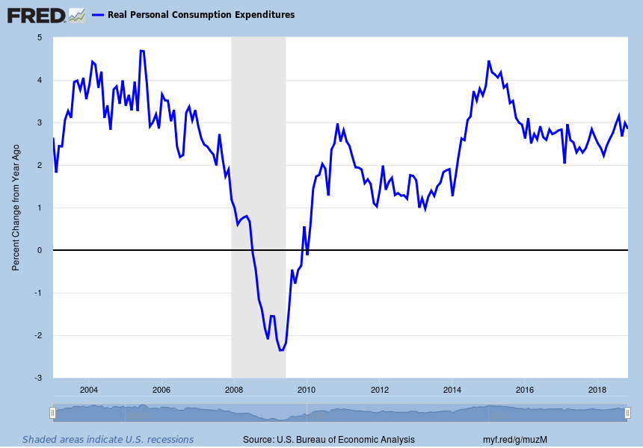
Annual Y-o-Y Percent Change in PCE
A very solid growth rate of 2.85%
Notes:
Updated 12-21-18. Monthly data. PCEC96. (PERMANENT) Also, DPCERX1A020NBEA PCECC96 is quarterly.
Comment 1-29-18.

Slide 15
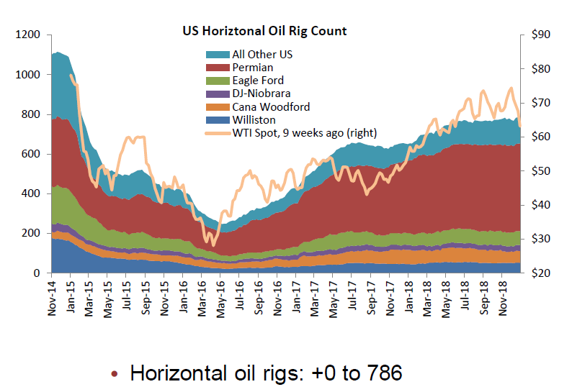
Drilling Activity is High But Flat
Falling prices hurt but a lack of pipelines are a more lasting problem
Notes:
1/16/19 CalculatedRisk Blog. He got it from Princeton energy advisors. LLC. http://www.prienga.com/
See baker Hughes data here: http://phx.corporate-ir.net/phoenix.zhtml?c=79687&p=irol-reportsother

Slide 16
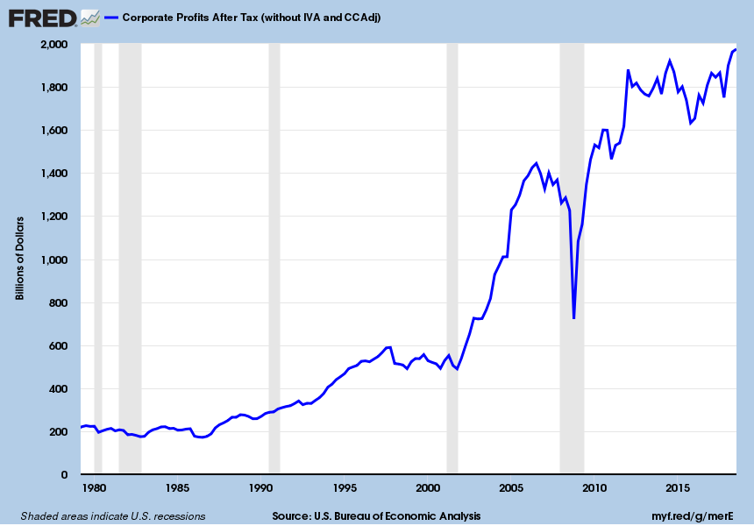
Corporate Profits are at a Record High
Corporate profit growth in 2019 will be much weaker
Notes:
Updated 11-28-18 Quarterly data. CP (PERMANENT)

Slide 17
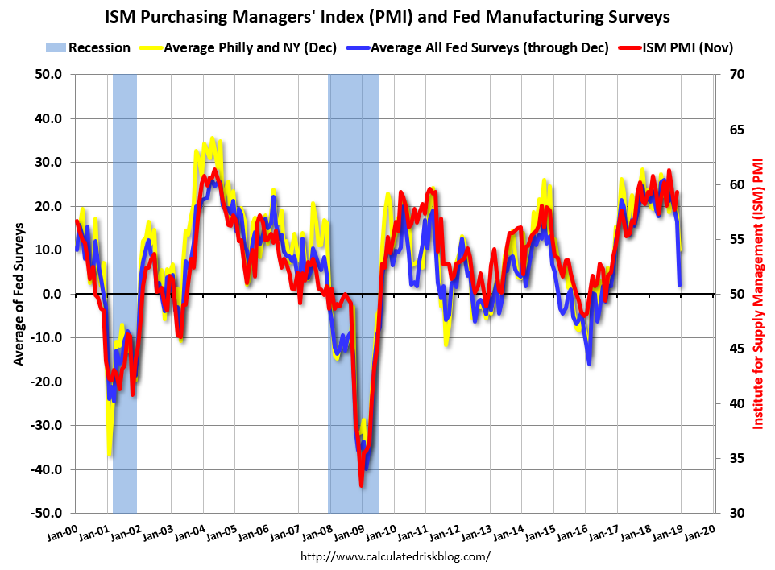
ISM Manufacturing Numbers Decline!
Manufacturing is less important than in decades past. Has it peaked?
Notes:
Updated 12-31-18. Monthly data. NY, Philly, Richmond, Dallas and KC fed data.

Slide 18
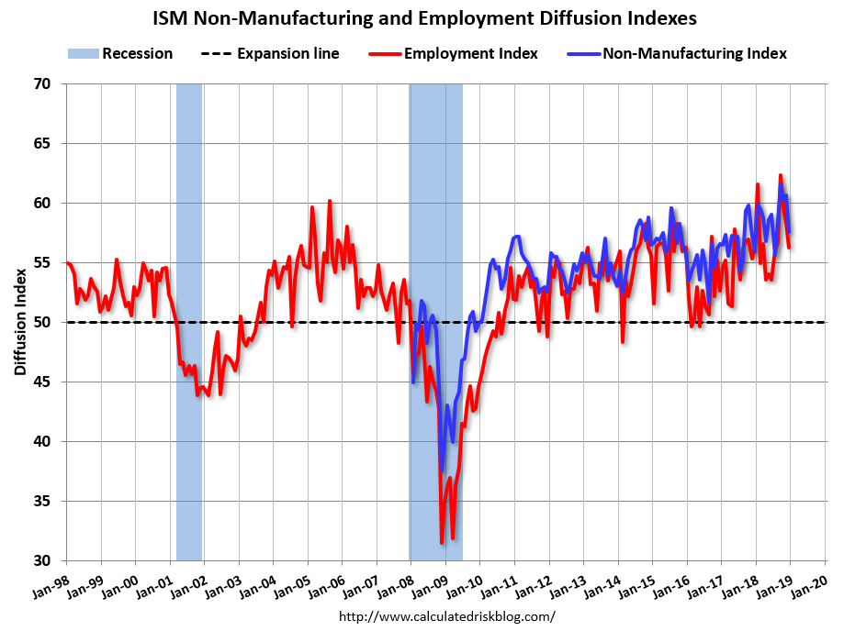
ISM Non-Manufacturing Numbers are Good
Service sector is hold up
Notes:
Updated 1-6-18. Monthly Index. Calculated Risk Blog

Slide 19
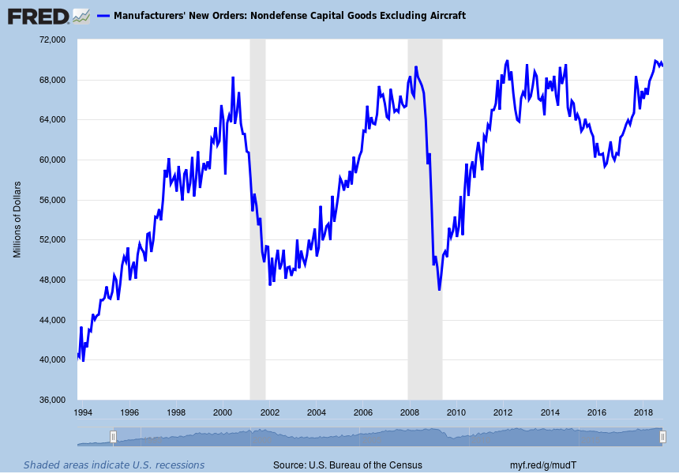
Look at Capital Goods Orders. They are OK
Slowing global growth, trade concerns and falling oil prices are why
Notes:
Updated 12-21-18. Monthly data. NEWORDER (PERMANENT)

Slide 20
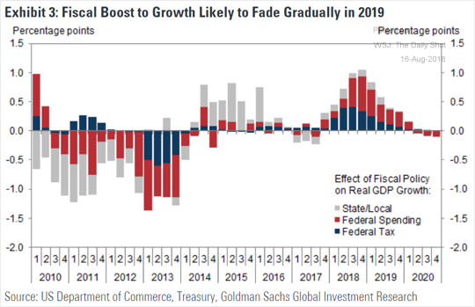
Tax Cuts Are Supercharging the Economy
But, only in the short run
Notes:
Updated 7/16/18.

Slide 21
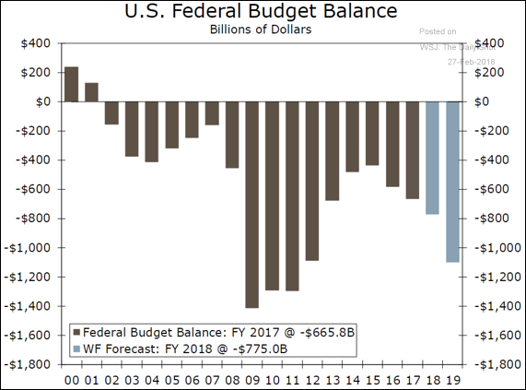
Deficit Will Explode
And then continue deteriorating
Notes:
Updated 2/27/18. The WSJ’s The Daily Shot

Slide 22
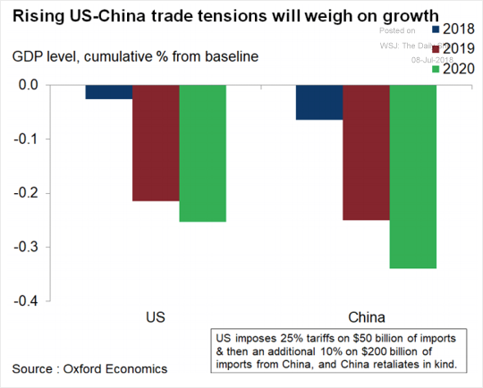
$250 Billion Trade War Hurts GDP
The impact will rise over time, and is now quite small
Notes:
Updated 7-9-18 The WSJ’s The Daily Shot

Slide 23
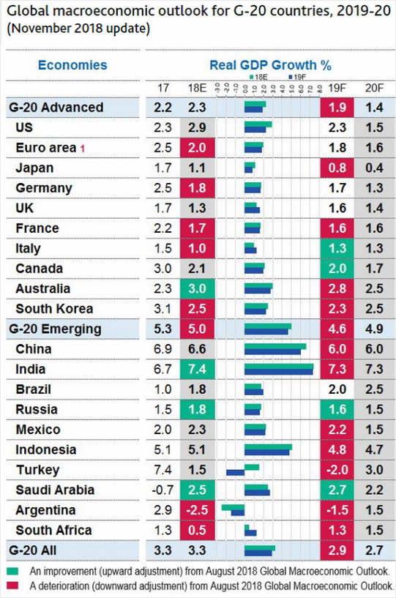
The G20 Nations Growth Will Slow
Slowing US is a key reason
Notes:
Updated 11-9-18 Moody’s Investors Service

Slide 24
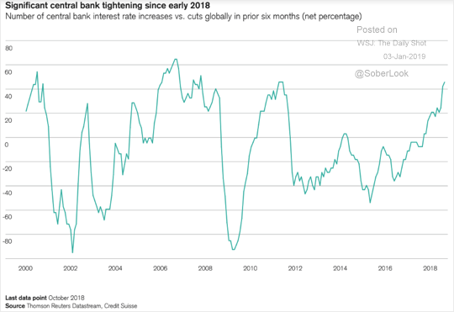
Global Monetary Policy is Tightening
More nations are tightening. Near a decade high!
Notes:
Updated 1-3-19. The WSJ’s The Daily Shot.

Slide 25
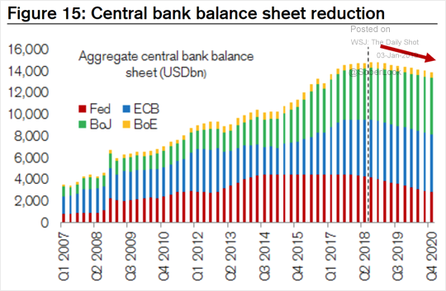
Global Monetary Policy is Tightening
More nations are tightening or are close to
Notes:
Updated 1-3-19. The WSJ’s The Daily Shot.

Slide 26
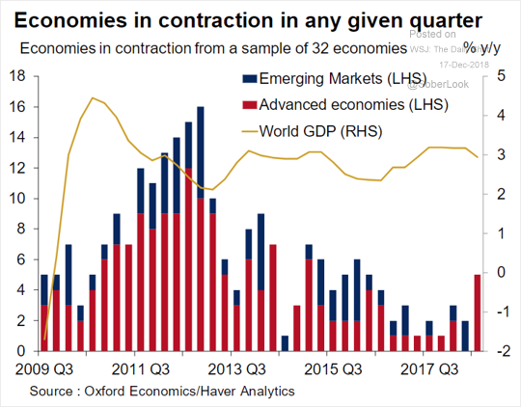
Advanced Nations are Weakening
This suggests global slowing
Notes:
Updated 12-17-18 The Daily Shot.

Slide 27
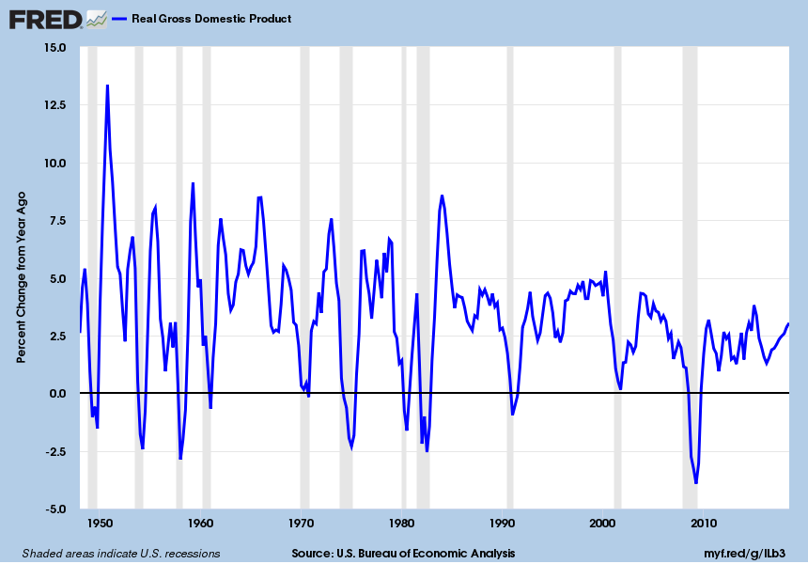
GDP Growth Will Slow
Impact of the recent tax cuts and spending increases will fade through 2019
Notes:
Updated 11-28-18. Quarterly Data. GDPC1 (PERMANENT) NBER LIKES THIS SERIES. Look at FOMC data too.

Slide 28
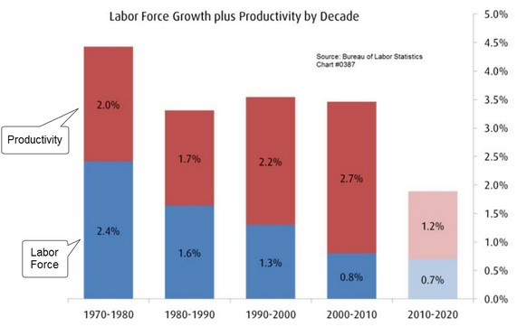
GDP Can’t Grow Fast!
Very weak population growth and labor productivity growth
Notes:
Updated 3-29-17. WSJ’s The Daily Shot
Source: BMO Wealth Management

Slide 29
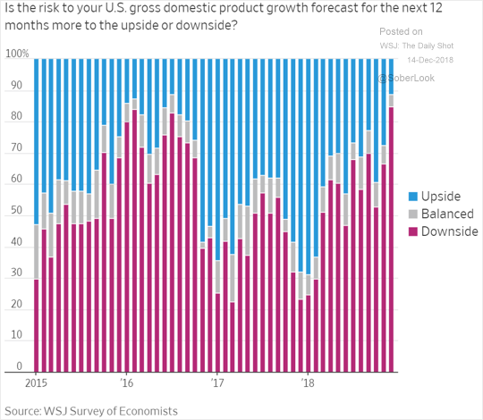
Future GDP Growth is Imperiled
Ill timed tax cuts, spending increases and trade wars are why
Notes:
Updated 12-14-18. WSJ’s Daily Shot. From WSJ’s survey of economists.
https://www.wsj.com/articles/economists-see-u-s-china-trade-war-as-biggest-threat-in-2019-11544713201?mod=djemDailyShot&mod=djemDailyShot

Slide 30
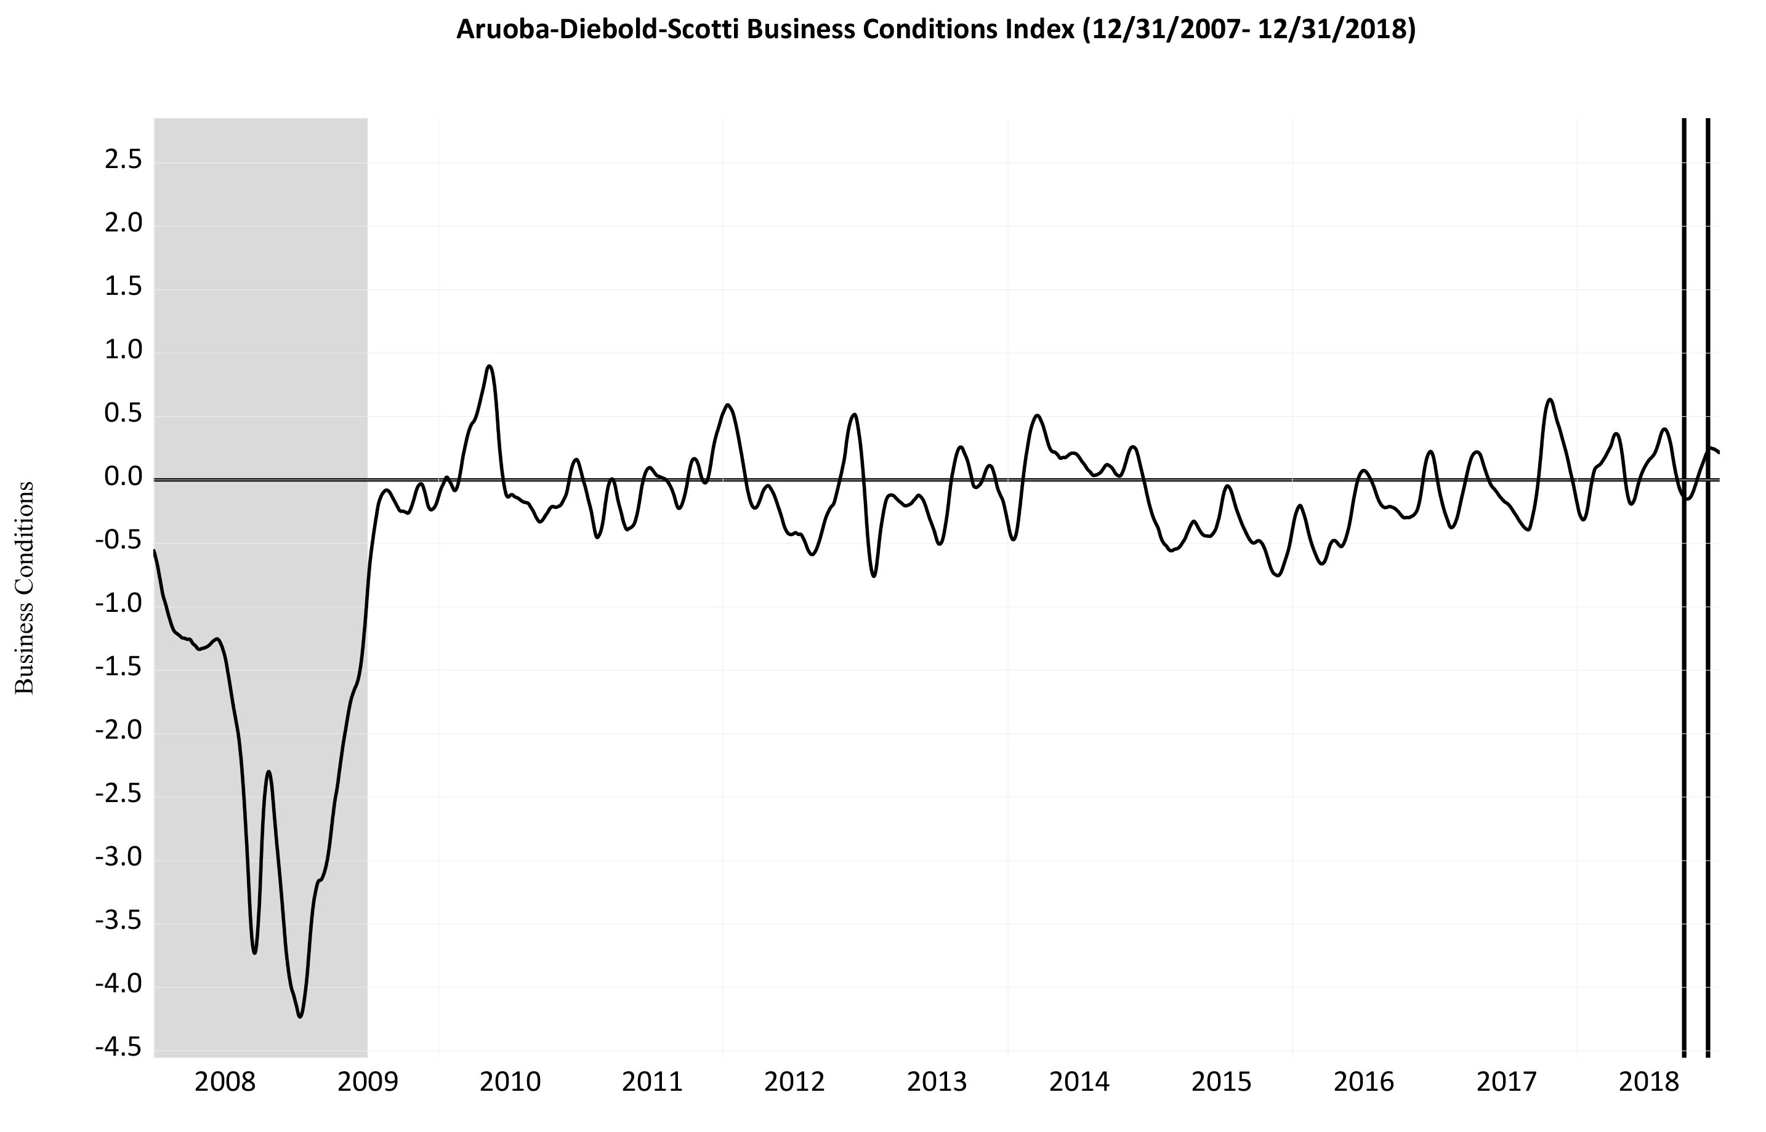
Best of All, No Recession Now!
Designed to track real macroeconomic activity in real time
Notes:
Updated 1-4-19. Daily data. FRB Philadelphia.
https://www.philadelphiafed.org/research-and-data/real-time-center/business-conditions-index
https://www.philadelphiafed.org/research-and-data/real-time-center/real-time-data

Slide 31
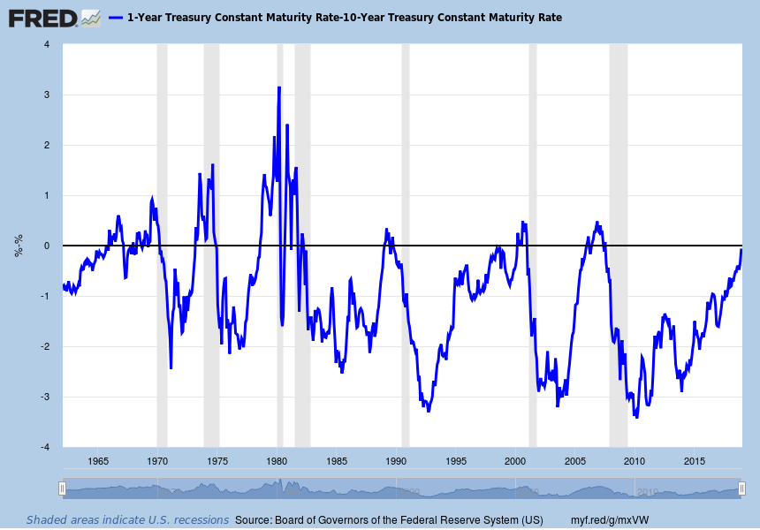
Best of All, No Recession Soon
Yield Curve Inversion Test: 1-Year Treasury Yield – 10-Year Treasury Yield
Notes:
Updated 12-31-18. Updated monthly. DGS1, DGS10 (PERMANENT)

Slide 32
Labor Markets:
They’re Tight, Very Tight

Slide 33
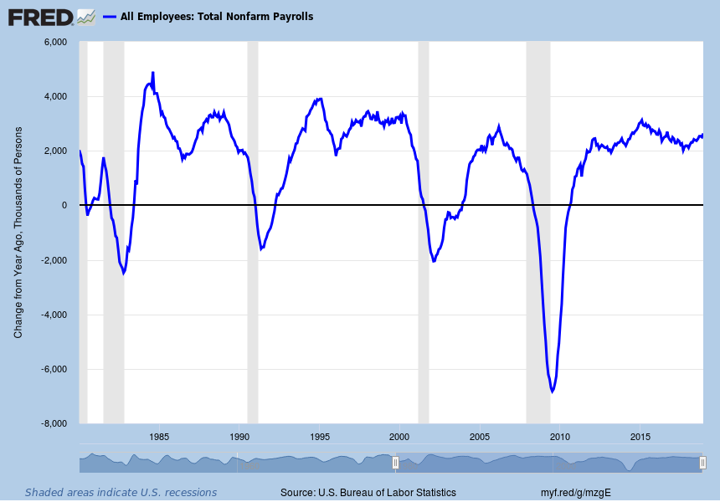
Historical Job Growth
Y-o-Y Total employment growth is spectacular. But, we will run out of workers
Notes:
Updated 1-4-19. Monthly data. PAYEMS (PERMANENT)

Slide 34
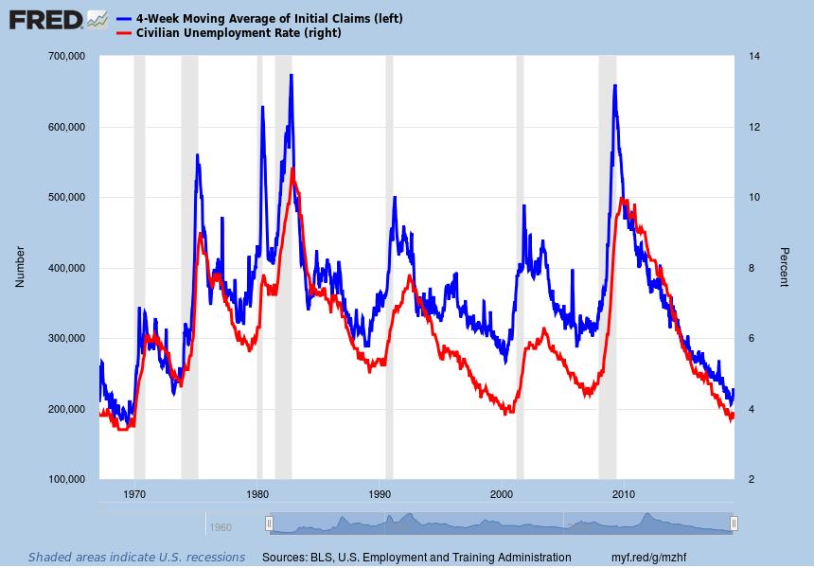
STEADY Labor Market Improvement: Involuntary Separation
Long Term Trends: 1967-2017 Initial claims below 300K for 200 straight weeks!
Notes:
IC4WSA Updated 1-3-19. Weekly data. UNRATE 1-4-19 updated monthly data. (PERMANENT)
Comment 10-6-17

Slide 35
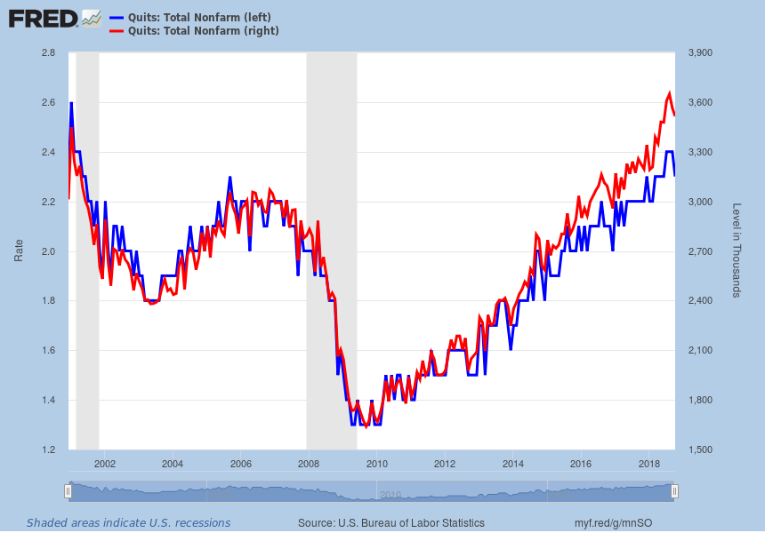
Quits, No matter How Measured Are Superb
Are above their pre-recession level. At 2.3% (in blue) or 3.5 million (in red)
Notes:
Updated 12-10-18. Monthly data. JTSQUR, JTSQUL (PERMANENT) Job Openings and Labor Turnover Survey News Release
Job separation data. Quits/job separations and layoffs/job separations are approaching 60% and 35% respectively; normal pre-recession levels. Comment 11-7-17.

Slide 36
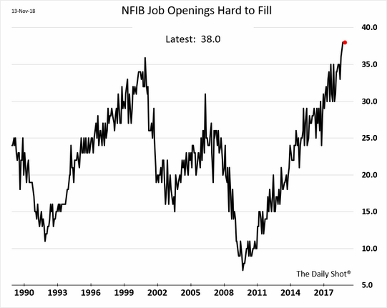
Job Openings are Hard to Fill
Increasingly hard to fill
Notes:
Updated 11-14-18. WSJ’s The Daily Shot

Slide 37
Wage Growth is Slowly Rising

Slide 38
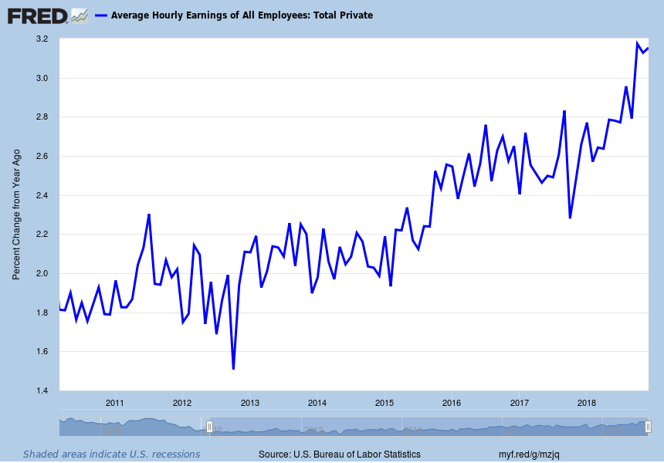
Y-o-Y Percent Change in Hourly Earnings
Despite a very low unemployment rate, wages growth is relatively weak
Notes:
Updated 1-4-19. Monthly data. CES0500000003 (PERMANENT). (Can also look at Business Sector: Unit Labor Cost (ULCBS))
See also FRB ATL Wage Tracker https://www.frbatlanta.org/chcs/wage-growth-tracker.aspx?panel=1

Slide 39
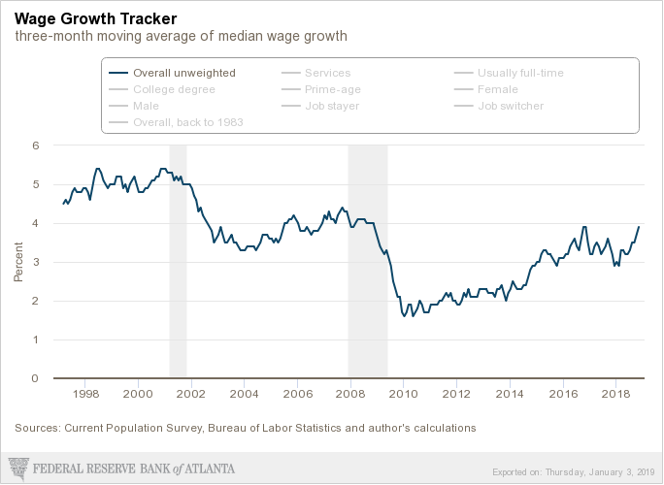
Changes in Median Wage Growth Looks OK!
Looks only at those continuously full-time employed
Notes:
Updated 12-14-18. Monthly data. FRB ATL Wage Tracker https://www.frbatlanta.org/chcs/wage-growth-tracker.aspx?panel=1
Exports as a PNG file!

Slide 40
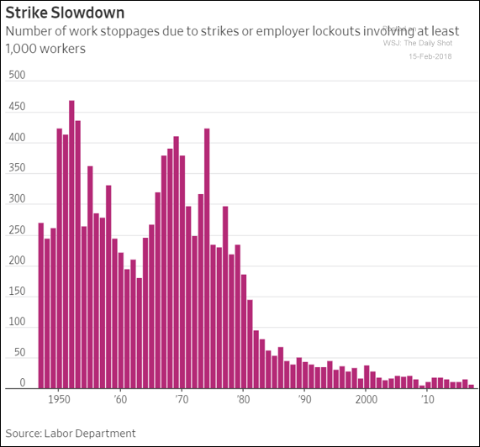
Less Unionized Labor Reduces Bargaining Power
The number of strikes is way down
Notes:
Updated 2-15-18. The WSJ’s The Daily Shot.
https://blogs.wsj.com/economics/2018/02/09/why-workers-are-striking-less-than-ever/

Slide 41
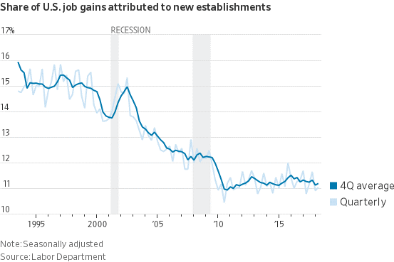
Business Formation is Very Tepid
New firms are not appearing as much as they should
Notes:
Updated 11-8-18. WSJ. Real Time Economics.

Slide 42
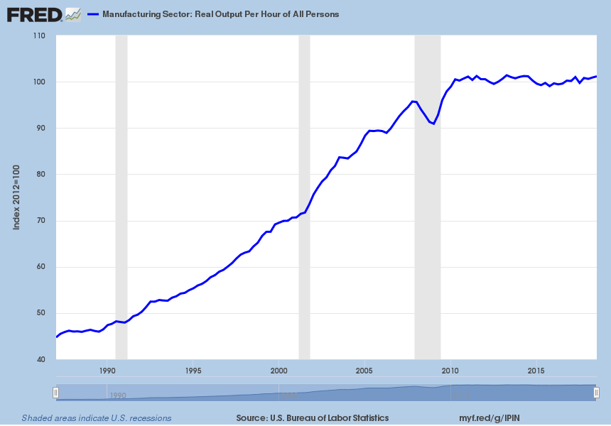
Labor Productivity Growth Remains Dismal
Barely any improvement since mid-2010
Notes:
Updated 12-6-18. Quarterly data. OPHMFG (PERMANENT) Updated quarterly. (In Labor Markets file)
This data comes out 5 weeks (1st estimate) and 9 weeks (2nd estimate) after the quarter ends

Slide 43
Inflation?
It’s Probably Coming

Slide 44
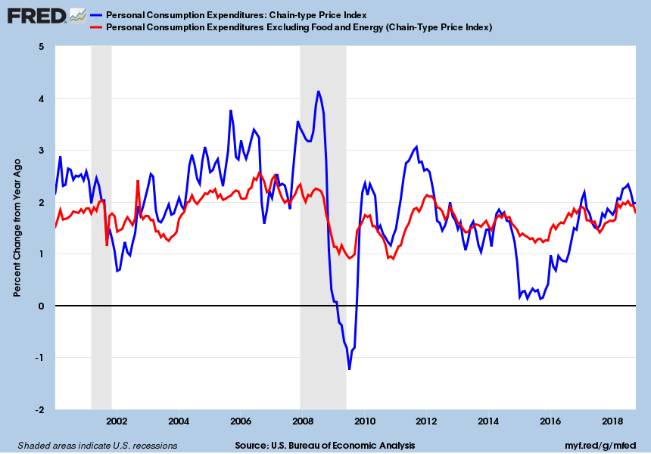
Core PCE Price Index
Inflation is fortunately being held back by a number of factors
Notes:
Updated 11-29-18. Monthly data. PCEPI, PCEPILFE (PERMANENT)

Slide 45
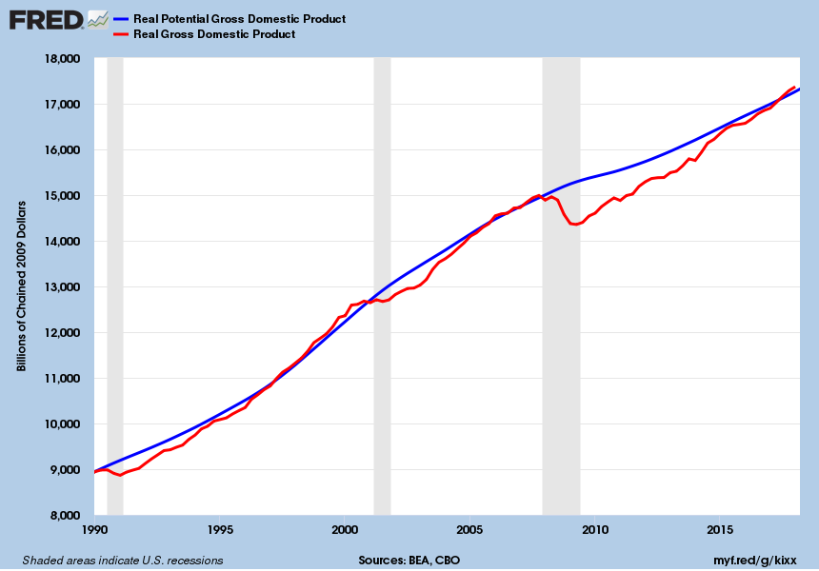
Gap Between Potential GDP and Real GDP is Gone!
Nice news, but note that the blue line fell! Now inflation may rise!
Notes:
Updated 6-28-18 GDPC1 data monthly 4-27-18 and GDPPOT quarterly 8-8-17

Slide 46
Federal Reserve Behavior
Rates Will Rise.
But, How Fast?
Notes:
Updated 11-14-15.

Slide 47
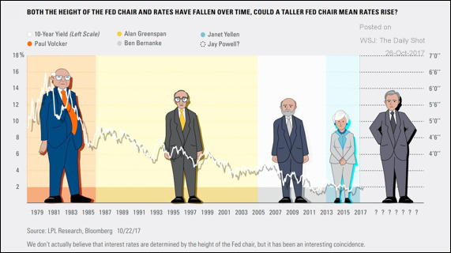
Taller Fed Chair, Higher Rates?
Notes:
WSJ’s The Daily Shot 10-26-17.

Slide 48
Federal Reserve Behavior
Most optimistic scenario
Fed funds is currently 2.375%
12/31/19: 2.875% 10-yr Treasury @ 3.35% 12/31/20: 3.125% 10-yr Treasury @ 3.45%
12/31/21: 2.875% 10-yr Treasury @ 3.35%
Balance sheet keeps shrinking.
Notes:
Updated 12-29-18.

Slide 49
New Housing?
Not enough is being built!

Slide 50
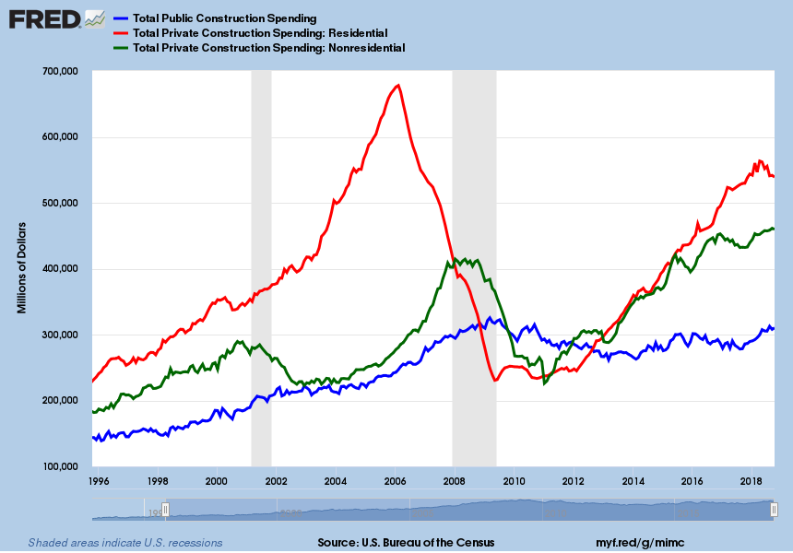
Residential Fixed Investment Stalls
Non-residential is up 11%, public is down 5% and residential is down 21% from peak
Notes:
Updated 12-3-18. Monthly Data. TLPBLCONS, PRRESCONS, PNRESCONS (PERMANENT).
Comment 12-3-18.

Slide 51
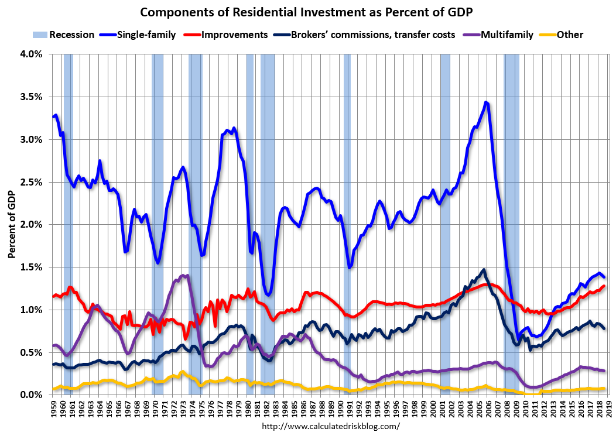
Housing Recovery Is Stalling
Single family is what is lagging. Other components have largely recovered.
Notes:
Updated 10/29/18. Quarterly data.
Also look at A011RY2Q224SBEA = RFI’s contribution to percent change in GDP.

Slide 52
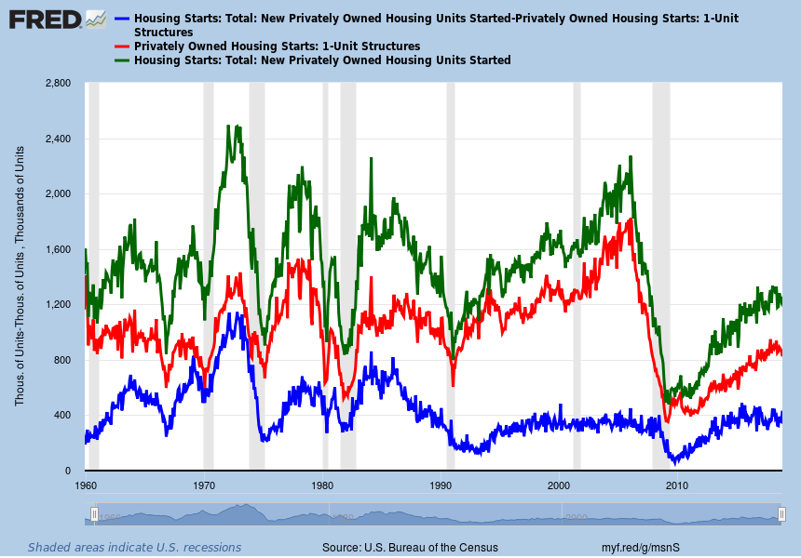
Single-Family and Multifamily Starts – A Slow Recovery
Lack of lots, rising rates, high prices, SF remains near recessionary lows
Notes:
Update 12-18-18. Monthly data. HOUST, HOUST1 (PERMANENT)

Slide 53
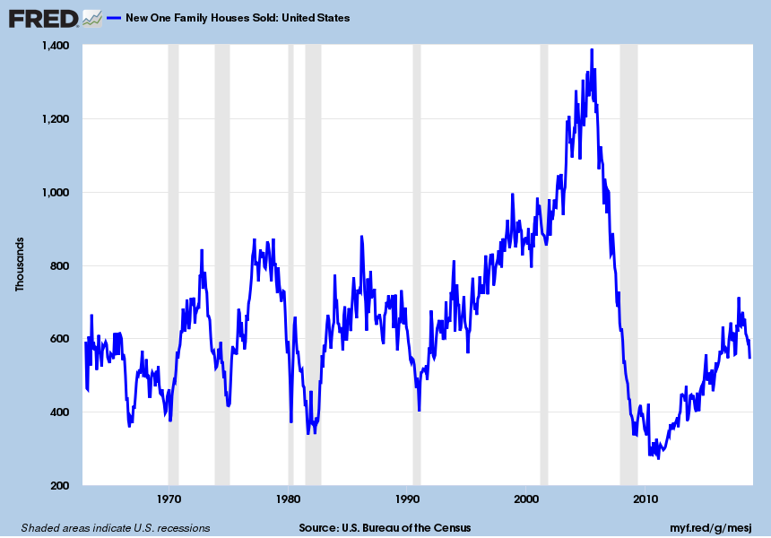
New Home Sales Were Rising Till Recently
Now they are barely up year-over-year
Notes:
Updated 11/28/18. Monthly data. HSN1F To get non Seasonally Adjusted data series is HSN1FNSA (PERMANENT)

Slide 54
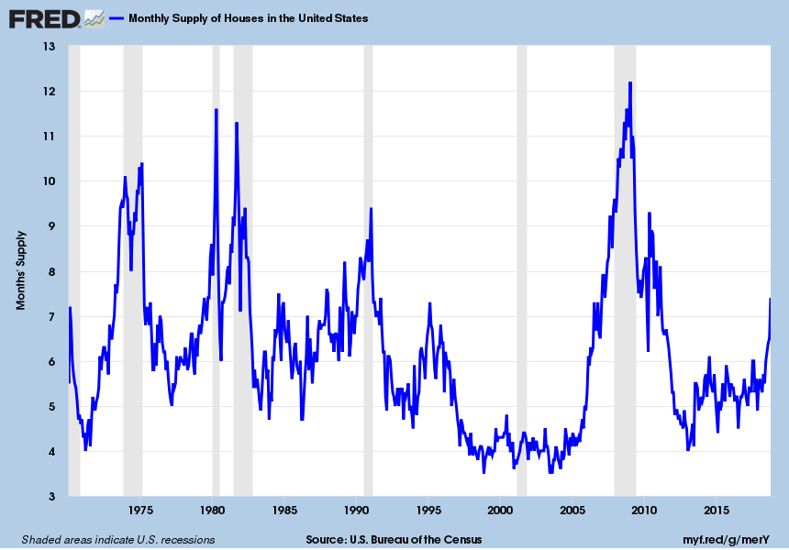
Yikes! New Home Inventory is Skyrocketing
Six months supply is healthy. It’s now above seven months
Notes:
Updated 11/28/18. Monthly data. MSACSR (PERMANENT) Census data. This data comes two days late. So it was actually X/X+2/XX

Slide 55
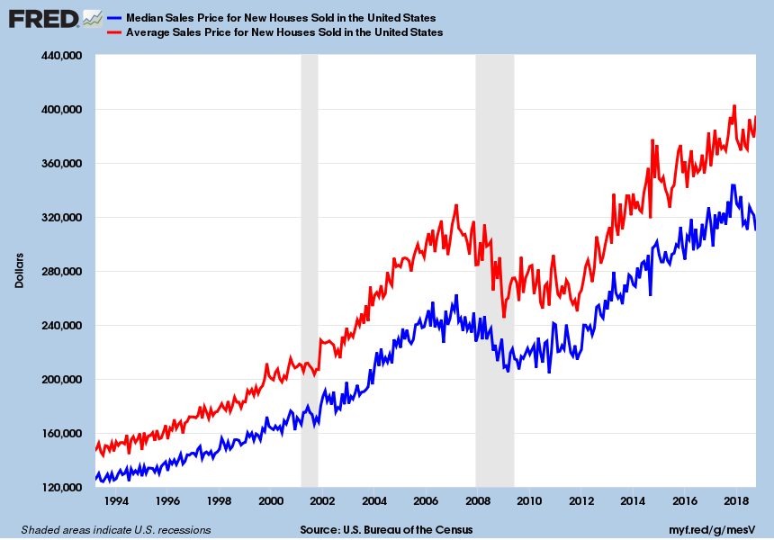
New Home Prices Are Too High, But Slowing Growth
Way above the nominal pre-recession high
Notes:
Updated 11/28/18. Monthly data. MSPNHSUS, ASPNHSUS (PERMANENT)

Slide 56
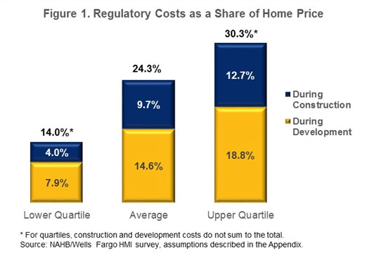
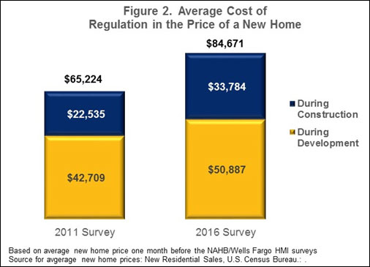
New Home Prices Are Too High Due to Regulation
Notes:
5-2-16 GOVERNMENT REGULATION IN THE PRICE OF A NEW HOME https://www.nahbclassic.org/generic.aspx?sectionID=734&genericContentID=250611&channelID=311

Slide 57
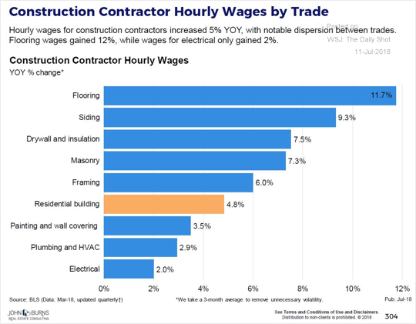
Construction Workers are in Serious Short Supply
Average wage growth/year for construction workers is 5%, much higher than the average
Notes:
Updated 7-11-18. WSJ’s The Daily Shot
Comment 10-11-17

Slide 58

Input Costs Were Way Up due to Policy and China
Prices are down 22% to 25% Y-o-Y. Tariffs, wildfires, who cares!
Notes:
Updated 1-6-19. Updated monthly. CME futures price and Random Lengths composite price.

Slide 59

Has Existing Inventory Bottomed?
Inventory’s up 4.2% Y-o-Y ! 4th consecutive month of growth and biggest rise since late 2014 Rental conversions especially at lower price points, aging in place & mortgage lock-in hurt
Notes:
Updated 12-19-18. Monthly data.
Comment 12-19-18

Slide 60

Has Inventory Bottomed?
It looks like it did in mid 2018
Notes:
Updated 12-18-18. Monthly data.
Comment 12-18-18

Slide 61

Price Growth Appears to be Topping
Prices rise faster than wages! Y-o-Y prices up 4.7%, 5.1% or 5.5% depending on the measure
Notes:
Updated 12-26-18 Monthly data.
Comment 12-26-18.

Slide 62

Pending Home Sales Decline
High prices, rising rates, and low inventories are finally being felt
Notes:
Updated 1-2-19. The WSJ’s The Daily Shot.

Slide 63

MBA Mortgage Purchase Apps Flatten
1st time applications are up 2% Y-o-Y, at level of the late 1990s!
2019 purchase volume looks to be $1.2 trillion, unchanged from 2018
Notes:
Updated 12-19-18. MBA Data, updated weekly.
Comment 12-19-18
www.mba.org

Slide 64

Existing Home Sales Have Plateaued
Regrettably this is occurring while the economy rocks!
Notes:
Updated 12/19/18. NAR monthly data. EXHOSLUSM495S (PERMANENT). To get single-family data look at EXSFHSUSM495S.
Comment 9-20-18

Slide 65

Refinance Activity Keeps Declining!
2019 refi activity falls to $400 billion from $460 in 2018 and $600 in 2017. Ouch
Notes:
Updated 12-19-18. Weekly
Comment 12-19-18, Ellie Mae data. https://www.elliemae.com/origination-insight-reports/Ellie_Mae_OIR_FEBRUARY2015.pdf

Slide 66

Builders Are Getting Nervous
Builder happiness is rapidly declining
Notes:
Updated 12-17-18.

Slide 67
Notes:
Updated 11-16-18. Quarterly data. NY Fed. Quarterly Report on Household Debt and Credit 18Q3
https://www.newyorkfed.org/microeconomics/hhdc
https://www.newyorkfed.org/medialibrary/interactives/householdcredit/data/pdf/HHDC_2018Q3.pdf

Slide 68

Millennials Will Keep This Issue Front and Center
Beginning to approach the Peak. Chase Millennials, move-up buyers and Boomers
Notes:
12-15-17. CoreLogic
https://bdmag.com/peering-into-2018/

Slide 69

The U.S. Home Ownership Rate is Rising
Demographic changes are pushing it up, but slowly
Notes:
Updated 10-30-18. Quarterly data from HVS from census. RSAHORUSQ156S (PERMANENT)
Comment 10-30-18.

Slide 70
What About Things Here?

Slide 71

Oil Prices are Rising but Have Been Contained
At the current price oil is neither helping nor hurting our economy
Notes:
Updated 1-4-19. Daily data. DCOILWTICO (PERMANENT)

Slide 72

Natural Gas Prices are Relatively Low
One CF is (roughly) equal to 1,020 BTU’s
Notes:
Updated 1-4-19 WHHNGSP

Slide 73

US Farm Income is Very Weak
At its lowest level since 2009
Notes:
9-4-18 WSJ’s The Daily Shot
https://www.wsj.com/articles/farm-belt-braces-for-falling-incomes-trade-disputes-1518114582?mod=djemRTE_h

Slide 74

Population Growth by State 1950 to Present
The west grows fastest!
Notes:
1-10-18 The WSJ’s The Daily Shot.

Slide 75
States With Fastest % Growth 7/1/17-6/30/18
Rank | Name | 2010 | 2017 | 2018 | Percent growth
1 | Nevada | 2,700,679 | 2,972,405 | 3,034,392 | 2.1
2 | Idaho | 1,567,657 | 1,718,904 | 1,754,208 | 2.1
3 | Utah | 2,763,891 | 3,103,118 | 3,161,105 | 1.9
4 | Arizona | 6,392,288 | 7,048,876 | 7,171,646 | 1.7
5 | Florida | 18,804,580 | 20,976,812 | 21,299,325 | 1.5
6 | Washington | 6,724,540 | 7,425,432 | 7,535,591 | 1.5
7 | Colorado | 5,029,316 | 5,615,902 | 5,695,564 | 1.4
8 | Texas | 25,146,114 | 28,322,717 | 28,701,845 | 1.3
9 | South Carolina | 4,625,381 | 5,021,219 | 5,084,127 | 1.3
10 | North Carolina | 9,535,736 | 10,270,800 | 10,383,620 | 1.1
Notes:
Updated 12-19-18
https://www.census.gov/newsroom/press-releases/2018/estimates-national-state.html

Slide 76
States With Fastest Pop Growth 7/1/17-6/30/18
Rank | Name | 2010 | 2017 | 2018 | Numeric growth
1 | Texas | 25,146,114 | 28,322,717 | 28,701,845 | 379,128
2 | Florida | 18,804,580 | 20,976,812 | 21,299,325 | 322,513
3 | California | 37,254,523 | 39,399,349 | 39,557,045 | 157,696
4 | Arizona | 6,392,288 | 7,048,876 | 7,171,646 | 122,770
5 | North Carolina | 9,535,736 | 10,270,800 | 10,383,620 | 112,820
6 | Washington | 6,724,540 | 7,425,432 | 7,535,591 | 110,159
7 | Georgia | 9,688,709 | 10,413,055 | 10,519,475 | 106,420
8 | Colorado | 5,029,316 | 5,615,902 | 5,695,564 | 79,662
9 | South Carolina | 4,625,381 | 5,021,219 | 5,084,127 | 62,908
10 | Nevada | 2,700,679 | 2,972,405 | 3,034,392 | 61,987
Notes:
Updated 12-19-18
https://www.census.gov/newsroom/press-releases/2018/estimates-national-state.html

Slide 77

Things Are Good Now
Notes:
Updated 12/27/18. Philadelphia Fed. Monthly updated.
https://www.philadelphiafed.org/research-and-data/regional-economy/indexes/coincident
Also see: https://www.businesscycle.com/ecri-reports-indexes/all-indexes (ECRI)
Nonfarm payroll employment, avg hours worked in manufacturing by production workers, unemployment rate, real wage and salary disbursements.

Slide 78

The Future Looks Good Too!
Notes:
Updated 12-4-18. Updated monthly. (FRED = Leading Index for Texas (TXSLIND)
https://www.philadelphiafed.org/research-and-data/regional-economy/indexes/leading
Also see: https://www.businesscycle.com/ecri-reports-indexes/all-indexes (ECRI)

Slide 79
ANY QUESTIONS?
Elliot F. Eisenberg, Ph.D.
Cell: 202.306.2731
elliot@graphsandlaughs.net
www.econ70.com
Do you want to get my daily 70 word economics email?
Please give me your business card or text “bowtie” to 22828
Thank YOU all very very much!
@ECON70

