Slide 1


MAINTAINING MOMENTUM??
2019 Economic Forecast for Metro Denver
January 10, 2019
noun mo·men·tum \ mō-ˈmen-təm , mə- \
1 b : the strength or force that allows something to continue or to grow stronger or faster as time passes
- Merriam-Webster, LearnersDictionary.com
Prepared by:
In Partnership with:

Slide 2

U.S. GDP Increased Faster than Expected in 2018; Slowdown in 2019
Recent Quarterly Data: 1q2018=+2.2%; 2q2018=4.2%; 3q2018=3.4%
(seasonally adjusted at annual rates)
Source: U.S. Bureau of Economic Analysis, Chained 2012 Dollars. 2018e=DRP Estimate; 2019f=DRP Forecast.

Slide 3




Business Momentum

Slide 4
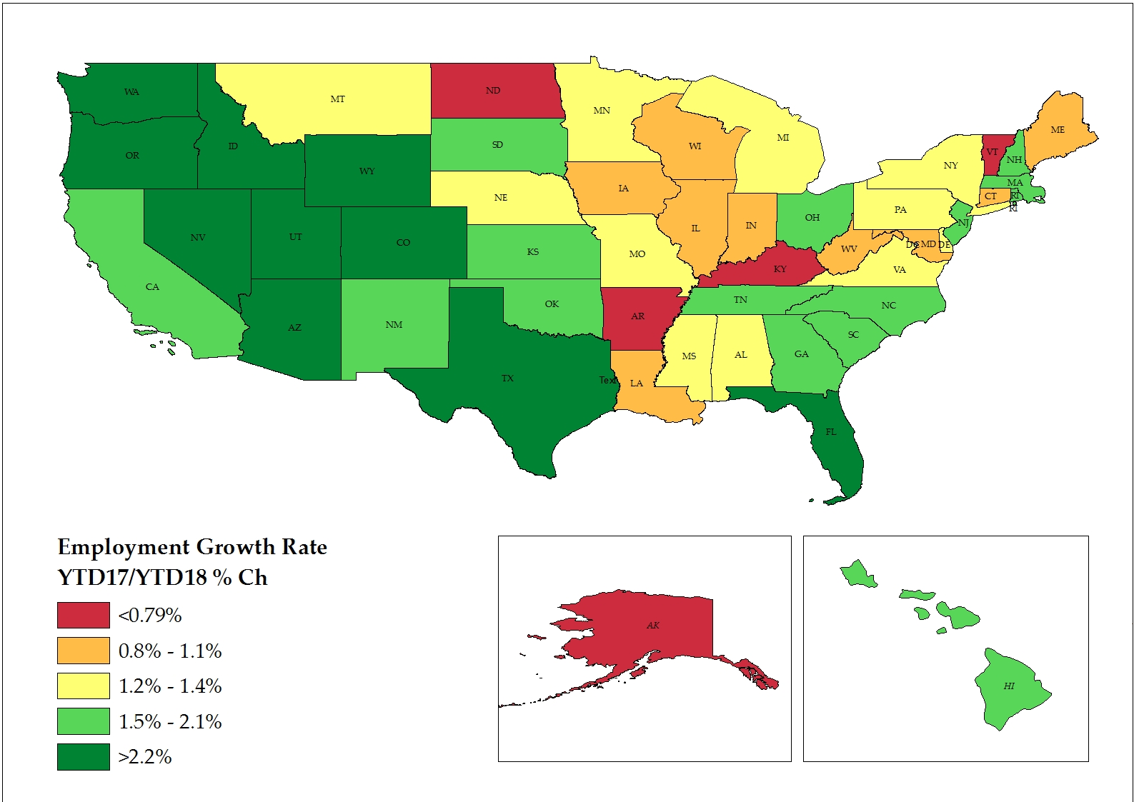
Employment Growth Varies Across the Country
Alaska & Vermont Employment Lower in 2018 than 2017
Source: U.S. Bureau of Labor Statistics.

Slide 5
Metro Denver Employment Slowing, But Still Positive
U.S. Employment = 149 million +2.4 M in 2018 +1.6 M in 2019
Colorado Employment = 2.7 million +68,000 in 2018 +50,000 in 2019
Metro Denver Employment = 1.7 million +43,000 in 2018 +31,000 in 2019
Source: U.S. Bureau of Labor Statistics, Current Employment Statistics.
2018e=DRP Estimate; 2019f=DRP Forecast.

Slide 6
Labor Force Continues to Expand, Unemployment Rises
Source: U.S. Bureau of Labor Statistics, Local Area Unemployment Statistics.
2018e=DRP Estimate; 2019f=DRP Forecast.

Slide 7
Employment Growth Varies Across the State
Source: U.S. Bureau of Labor Statistics, Current Employment Statistics.
Notes:
7

Slide 8
Notes:
Counties in Orange or Red have recovered all the jobs that were lost during the recession. Dark red = Strongest Recovery.
Lack of economic diversity has caused nearly all of the counties in the western 1/3 of the state to lag in the recovery and remain between 5 and 10% or more below pre-recession peaks. 11 counties still 10% or more below pre-recession peak, 9 counties between 5-10% below, and 18 counties that are 0-5% below.
Only 26 of the 64 counties have fully recovered. 15 – have more than 5% and half of those are above 10, and 11 have 0 to 5% more jobs.
It is also worth noting that the pre-recession peaks for many Western slope counties were “frothy” and it is questionable if those employment levels were sustainable.

Slide 9
Metro Denver Employment Growth by Supersector
Largest: 306,700 workers
# Jobs
2018e = 1.69 M
2019f = 1.72 M
Smallest: 58,600 workers
Source: Colorado Department of Labor & Employment.
2018e=DRP Estimate; 2019f=DRP Forecast.

Slide 10
Proprietors Are Another Significant Component Of Employment
Proprietors Employment
25.6% of Colorado’s Total Employment (US avg = 22.6%)
Source: U.S. Bureau of Economic Analysis.

Slide 11
Key Metro Denver and Northern Colorado Industry Clusters
Aerospace
Aviation
Beverage Production
Bioscience
  Medical Devices & Diagnostics
  Pharmaceuticals & Biotechnology
Broadcasting & Telecommunications
Energy
  Fossil Energy
  Cleantech
Financial Services
  Banking & Finance
  Investments
  Insurance
Healthcare & Wellness
IT/Software

Slide 12
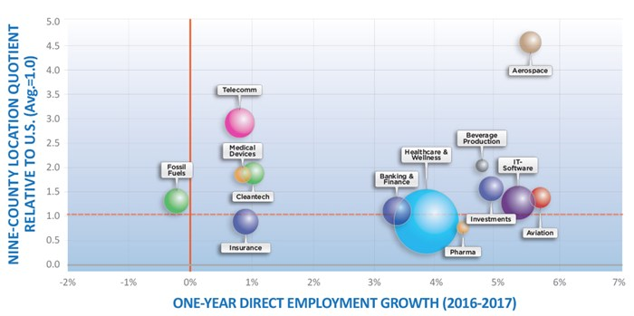
Metro Denver and Northern Colorado Industry Clusters, 2016-2017
Full reports at www.metrodenver.org
Source: Development Research Partners.

Slide 13

Office Market Still Healthy, but Showing Signs of Change
4Q 2018
Total Space= 191.5 MSF
Lease Rate = $26.62
YOY Change =
0%
Under Construction = 4.1 MSF
2018 Completions =
3.8 MSF
Source: CoStar Group, Inc.
2019f=DRP Forecast.

Slide 14
Record Level of Industrial Space Completed in 2018
4Q 2018
Total Space= 220.4 MSF
Lease Rate = $8.05NNN
YOY Change = +3.9%
Under Construction = 4.6 MSF
2018 Completions =
5.75 MSF
Source: CoStar Group, Inc.
2019f=DRP Forecast.

Slide 15
Retail Market Healthy Despite Major Company Closures
4Q 2018
Total Space= 169.3 MSF
Lease Rate = $19.12 NNN
YOY Change = +5.2%
Under Construction = 1.0 MSF
2018 Completions =
1.6 MSF
Source: CoStar Group, Inc.
2019f=DRP Forecast.

Slide 16
New Commercial Real Estate Added in Metro Denver
Source: CoStar Group, Inc.
2019f=DRP Forecast.

Slide 17
The Case for Business Momentum…
Decreasing
  Uncertainty
  Hard to find workers
  Rising interest rates
  Rising wages and costs
  Tariffs on raw materials
  National debt concerns
Increasing
  Diversity of economic base
  Confident consumers
  Technology driving major changes
  Active commercial real estate market
  Large infrastructure projects underway

Slide 18




Consumer Momentum

Slide 19
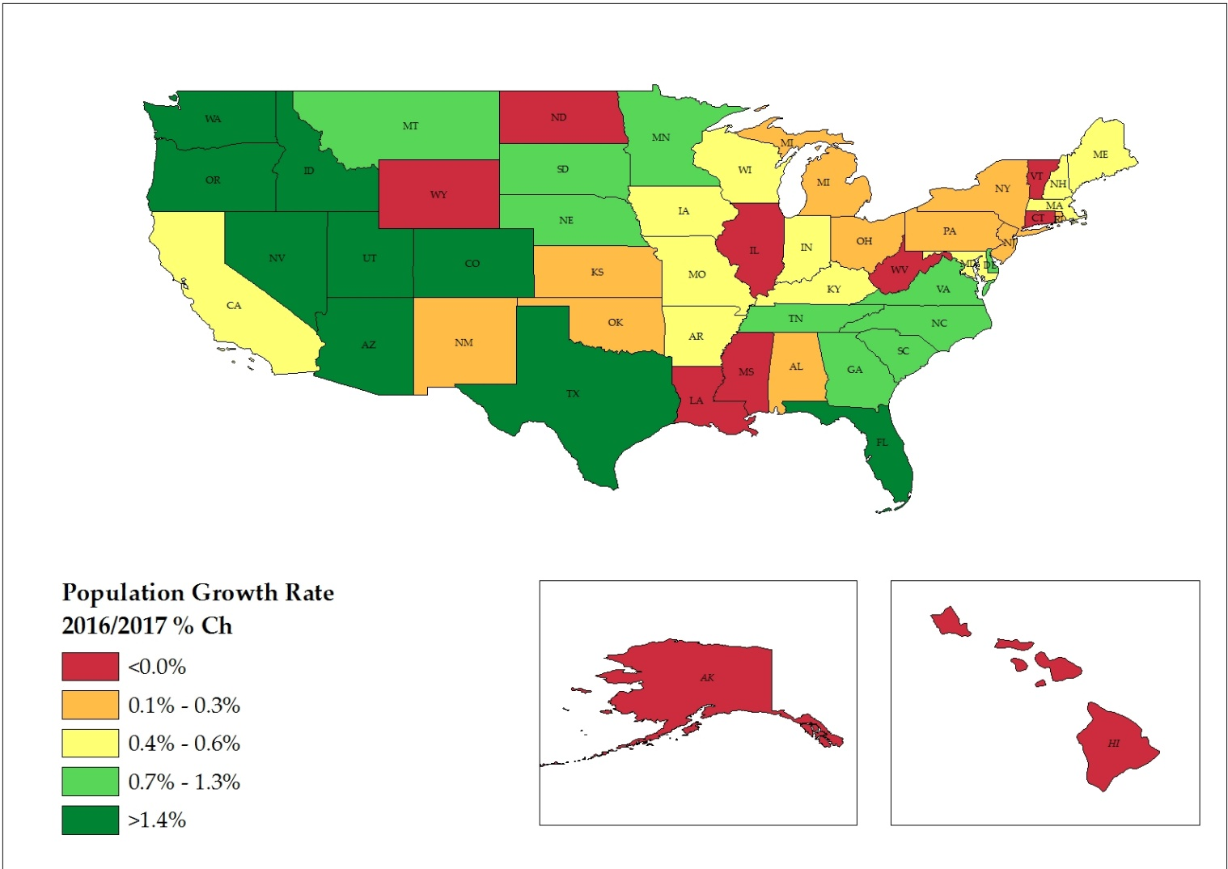
U.S. Population = 327.2 million (July 1, 2018)
U.S. Population increases by 1 person every 12 seconds
Source: U.S. Census Bureau.

Slide 20
Metro Denver Annual Change in Population
Source: Colorado Division of Local Government, State Demography Office.

Slide 21
Metro Denver Aging Changes Housing, Spending Needs and Patterns
Source: Colorado Division of Local Government, State Demography Office.

Slide 22
Metro Denver Aging Changes Housing, Spending Needs and Patterns
Source: Colorado Division of Local Government, State Demography Office.

Slide 23
Consumers Are Confident & Spending
Retail Change in
Various Markets (YTD)
National: +5.3% (Oct)
Denver: +5.2% (Sep)
Aurora: +5.0% (Oct)
Broomfield: +4.9% (June)
Sources: Colorado Department of Revenue; The Conference Board.
2017e=DRP Estimate; 2018f=DRP Forecast.

Slide 24
Metro Denver Wages Increasing Faster than Inflation, not Faster than Housing Costs
Sources: U.S. Bureau of Labor Statistics; National Association of REALTORS.

Slide 25
Metro Denver #12 and Boulder #7 for Highest Median Home Price, 3Q 2018
Source: National Association of REALTORS.
2018e=DRP Estimate; 2019f=DRP Forecast.
Notes:
Metro Denver prices increasing 7 – 9% in 2017, depending upon which measure viewed (Case Shiller at about 8%); expect 6% increase in 2018
U.S. prices increasing at about 6% in 2017, expect 5% in 2018
Core Logic says that about half of the nation’s 50 largest housing markets are overvalued.

Slide 26
Home Sales Slowing due to Lack of Inventory, Rising Prices
Sources: Metrolist (2005-2010); Denver Metro Association of REALTORS (2011-2018).
2019f=DRP Forecast.

Slide 27
Apartment Vacancy and Rental Rates Rising at Moderate Pace
Source: Denver Metro Apartment Vacancy & Rent Survey.
2018e=DRP Estimate; 2019f=DRP Forecast.

Slide 28
Multi-family 51% of New Construction in 2017, 42% in 2018
(30+ year average = 28%)
* The Census Bureau tracks building permits by the number of housing units in the structure.
Source: U.S. Census Bureau, Building Permits.
2018e=DRP Estimate; 2019f=DRP Forecast.

Slide 29
The Case for Consumer Momentum…
Decreasing
  Uncertainty
  Rising interest rates
  Rising inflation rate
  Housing costs increasing faster than wages
  Lack of affordable housing
Increasing
  Continued job growth
  Tax Cuts and Jobs Act influence
  Some tempering in residential markets
  Wages increasing at a faster pace than prior years

Slide 30
Questions?
Development Research Partners
10184 West Belleview Avenue, Suite 100
Littleton, Colorado 80127
(303) 991-0070
www.DevelopmentResearch.net
Patricia Silverstein, President
Patty@DevelopmentResearch.net

