Slide 1
The Voice of Real Estate® in the Denver Metro Area
A monthly research tool published by the
Denver Metro Association of REALTORS® Market Trends Committee
Denver Metro Real Estate Market Trends
January 2019
Presented by Jill Schafer
Market Trends Committee Chair
Kentwood Cherry Creek Broker Associate
Notes:
Hi, I’m Jill Schafer. I’ve been a full time real estate agent in the Denver Metro area for 15 years. I joined the Denver Metro Association of Realtors Market Trends Committee in October 2014.
This past October, I was Appointed Chair. The Market Trends Committee members operate as the voice of real estate and are often interviewed by the press because of our knowledge of the trends..

Slide 2
DMAR Market Trends
The DMAR Market Trends Committee releases reports monthly, highlighting important trends and market activity from across the Denver metro area.
11- County Coverage : Adams, Arapahoe, Boulder, Broomfield, Clear Creek, Denver, Douglas, Elbert, Gilpin, Jefferson and Park counties. Data for the report is sourced from REcolorado® and interpreted by DMAR.
Notes:
The report is released monthly and has charts and graphs and insights to the market trends in real estate.
We use numbers provided by ReColorado.com and cover the 11 county metro area.

Slide 3
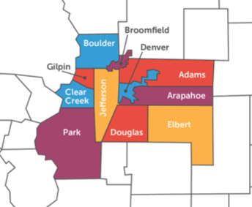
DMAR Market Trends
Notes:
Some reports do different counties or fewer counties, but ours covers Adams, Arapahoe, Boulder, Broomfield,
Clear Creek, Denver, Douglas, Elbert,
Gilpin, Jefferson and Park counties

Slide 4
2018 Wrap Up
DMAR Market Trends
Notes:
Since we are only 10 days into 2019- I’m going to start with a wrap up of 2018.
2018 had two different markets- the first half of the year was a blur of multiple offers and bids thousands over asking price. The second half of the year there was a distinct shift as the market normalized. But overall 2018 saw a number of RECORD BREAKERs

Slide 5
2018 Wrap Up
DMAR Market Trends
SALES PRICE Detached Homes
Average
$522,839
8.05%
Median
$440,500
6.92 %
Notes:
Our sales price average broke a record this year. 2018 ended with a record high average and median sales price.
For Detached Homes the yearend Average price was $522,839, that’s up a little more than 8 percent from 2017.
And a median of $440,500 which is 6.92 percent higher than 2017.

Slide 6
2018 Wrap Up
DMAR Market Trends
SALES PRICE Attached Homes/Condos
Average
$351,677
9.82%
Median
$300,000
11.11%
Notes:
It was a record year for the average and median sales price of attached homes, Condos, Townhomes, duplexes, Triplexes etc. as well.
Average price was $351,677 up 9.82% year over year. Annual Median price closed out the year at $300,000 up 11.11%.
This is great news for home owners as they see their assets appreciate. But these price increases make affording the American Dream in Denver Metro more difficult for many people.

Slide 7
2018 Wrap Up
DMAR Market Trends
$ales Volume
2014 $17.6 B
2015 $20.8 B up 17.96%
2016 $22.8 B up 9.92%
2017 $25.9 B up 13.29%
2018 $26,512,027,993 up 2.36%
up 43.53% in 4 Years
Notes:
Another Record we reached in 2018 was Sales Volume.
In 2014 real estate sales volume was $17.6 Billion
2015 jumped up 17.96% to $20.8 Billion
2016 we saw another jump- up nearly 10% to $22.8 Billion
Sales volume took another big jump in 2018, up 13.29% to $25.9 billion
2018 sales volume didn’t increase as much, only 2.36%
closing out the year with $26.5 billion dollars in sales.
That’s a 45.53% increase in 4 years. Real Estate has a pretty big economic footprint.

Slide 8
2018 Wrap Up
DMAR Market Trends
RIGHT?
Notes:
Those are Pretty impressive numbers in 2018.
But was everything waterfalls and rainbows?

Slide 9
2018 Wrap Up
DMAR Market Trends
Housing Inventory
UP 44.71 %
Number of Home SALES down 5.52 %
Notes:
Much of what contributed to our record breaking year came in the first half of 2018. Mid year we saw a large increase in inventory causing a market adjustment. People started asking me if we were poised for a bust and many people felt panicky.
We saw days on market increase and for the first time in years we saw price ‘adjustments’ as sellers who were anticipating prices to continue to increase at the rate in the first half of the year overshot their asking prices.
The positive side of the second 1/2 of the year was that timid or overwhelmed buyers finally had a few more days to make up their mind and a lot more choices to choose from. We ended the year with inventory up 44.71% and the number of sales down 5.52%
Does that mean we’ve busted?

Slide 10
The 11-county report
DMAR Market Trends
Look Closer
Notes:
Let’s take a closer look
At first glance this home looks awesome. I’ve always wanted a beautiful swimming pool! How about you?

Slide 11
The 11-county report
DMAR Market Trends
Notes:
Belly flop! This isn’t exactly what I had in mind.
I can spout all kinds of statistics to you but without perspective, they don’t mean much.And as it says- Perspective is everything!

Slide 12
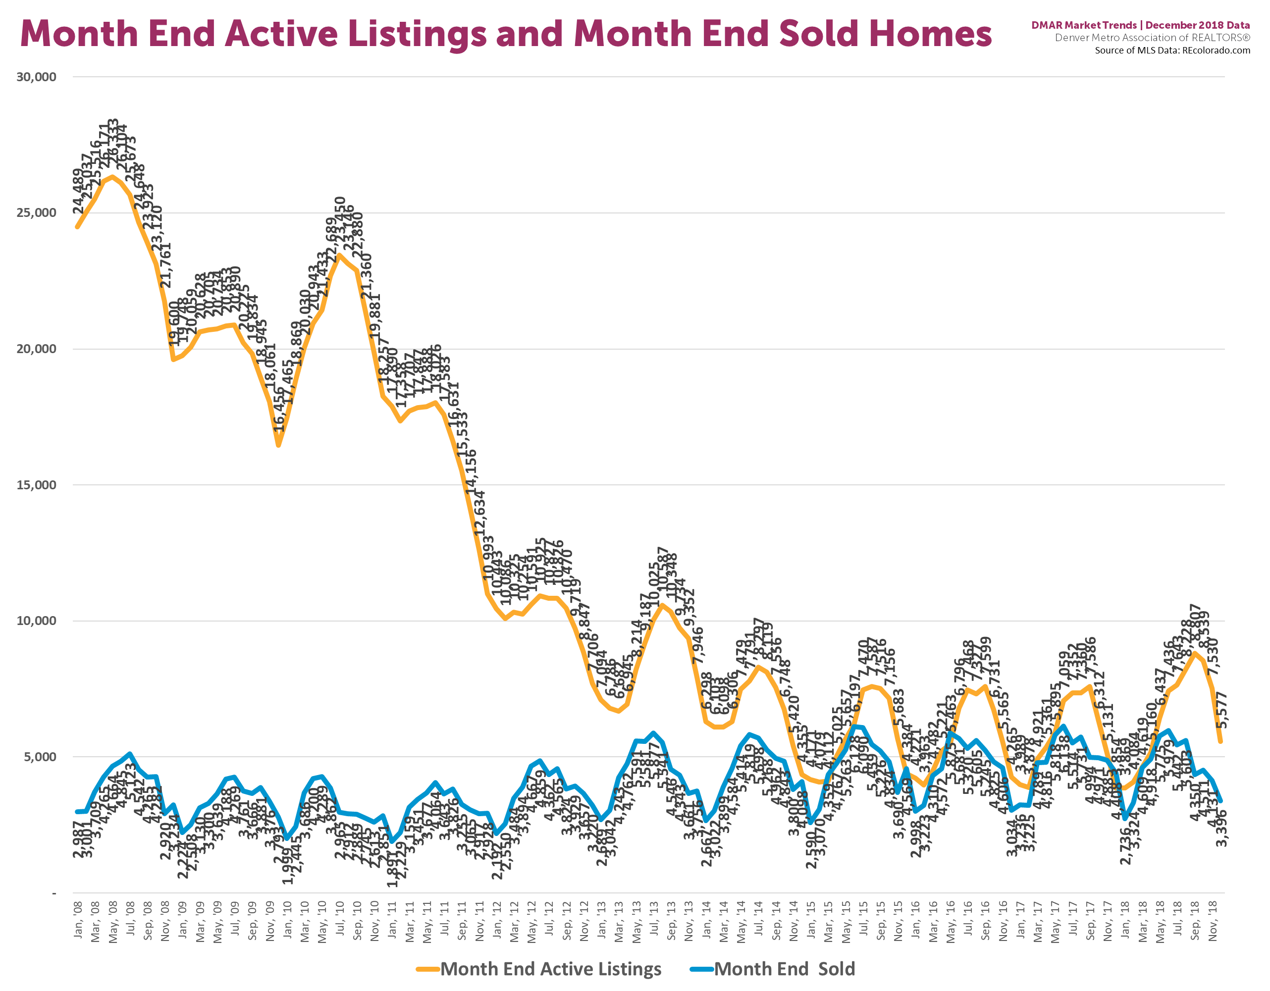
2018 Wrap Up
DMAR Market Trends
ACTIVES Mid 2008 Peak: 26,333
Actives Mid 2018
8,807 Highest peak since mid 2013
End of 2018
5,577 actives
Jan. 2008
Dec. 2018
Notes:
This chart gives you a quick visual of what’s happened in real estate in the past 10 years. The top, yellow line is the number of active listings at each months’ end- the number of homes for sale. You can see we peaked in mid 2008 at 26,333 active listings. That’s a lot of choices!! I remember being able to set 2 dozen showings on a weekend trip for relocating buyers and they could come back a few months later and most of those homes would still be available. Compare that to our peak this year in August at 8,807 active listings. This year looks a lot better than 2008. Now that is the highest peak we’ve had since 2012 but it is still low when you compare to the last ‘bust’ We ended the year with 5,577 active listings.

Slide 13
2018 Wrap Up
DMAR Market Trends
Lowest # Sold in 2018
2,736 in January
Lowest # Sold 1,897 in Jan. 2011
# Sold in Dec.2018
3,396
Jan. 2008
Dec. 2018
Notes:
Now look at the blue line. That’s the number of homes SOLD at the end of each month- again the chart shows the past 10 years. January 2011 marked the lowest number of homes sold in a month at 1,897. Compare that to our lowest number sold in 2018, which also occurred in January. We sold 2,736 homes. The last month of 2018 we sold 3,396 properties. So again, with perspective- things looked pretty positive in 2018 when compared to the data over the past 10 years.

Slide 14
2018 Wrap Up
DMAR Market Trends
8,807 Homes for Sale in Sept.
12/17 SOLDS 4,408
12/18 ACTIVES 5,577
12/17 ACTIVES 3,854
12/18
SOLDS 3,396
Dec.2017
Dec. 2018
Notes:
Let’s look a the more recent history for perspective. This chart shows the past 13 months. The yellow columns are active listings, Blues are the solds, greens indicates Under Contract and the purplish colored column is the number of sold residential properties (both detached and attached homes combined)
We sold 4,408 in December of 2017
But in the last month of 2018, we only sold 3,396
That’s a 22.96% reduction in sales
Meanwhile, The yellow columns are the number of active listings at months end.
You can see buyers had the most choices in September when we had 8,807 active listings
When you compare our most recent data from December to the same month in 2017 -to again give us some perspective.
In December 2017 buyers had 3,854 choices
December 2018 buyers had 5,577 choices. 44.71% more choices

Slide 15
2018 Wrap Up
DMAR Market Trends
Notes:
After 15 years in this business. One thing I know for sure. Real estate Is a roller coaster ride every year! Some of us take the ride like the guy on the right!
Meanwhile, some take the ride with white knuckles and the media likes to report on the white knuckled guy’s fears the most.

Slide 16
The 11-county report
DMAR Market Trends
What to expect in 2019
Notes:
What will the ride look like in 2019? That’s what everyone wants to know and next to “How’s the market” the most common question I hear is. “What can I expect to see in the coming year.” Oh, how I wish I had a crystal ball!!! Think how rich I would be! I’d be looking at that crystal ball from a beach in the Cayman Islands!

Slide 17
The 11-county report
DMAR Market Trends
What to expect in 2019
Notes:
I usually say the real estate market kicks into gear after the Super Bowl, but this year, it appears the warm weather has things jumping a few weeks earlier. I’m as excited as my squirrel friend for 2019. The ride has already started. I spoke to a real estate photographer in mid December and he said this was his busiest December in 10 years. Many sellers spent the end of the year getting their homes ready to go on the market. Looking at just my office’s list of COMING SOON homes I think we are going to see some great new inventory choices. Kentwood Real Estate also sends out a list of Buyer Needs to our agents and that’s long already this year too.
So while we have inventory now, buyers are still trying to find ‘the right home” and new choices will be welcome.

Slide 18
The 11-county report
DMAR Market Trends
What to expect in 2019
Highest # of New Listings in 2018 May 7,750
Highest # of Solds in 2018 June 5,979
Lowest # of Solds in 2018
January 3,012
Lowest # of New Listings December 2,376
Notes:
We are currently in the anticipation portion of the real estate ride. Let’s look at our slowest and busiest months. Remember I don’t have that crystal ball so I look at the past to try and predict the future. As Dr. Phil says “The best predictor of future behavior is relevant past behavior.
At the end of the year - few people are putting their homes on the market. I guess they are busy with entertaining and baking and family. At the end of 2017 NEW LISTINGS were at a low of 2,376- not a record low but the lowest in the past 13 months,
Then more and more homes came on the market until May when we had the most new listings, 7,750 homes came on the market.
The lowest number of SOLDS was in January with 3,012
We saw a steady increase in sales as the market picked up steam. The largest number of homes closed in June in 2018 These peaks and valleys vary a little year to year, but the trend lines are similar.
What that tells me is that now is the time for people who want to sell to start working with a Realtor to prepare their home or get pre-approved to buy.

Slide 19
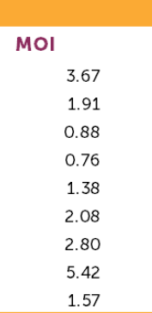
The 11-county report
DMAR Market Trends
What to expect in 2019
Who Will Have The Negotiating Power?
Single Family
Condos
Under 5 MONTHS OF INVENTORY (MOI) Is Considered a Seller’s Market
Between 5 -6 MONTHS MOI Is Considered an Equal Market Between Buyers and Sellers
Notes:
One of the indicators I use the most to set prices and to give my sellers an idea of how long they can expect to have their homes on the market is Months of Inventory or MOI. Basically what MOI shows us is If the rate of sales stays the same, how long will it take to sell all of the homes currently on the market.
Less than 5 months of inventory is considered a Seller’s Market. With homes selling quickly, buyers don’t have much negotiating power, if they want the house- they are going to have to lay all their cards on the table. Sellers know they have a hot commodity and are likely to get what they are asking or at least close to it.
Between 5 and 6 months is an equal market where neither buyers or sellers are at an advantage. And over 6 months puts the negotiating power in the BUYERS hands.
As you can see, every price range except for single family luxury homes priced over $1m has LESS than 5 months of inventory. Between 200,000 and $400,000 there’s less than a month of inventory, with only 771 houses available. That’s why those first time home buyers are having a hard time finding a starter home. Above $1M neither buyers or sellers have much of an advantage. Although location has an impact in the luxury market. Remember, These numbers cover 11 counties. But if you look at the popular Denver central neighborhoods, the sellers’ have the advantage and the further out in the suburbs, the buyer’s have more negotiating power. In fact in Cherry Hills Village there are 22 months of inventory of homes priced over $3 million.So if you’re looking for a deal- let me know and we will head that way. But buyers don’t have as many choices in Country Club, HIlltop, Wash Park and other closer-in luxury neighborhoods.
Every section of the attached home/condo market has less than 5 months of inventory. Things are almost even with luxury condos as well but not quite. While you see condos and duplexes popping up all over, the demand is still high.

Slide 20
The 11-county report
DMAR Market Trends
What to expect in 2019
Sellers Have The Power In Every Price Segment
Buyers
Sellers
EXCEPT Luxury Single Family Homes ($1 Million+)
Where Neither Buyers nor Sellers Have The Upper Hand
Buyers
Sellers

Slide 21
The 11-county report
DMAR Market Trends
What to expect in 2019
Will People Still Be Moving Here?
Will Buyers Have More Choices?
Will Prices Continue to Go Up?
YES YES YES
Will Interest Rates Go Up?
Will Affordability Continue To Be An Issue?
Will First-Time Buyers Have A Difficult Time?
YES YES YES
Notes:
According to the US Census Bureau, 80,000 people moved to Colorado from mid-2017 to mid-2018. Will people continue moving here in 2019?
We ended the year with 44.71 percent more active listings. Will buyers have more choices?
Annual price appreciation was up in 2018 between 6.92% and 8.32% Will prices continue to go up?
I think it’s safe to predict that yes, people will continue to move here
yes, buyers will have more choices
and yes, prices will continue to go up
What things may cause problems in 2019?
We had a drop in interest rates recently with the drop in the bond market and stock market but Interest rates are expected to go up again.
That and rising prices cause the affordability gap to widen since salaries are not going up a the same rate.
With the higher prices, homeownership may become a pipe-dream to more people especially those trying to get into the market for the first time. So the answer to those questions is also yes, Interest rates will go up, Yes, affordability will still be an issue, and yes, 1st Buyers are going to have a tough time breaking into the market.

Slide 22
The 11-county report
DMAR Market Trends
What to expect in 2019
Real Estate is Like a Roller Coaster You Can Either Scream Every Time There Is A Bump Or You Can Throw Your Hands Up And Enjoy The Ride
Notes:
Like all statistics- its how you look at things. I feel like Real Estate is like a Roller Coaster You can either scream every time there is a turn or a bump or you can throw your hands up and enjoy the ride. No matter what the numbers say, people are always moving, in and out, up in size or down and every type of the market has someone who can benefit For some time now it’s been the sellers. As we see some normalizing of the market, buyers have some opportunities to get into homes and investors may have some better options to pick up as rentals.

Slide 23
The 11-county report
DMAR Market Trends
What to expect in 2019
Notes:
I know one thing and I learned it from Will Rogers! Real Estate is the best investment in the world because it’s the only thing they’re not making anymore!

Slide 24
DMAR Market Trends
Questions

Slide 25
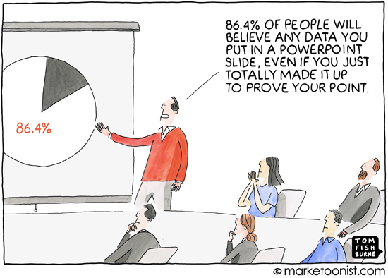
DMAR Market Trends

