Slide 1
Federal and State Regulatory and Legal Considerations
Unmanned Aircraft Systems
Prepared for:
Denver Metro Association of Realtors
January 18, 2017
Tom Dougherty
Lewis Roca Rothgerber Christie LLP

Slide 2

Overview
Introduction to Unmanned Aircraft Systems
UAS in the Real Estate Industry
Federal Laws and Regulations
State Law Considerations - Property Rights and Privacy
Key Business Considerations
UAS Trends

Slide 3
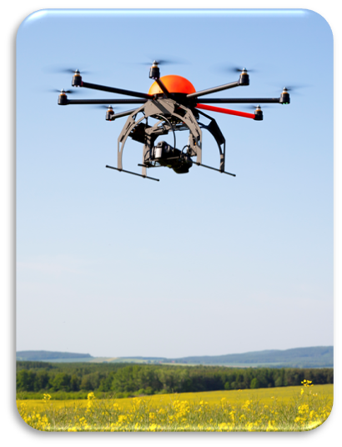
UAS Introduction - Terminology
Unmanned Aircraft (UA)
Unmanned Aircraft System (UAS)
Unmanned Aerial Vehicle (UAV)
Unpiloted Aerial Vehicle (UAV)
Remotely Piloted Vehicle (RPV)
Remotely Piloted Aircraft (RPA)
Drone

Slide 4
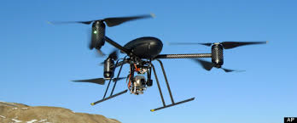
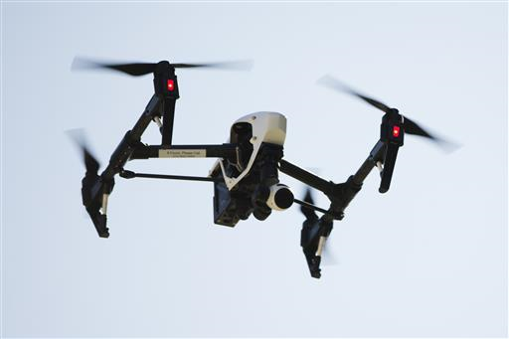
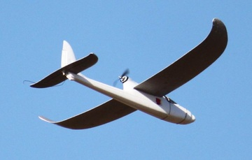
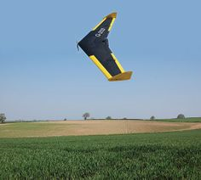
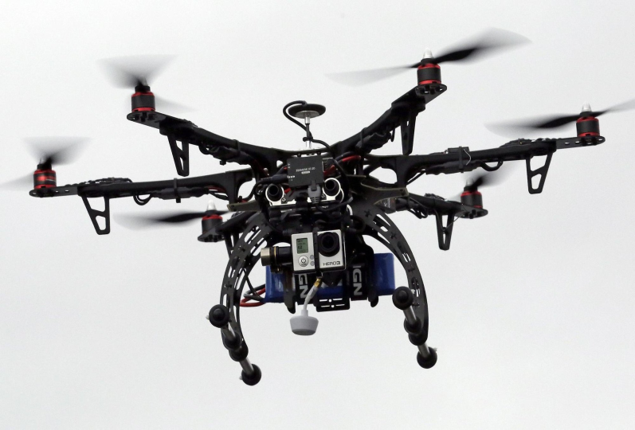
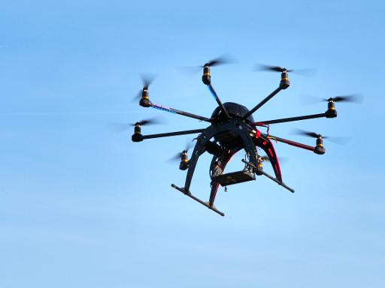
UAS Introduction

Slide 5
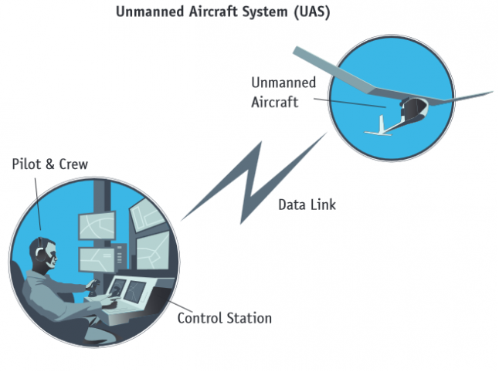
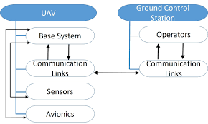
UAS Introduction – More Than Just the Drone
Unmanned Aircraft System
      “An unmanned aircraft and associated elements (including communication links and the components that control the unmanned aircraft) that are required for the pilot in command to operate safely and efficiently in the national airspace system.” (P.L. 112-95, section 331(9))

Slide 6
Drones in the Real Estate Industry
One of the first Section 333 Exemptions granted by FAA for commercial operations was to a realtor: Doug Trudeau, Tierra Antigua Realty, Tucson, AZ, January 6, 2015
As of August 29, 2016, 3,434 out of 5,521 total Section 333 Exemptions identified “Real Estate” as an intended application
Florida – 388
California – 358
  Texas – 294
  Colorado – 100
  Majority of companies are “small businesses” with revenues of less than $1M and less than 10 employees
      - Association of Unmanned Vehicle Systems International
  ( www.auvsi.org/advocacy/exemptions70 )
  “NAR supports efforts to create new federal regulations to allow for the future commercial use of unmanned aerial vehicle technology by the real estate industry. NAR is committed to working with the Federal Aviation Administration, and any other relevant federal agencies, during the regulatory approval process. The National Association of REALTORS® will continue its ongoing efforts to educate REALTORS® about the current and future regulatory structure for the safe and responsible operation of unmanned aerial vehicles.”
    - National Association of Realtors ( http://narfocus.com/billdatabase/index.php )

Slide 7
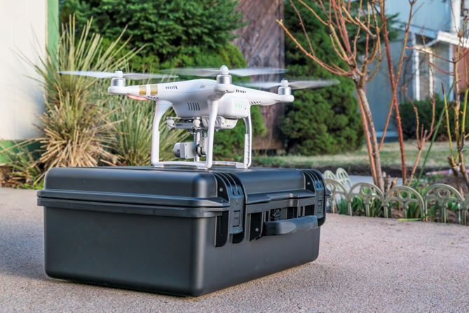
Drones in the Real Estate Industry
Real Estate Industry applications include:
  Aerial photography and videography for property marketing
  Neighborhood Perspective
  Property Inspections
  Property Maps and Surveys
  Appraisals
  Property Management
  Security
  Insurance

Slide 8

Federal Law and Regulations – FAA’s Role
FAA Mission – “Provide the safest, most efficient aerospace system in the world.”
FAA’s Major Roles and Responsibilities:
Regulating civil aviation to promote safety
Encouraging and developing civil aeronautics,
including new aviation technology
Developing and operating a system of air traffic
control and navigation for both civil and military
aircraft
Researching and developing the National Airspace
System and civil aeronautics
Developing and carrying out programs to control
aircraft noise and other environmental effects of civil aviation
Regulating U.S. commercial space transportation
( http://www.faa.gov/about/mission/ )

Slide 9
Federal Law and Regulations – Drones Are Aircraft
Aircraft – “Any contrivance invented, used, or designed to navigate, or fly in, the air.”(49 U.S.C. § 40102(a)(6);
14 C.F.R. § 1.1)
Unmanned Aircraft – “An aircraft that is operated without the possibility of direct human intervention from within or on the aircraft.” (P.L. 112-95, section 331(8); 14 C.F.R. § 107.3)
“No person may operate an aircraft in a careless of reckless manner so as to endanger the life or property of another.”
(14 C.F.R. § 91.13(a))
“No person may operate a UAS in the National Airspace System without specific authority.” (FAA Notice No. 07-01, Policy Statement, “Unmanned Aircraft Operations in the National Airspace System,” February 13, 2007, Docket No. FAA-2006-25714)

Slide 10
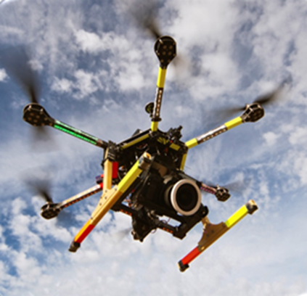
Federal Law and Regulations - UAS
Federal Aviation Regulations - Operation and Certification of Small Unmanned Aircraft Systems (14 C.F.R. 107)
Operating Rules
Remote Pilot Certificate
Registration and Marking
FAA Modernization and Reform Act of 2012 (FMRA)
Section 333 – Civil UAS
Section 334 – Public UAS
Section 336 – Model Aircraft

Slide 11
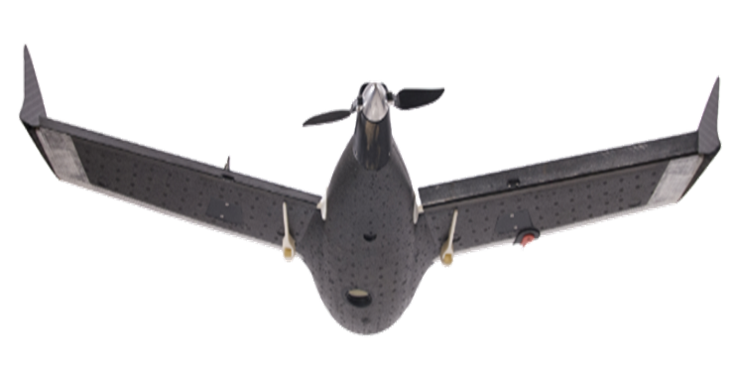
Federal Law and Regulations –
Section 333 Exemptions
  Commercial operations previously required an Exemption
  FMRA, Section 333, Exemption
    Grants Secretary of Transportation the authority to determine whether certain UAS may operate safely in the National Airspace System before permanent UAS rules are issued.
    FAA is using this authority to grant exemptions for commercial, small UAS operations.
Only 20 Section 333 Exemptions granted prior to February 15, 2015
As of September 28, 2016, 5,552 total Section 333 Exemptions had been granted.

Slide 12

Federal Law and Regulations –
Permanent Rules are Here!
      Final Rules for Operation and Certification of Small Unmanned Aircraft Systems went into effect on August 29, 2016 as 14 C.F.R., Part 107
      Applies to commercial operation of small UAS
      FAA Resources: https://www.faa.gov/uas/

Slide 13
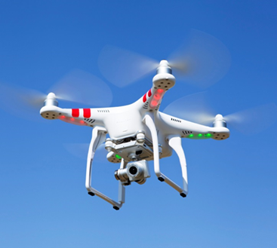
Federal Law and Regulations –
Part 107 Rules
UAS must weigh less than 55 pounds
UAS must remain within operator’s VLOS
May not operate over persons not directly involved in UAS operation unless under covered structure or inside covered stationary vehicle
Daylight operations only; operations during
civil twilight allowed with appropriate
anti-collision lighting
Visual Observer allowed but not required
Maximum groundspeed of 100 MPH
Maximum altitude of 400 feet AGL or higher if within 400 feet of a structure
No operations from a moving vehicle unless over a sparsely populated area

Slide 14
Federal Law and Regulations –
Part 107 Rules
Preflight inspection required; airworthiness certification not required
Intrastate, VLOS transportation of property for compensation is allowed
External load operations are allowed
Some operating restrictions are waivable; online waiver request
Pilot’s license no longer required
UAS Operator must hold a remote pilot airman certificate (at least 16 years old; aeronautical knowledge test; TSA clearance)
COA no longer required for most Part 107 sUAS operations
Operations in Class G airspace allowed without ATC permission; ATC permission required in Class B, C, D and E airspace
NOTAM no longer required

Slide 15
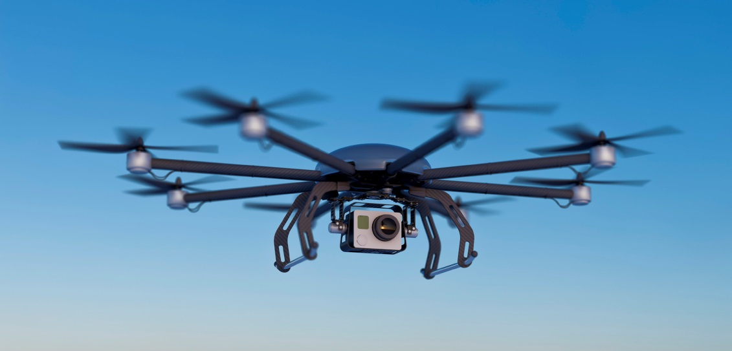
Federal Law and Regulations –
Small UAS Must Be Registered
Public and Civil sUAS must be registered and must display
N-number
As of March 31, 2016, commercial, public, and other non-model aircraft sUAS may register using FAA’s online registration system
Unmanned Aircraft System Registration:
http://www.faa.gov/uas/registration/

Slide 16
FAA Extension, Safety, and Security Act of 2016
§ 2202 – Development of industry standards for remote identification of UAS and operators; regulations w/in 2 years
§ 2203 – Required safety statements provided by manufacturer at time of UAS delivery
§ 2204 – Interagency and other agreements to expedite approval of UAS operations related to firefighting and utility service restoration
§ 2205 – Prohibits UAS operations that interfere w/ wildfire suppression, law enforcement, or emergency response; civil penalty ≤ $20,000
§ 2206 – Pilot project for UAS detection at airports and critical infrastructure

Slide 17
FAA Extension, Safety, and Security Act of 2016
§ 2207 – Emergency exemption or COA process for civil or public emergency response (firefighting, SAR, utility and infrastructure restoration, etc.) UAS operations
§ 2208 – UAS traffic management R&D plan and pilot project
§ 2209 – Process to designate fixed site facilities and prohibit UAS operations (energy production, transmission and distribution; oil refineries; chemical facilities; amusement parks; other); public website of designated facilities
§ 2210 – Section 333 exemption process for BVLOS and night UAS operations related to inspection and disaster response for critical infrastructure and covered facilities (pipeline; electric energy generation, transmission, and distribution; oil or gas production, refining, or processing); process in place w/in 3-9 mos.

Slide 18
UAS Issues and Responsibilities
 | Federal | State
Airspace | ✓
Air Traffic Management | ✓
Aircraft and Equipment | ✓
Pilots and Crew | ✓
Safety | ✓
Commerce | ✓
Property Rights |  | ?
Privacy |  | ?

Slide 19
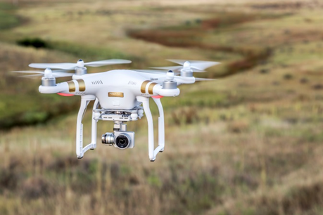
Federal Authority v. State and Local Authority?
Open question as to the extent federal law preempts state and local UAS-related legislation
      Neither FMRA, FESSA, nor Part 107 include express preemption provisions
      FAA Drone Advisory Committee – ad hoc committee to consider preemption issues
      FAA Fact Sheet on State and Local UAS Laws
      (December 17, 2015) (https://www.faa.gov/news/updates/?newsId=84369 )
      Similar question related to state efforts to preempt local UAS regulations
      (e.g., MD and AZ)
      Examples of municipal drone regulations: Chicago, IL; Miami, FL; Santa Clara, CA;
      San Jose, CA; Paradise Valley, AZ; Scottsdale, AZ; Ocean City, MD

Slide 20
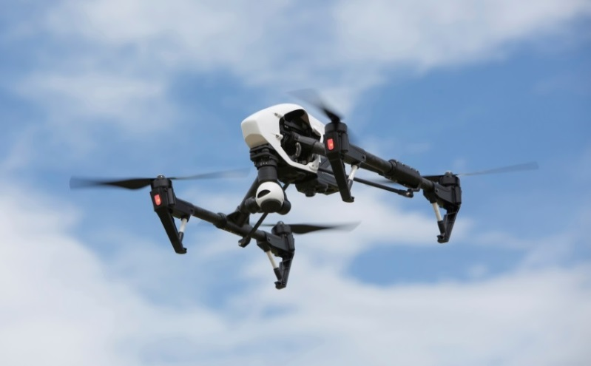
State UAS Legislation
According to the National Conference of State Legislatures:
      As of January 5, 2017, 32 states have enacted some form of UAS law
      In 2016, at least 38 states considered bills related to UAS
      At least seven states have formed task forces or committees to consider UAS-related regulations or economic development opportunities
      State and local UAS-related legislation tends to focus on issues related to property rights, privacy, and law enforcement uses

Slide 21
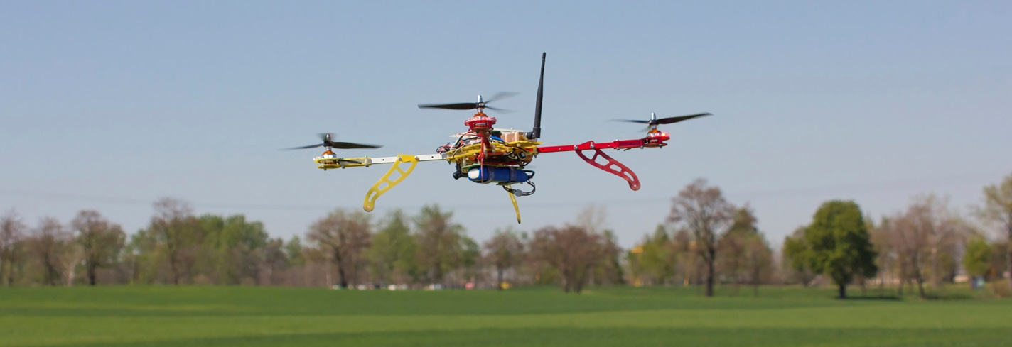
Colorado Legislation
Recent UAS-Related Legislation
      HB1020 (2016) – Contraband; prohibited UA operations (PI)
      HB1213 (2016) – Emerging Technologies (PI)
      HB1115 (2015) – Privacy Regarding Emerging Technologies (PI)
      SB059 (2015) – Law Enforcement Use (PI)

Slide 22
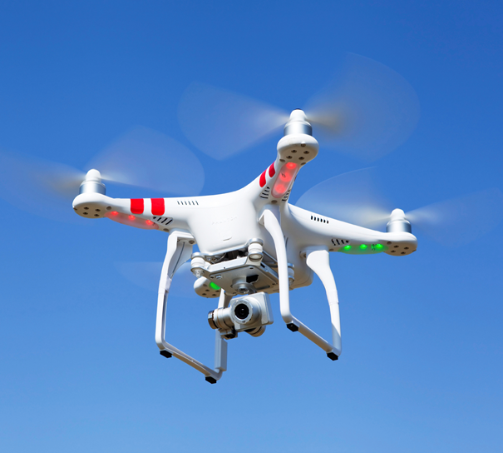
State Law Considerations - Airspace and Property Rights
Historical Perspective
Cujus est solum, ejus est usque ad coelom – Whose is the soil, his it is up to the sky.

Slide 23
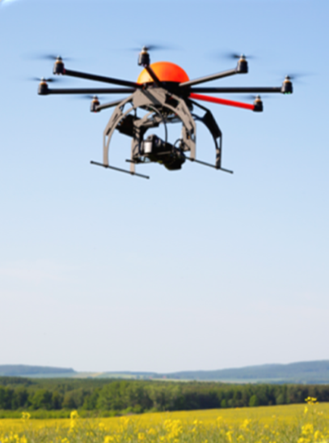
State Law Considerations - Airspace and Property Rights
Modern Perspective
“That doctrine has no place in the modern world.”
United States v. Causby, 328 U.S. 256, 261 (1946)
Question – What interest in airspace do you own?

Slide 24
State Law Considerations - Airspace and Property Rights
National Airspace System
“The United States Government has exclusive sovereignty of airspace of the United States.” “A citizen of the United States has a public right of transit through the navigable airspace.” (49 U.S.C. § 40103(a))
FAA Authority – “The Administrator of the Federal Aviation Administration shall develop plans and policy for the use of the navigable airspace and assign by regulation or order the use of the airspace necessary to ensure the safety of aircraft and the efficient use of airspace.” (49 U.S.C. § 40103(b))
National Airspace System – Created to protect persons and property on the ground, and to establish a safe and efficient airspace environment for civil, commercial, and military aviation. Includes a network of air navigation facilities, air traffic control facilities, airports, technology, and appropriate rules and regulation.
See National Airspace System Overview
(https://www.faa.gov/air_traffic/nas/nynjphl_redesign/documentation/feis/media/Appendix_A-National_Airspace_System_Overview.pdf )

Slide 25
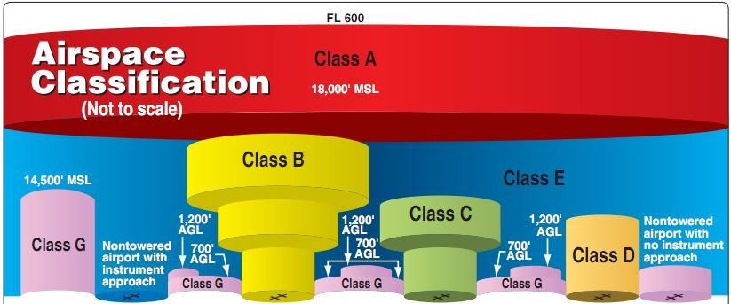
National Airspace System - Structure
(www.faasafety.gov)

Slide 26
State Law Considerations - Airspace and Property Rights
Common belief is that a landowner owns up to the lower limits of the navigable airspace.
Navigable Airspace – “Airspace above the minimum altitudes of flight prescribed by regulations . . . including airspace needed to ensure safety in takeoff and landing of aircraft.” (49 U.S.C. § 40102(a)(32))
Minimum Safe Altitudes (14 C.F.R. 91.119)
For Any Aircraft
An altitude allowing an emergency landing without undue hazards to persons or property on the ground if a power unit fails
over congested areas - 1,000 feet above the highest obstacle within 2,000 feet
over non-congested areas - 500 feet AGL; lower if over open water or sparsely populated areas but not closer than 500 feet to persons, vehicles, or structures
For Helicopters – Less than prescribed minimum provided operation complies with FAA helicopter routes or altitudes and without hazard to persons or property on the surface
Navigable Airspace as boundary for property rights purposes depends on location and type of aircraft.

Slide 27

State Law Considerations - Airspace and Property Rights
Permission to operate in the NAS does not necessarily address the operator’s rights with respect to the property rights within that airspace.

Slide 28
State Law Considerations - Airspace and Property Rights
Manned Aviation and Property Rights - Takings
United States v. Causby, 328 U.S. 256 (1946)
    Takings claim related to military aircraft takeoffs and landings over chicken farm.
    Ad Coelom Doctrine - “That doctrine has no place in the modern world.”
    “The landowner owns at least as much of the space above the ground as he can occupy or use in connection with the land.”
    “The airplane is part of the modern environment of life, and the inconveniences which it causes are not normally compensable under the Fifth Amendment. The airspace, apart from the immediate reaches above the land, is part of the public domain. We need not determine at this time what those precise limits are. Flights over private land are not a taking unless they are so low and so frequent as to be a direct and immediate interference with the enjoyment and use of the land.
      Key Take-Aways – Confirmed that landowner has a property right in airspace above his or her property. Left unanswered questions concerning the physical extent of the landowner’s airspace interest as compared to navigable airspace and aircraft operations. Focus is on interference with use and enjoyment of the land.

Slide 29
State Law Considerations - Airspace and Property Rights
Manned Aviation and Property Rights - Trespass
    “Flight by aircraft in the air space above the land of another is a trespass if, but only if, (a) it enters into the immediate reaches of the air space next to the land, and (b) it interferes substantially with the other’s use and enjoyment of his land.” Restatement (Second) of Torts, § 159, Intrusions Upon, Beneath and Above Surface of Earth
    Applying Causby reasoning that the “landowner owns at least as much of the space above the ground as he can occupy or use in connection with the land,” question is whether drone flight over property interferes with the landowner’s use and enjoyment of that portion of the airspace to which he or she can claim a right.
    Question – At what altitude does aircraft flight over private property constitute a trespass?
  Manned Aviation and Property Rights - Nuisance
    “A private nuisance is a nontrespassory invasion of another’s interest
    in the private use and enjoyment of land.” Restatement (Second) of Torts,
    § 821D, Private Nuisance
    Question – When does aircraft flight over adjacent property constitute
    a nuisance?
  Absent state statute, trespass and nuisance claims may be decided on a
  case-by-case, factual analysis.

Slide 30

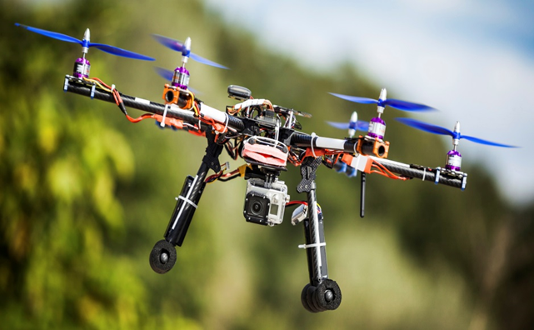
State Law Considerations - Airspace and Property Rights
Existing body of law concerning airspace and property rights in the context of manned aircraft.
Analyses of similar issues related to UAS operations may build on these precedents.

Slide 31
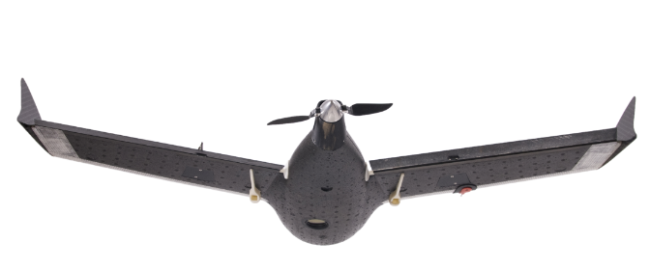
State Law Considerations - Airspace and Property Rights
    Unmanned Aviation and Property Rights - Takings
    Takings issue could arise in the context of public agency use of UAS
    Less likely since small UAS do not necessarily take-off and land at fixed airports
    Not inconceivable to have takings claim associated with public small UAS operations
    Less likely to be an issue for the commercial use of UAS

Slide 32
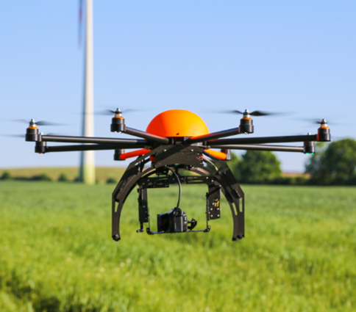
State Law Considerations - Airspace and Property Rights
    Unmanned Aviation and Property Rights - Trespass
Trespass law does not distinguish between manned and unmanned aircraft.
Same factual and legal analysis applies
Practical difference will be operating altitudes and navigable airspace reasoning
    Question – When does drone flight over private property constitute a trespass?
    Absent state statute, trespass claim
    may be decided on a case-by-case,
    factual analysis.

Slide 33

State Law Considerations - Airspace and Property Rights
    Unmanned Aviation and Property Rights - Nuisance
Nuisance law may be even more applicable to drones given public perceptions and privacy concerns
Same factual and legal analysis applies
    Question – When does drone flight over adjacent property constitute a nuisance?
    Absent state statute, nuisance claim may be decided on a case-by-case, factual analysis.

Slide 34
State Law Considerations - Airspace and Property Rights
Boggs v. Meredith, W.D.Ky. (Case No. 3:16-cv-6-DJH)
Drone alleged to be operating at 200’ AGL in Class G airspace
Homeowner shot-down drone he perceived to be trespassing and invading his family’s privacy
Homeowner charged with felony wanton endangerment and criminal mischief
State district court judge dismissed criminal charges stating homeowner “had a right to shoot” the drone
Federal complaint for Declaratory Judgment and Damages
Requests determination of rights of aircraft in navigable airspace relative to rights of property owner
Motion to dismiss for lack of subject matter jurisdiction

Slide 35
Airspace and Property Rights - Practical Considerations
Operating over your own property
Trespass
Nuisance
Operating over property with permission of owner
Trespass
Nuisance
Landowner perceptions
Operating over third-party property without permission
Trespass
Nuisance
Section 333 Exemption Conditions

Slide 36

Drones and Privacy
FAA has stated that privacy issues are not within its authority
FAA Drone Advisory Committee – ad hoc committee will consider privacy issues
  Neither FMRA, nor FESSA, nor Part 107 Rules specifically address privacy issues
Litigation
Electronic Privacy Information Center v. FAA, U.S. Dist. Ct., D.C. Cir., Case No. 15-1075 (March 31, 2015) - Dismissed
Electronic Privacy Information Center v. FAA, U.S. Dist. Ct., D.C. Cir., Case No. 16-1297 (August 22, 2016) - Pending

Slide 37
Drones and Privacy
Presidential Memorandum: Promoting Economic Competitiveness While Safeguarding Privacy, Civil Rights, and Civil Liberties in Domestic Use of Unmanned Aircraft Systems (February 15, 2015)
    Established privacy protections for federal government UAS uses
    Directed the National Telecommunications and Information Administration (NTIA) to undertake a multi-stakeholder process “to develop and communicate best practices for privacy, accountability, and transparency issues regarding commercial and private UAS use
    Voluntary Best Practices for Commercial UAS Privacy, Transparency, and Accountability (May 18, 2016): https://www.ntia.doc.gov/other-publication/2016/multistakeholder-process-unmanned-aircraft-systems

Slide 38
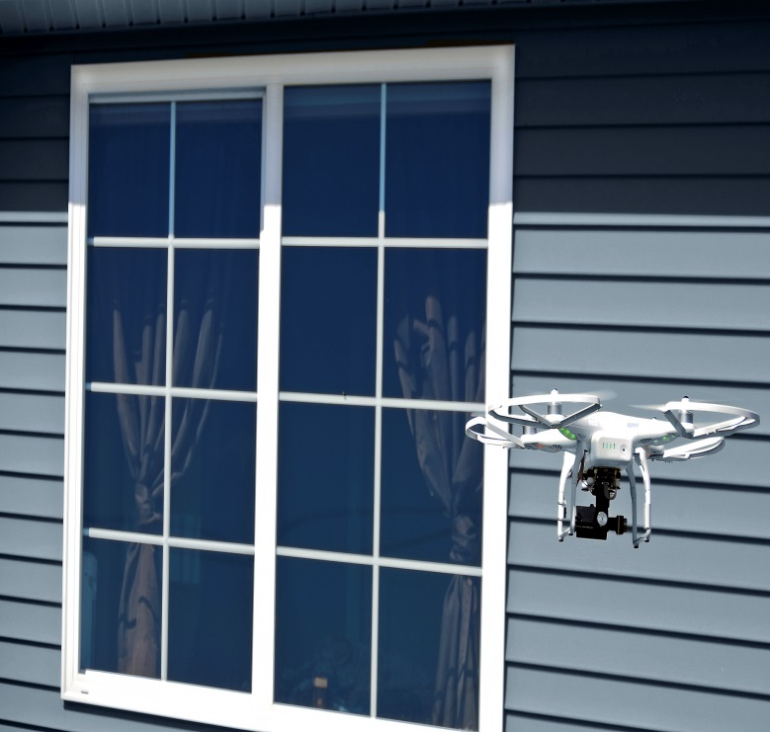
State Law Considerations - Privacy
At least 22 states have enacted UAS legislation addressing some aspect of privacy, including law enforcement use of UAS and privacy violations by non-government actors (AK, AR, CA, FL, ID, IL, IN, IA, KS, ME, MS, MT, NC, ND, NV, OR, TN, TX, UT, VT, VA, WI).
Common law torts may also apply to privacy claims related to UAS operations.
Traditional Privacy Torts
  Intrusion Upon Seclusion
  Public Disclosure Of Private Facts
  Publicity Which Puts Person In A “False Light”
  Appropriation Of Likeness
Other Privacy Related Issues
  News Gathering
  Law Enforcement
  Regulatory Actions
  Activists
  Commercial Competition

Slide 39

Key Business Considerations –
To Drone or Not to Drone?
What is the business case?
      Presently using manned aircraft?
      Presently using ground-based photography and inspection methods?
      Do UA offer new opportunities based on low cost, safety, flexibility, ease of use, maneuverability, sensor capabilities, etc.?
      Consider your competitors and users in similar industries.
      Can sUAS decrease costs, improve operations, increase safety?
If business case exists, do you develop internal UAS capability or pursue “drones as a service”?
Issues to Consider
  Costs
  FAA Regulatory Compliance
  Cybersecurity
  Liability
  Insurance
  Privacy
  Data Ownership, Integration, and Management

Slide 40
Key Business Considerations –
UAS Insurance
Many foreign jurisdictions require UAS operators to have appropriate insurance. Current and proposed sUAS rules do not require insurance.
Lenders may require insurance if UAS has been financed.
Insurance is advisable to protect assets and against liability
Risks
    UAS collision in the air or on the ground
    Control system failure, mechanical component failure, loss of communications/control link
    Cybersecurity (hijacking, hacking, data breach, etc.)
    Tort claims related to property rights and privacy

Slide 41
Key Business Considerations –
UAS Insurance
Coverage Issues
    UAS airframe, components, controls, sensors (Hull Coverage)
    First Party personal injury and property damage
    Third Party personal injury and property damage (CGL)
    Cybersecurity
    Workers’ Compensation
    D&O
    Product Liability (UAS and component manufacturers)
Do not assume that CGL and umbrella/excess policies cover commercial UAS operations. Standard exclusions for aviation operations and operations in violation of applicable regulations.
Important to review coverage and confirm with carrier that commercial use of a UAS is included.

Slide 42
Key Business Considerations –
Contracting for Drone Services
“Pros”
UAS contractor will be responsible for regulatory compliance, ATO coordination, sUAS registration, required and recommended documentation, FAA reporting requirements, sUAS maintenance, pilot/operator training and qualification, etc.
FAA will enforce against contractor, not you
“Cons”
New challenges associated with choosing the best contractor for the intended project
May lose some of the benefits of sUAS due to contracting and scheduling issues
Hundreds of exemptions granted to drone service providers

Slide 43
Key Business Considerations –
What To Do With All of That Data?
Broad range of sensors deployable on UAS: high resolution visual imagery, multispectral imaging (infrared, ultraviolet), acoustic sensors, LIDAR, low light imaging, chemical detectors, biometrics, etc.
UAS Operational Flexibility + Sensors = Potential Wealth of Data
Additional questions related to management of data collected by UAS
    Who owns the data?
    Should there be restrictions on the analysis and use of the data?
    What measures should be required to protect the data?
    How long may the data be retained?
    Should the data be deleted at some point?
    May the data be disseminated to third parties?
    Consider policies, procedures, and contracts addressing data issues

Slide 44

UAS Trends – What Comes Next?
FAA Pathfinder Program
  PrecisionHawk – Beyond Visual Line of Sight in Agricultural/Rural Settings
  BNSF – Beyond Visual Line of Sight in Railroad/Rural Settings
  CNN – newsgathering in urban areas (CNNAIR)
  Flights over People
  UAS Detection Initiative – CACI Intl., Gryphon, Liteye, others
  Counter-Drone Technology
Sense-and-Avoid Technology
Unmanned Aircraft Traffic Management System
  NASA
  PrecisionHawk/Verizon/Harris/Digital Global
Commercial Deliveries

Slide 45

Questions?
Feel free to contact:
Tom Dougherty
Lewis Roca Rothgerber Christie LLP
TDougherty@LRRC.com
303-628-9524

