Slide 1
NAR Update
Katie Johnson
General Counsel & Chief Member Experience Officer
NATIONAL ASSOCIATION OF REALTORS®

Slide 2
NAR-DOJ Settlement

Slide 3
Outcomes
NAR has agreed to make certain changes to the REALTOR® Code of Ethics and MLS Policies to accommodate questions raised by the DOJ.
No immediate action is required.
Most of the changes seek to more explicitly state what is already the spirit and intent of NAR’s Code of Ethics and MLS Policies.
All changes are subject to both DOJ and NAR Board of Director approval.

Slide 4
Outcomes
NAR admits no liability, wrongdoing or truth of any allegations by the DOJ.
No fines or any payments are required.
Allows NAR to remain focused on supporting our members as they preserve, protect and advance the American dream of homeownership.

Slide 5
Rule Change: Disclosure of Commissions
NAR must adopt one or more Rules that:
Repeal any Rule that prohibits, discourages, or recommends against an MLS or MLS Participant publishing or displaying to consumers any MLS database field specifying compensation offered to other MLS Participants.
Require all Member Boards and MLSs to repeal any Rule that prohibits, discourages, or recommends against an MLS or MLS Participant publishing or displaying to consumers any MLS database field specifying compensation offered to other MLS Participants.
Require all MLS Participants to provide to Clients information about the amount of compensation offered to other MLS Participants.

Slide 6
Rule Change: Prohibition on Advertising Services as Free
NAR must adopt one or more Rules that:
Repeal any Rule that permits all MLSs and MLS Participants, including buyer Brokers, to represent that their services are free or available at no cost to their Clients;
Require all Member Boards and MLSs to repeal any Rule that permits MLSs and MLS Participants, including buyer Brokers, to represent that their services are free or available at no cost to their Clients
Prohibit all MLSs and MLS Participants, including buyer Brokers, from representing that their services are free or available at no cost to their Clients.

Slide 7
Rule Change: Filtering of MLS Listings
NAR must adopt one or more Rules that:
Require all Member Boards and MLSs to prohibit MLS Participants from filtering or restricting MLS listings that are searchable by or displayed to consumers based on the level of compensation offered to the buyer Broker or the name of the brokerage or agent
Repeal any Rule that permits or enables MLS Participants to filter or restrict MLS listings that are searchable by or displayed to consumers based on the level of compensation offered to the buyer Broker, or by the name of the brokerage or agent.

Slide 8
Rule Change: Lockbox Access
NAR must adopt one or more Rules that:
Require that require all Member Boards and MLSs to allow any licensed real estate agent or agent of a Broker, to access, with seller approval, the lockboxes of those properties listed on an MLS.

Slide 9
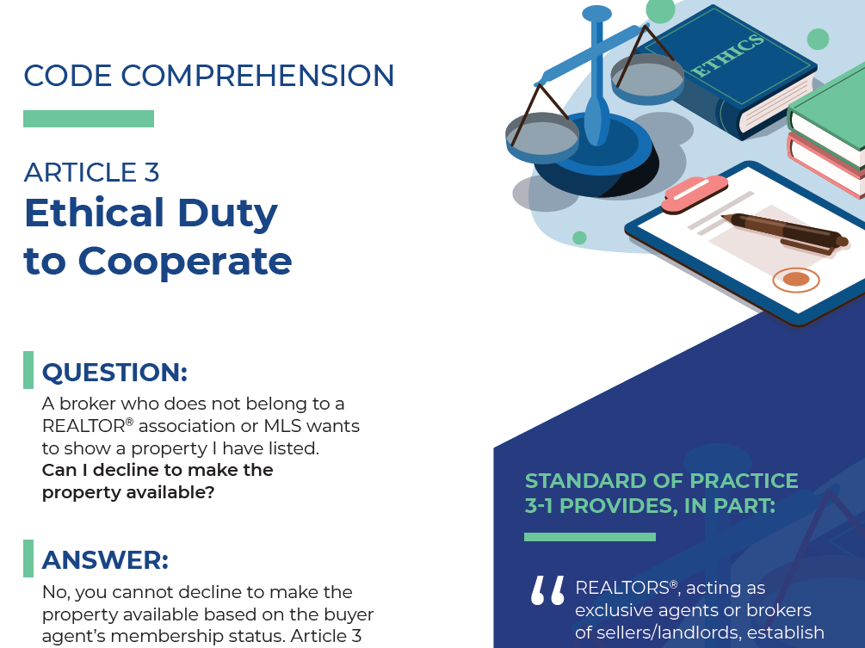
Article 3
Duty to Cooperate
https://www.nar.realtor/about-nar/governing-documents/code-of-ethics/code-comprehension-article-3-ethical-duty-to-cooperate

Slide 10
Next Steps
No immediate action required
Finalize proposed rule changes
NAR Board of Directors Meeting in Spring 2021 to approve rule changes
Implementation of final rules

Slide 11
Updated Information will be available on a dedicated page on the NAR website.
https://www.nar.realtor/2020-nar-doj-agreement-regarding-mls-rules

Slide 12
In other news on the LITIGATION FRONT

Slide 13
Moehrl v. National Association of REALTORS et al., Civil Action Nos.:1:19-cv-01610 and 1:19-cv-2544 (N.D. Ill. 2019)
Sitzer v. National Association of REALTORS et al., Case No. 4:19-cv-00332-SRB (W.D. Mo. 2019)

Slide 14
Leeder v. National Association of REALTORS et al., Civil Action No.:1:21-cv-00430 (N.D. Ill. Filed Jan. 25, 2021)

Slide 15
Our story
1
2
3
4
REALTORS® are champions of homeownership, property rights and the communities they serve.
The MLS system and the way commissions are paid create competitive, efficient markets that benefit home buyers, sellers and small business.
Local, expert brokers play a crucial role in helping buyers and sellers achieve their goals.
These lawsuits are wrong on the facts, wrong on the economics and wrong on the law.

Slide 16
CLEAR COOPERATION POLICY LAWSUITS

Slide 17
Clear Cooperation Policy
Adopted in November 2019, by the NAR Board of Directors (729-70) to provide crucial protection for consumers.
Provides greater transparency and competition between real estate listings and between brokers while still addressing privacy concerns.
Applies to listings that are publicly marketed and has no impact on properties sold exclusively within the listing brokerage.
Promotes equal opportunity for all and Fair Housing!
Remains in effect and is not altered in any way by these lawsuits.

Slide 18
Filed on May 11, 2020
Plaintiff asserts that the Clear Cooperation Policy is anticompetitive
On May 27, 2020, the Court denied Plaintiff’s Motion for TRO Injunction
On July 16, the Court denied Plaintiff’s Motion for Preliminary Injunction
On December 3, the Court granted Defendants’ Motion to Dismiss.
On January 13, 2021, TAN filed a Second Amended Complaint.
On February 15, 2021, NAR filed a Motion to Dismiss the Second Amended Complaint.
Top Agent Network v. National Association of REALTORS® et al., Case No. 3:20-cv-03198 (N.D. Cal., 2020)

Slide 19
The PLS.com, LLC v. National Association of REALTORS® et al., Case No. 2:20-cv-04790 (C.D. Cal., 2020)
Filed on May 28, 2020
California Regional MLS, Midwest Real Estate Data, LLC., and Bright MLS, Inc. are also named defendants
The Plaintiff asserts that the Clear Cooperation Policy is anticompetitive
Plaintiff seeks a permanent injunction
On February 3, 2021, the court granted NAR’s Motion to Dismiss the case with prejudice.

Slide 20
CHANGES TO THE CODE OF ETHICS AND PROFESSIONAL STANDARDS POLICIES
Approved by the NAR Board of Directors November 2020

Slide 21
HISTORY
The Code of Ethics was adopted in 1913 with the Golden Rule as its theme. It is premised upon moral integrity and competent service to clients as well as dedication to the public interest and welfare. The Code has been amended many times to reflect changes in the real estate marketplace, the needs of consumers, and the perceptions and values of society.
The NAR Professional Standards Committee met on October 5, 2020, to consider recommendations from its Interpretations and Procedures Advisory Board on the Code of Ethics’ applicability to discriminatory speech and conduct.
The Committee approved the Advisory Board’s recommendations, and six of them were presented to and approved by the NAR Board of Directors at their November 13, 2020 meeting.

Slide 22
REALTORS® should recognize that the interests of the nation and its citizens require the highest and best use of the land and the widest distribution of land ownership. . . Such interests impose obligations beyond those of ordinary commerce. They impose grave social responsibility and a patriotic duty to which REALTORS® should dedicate themselves, and for which they should be diligent in preparing themselves. REALTORS®, therefore, are zealous to maintain and improve the standards of their calling and share with their fellow REALTORS® a common responsibility for its integrity and honor.
Preamble, Code of Ethics and Standards of Practice of the National Association of REALTORS®
Notes:
Replace “rights” with “equality”, “humanity”, or “dignity”.

Slide 23
New Standard of Practice 10-5
Flows from requirement to not deny equal professional services or be parties to a plan to discriminate.
The public posting of hate speech would reveal bias against protected classes.
Thus, public posting of hate speech could result in REALTORS® not taking clients from certain protected classes or not treating clients equally.
Such actions would violate the Fair Housing Act due to overt discrimination or disparate impact.

Slide 24
The purpose of this law is simple; it does not restrict the freedom of any American, so long as he respects the rights of others.
President Lyndon B. Johnson, upon signing the Civil Rights Act of 1964
Notes:
Replace “rights” with “equality”, “humanity”, or “dignity”.

Slide 25
New Standard of Practice 10-5, Adopted and Effective November 13, 2020
REALTORS® must not use harassing speech, hate speech, epithets, or slurs based on race, color, religion, sex, handicap, familial status, national origin, sexual orientation, or gender identity.

Slide 26
NAR’s Code of Conduct and Anti-Harassment Policy
Harassment includes inappropriate conduct, comment, display, action, or gesture based on another person’s sex, color, race, religion, national origin, age, disability, sexual orientation, gender identity, and any other protected characteristic.

Slide 27
Examples of harassment include but are not limited to
Epithets, slurs or negative stereotyping; threatening, intimidating or hostile acts; denigrating jokes; and the display or circulation of written or graphic material that denigrates or shows hostility toward an individual or group based on a protected characteristic.

Slide 28
Merriam Webster's Dictionary defines hate speech as:
Speech that is intended to insult, offend, or intimidate a person because of some trait (as race, religion, sexual orientation, national origin or disability).

Slide 29
Merriam Webster’s Dictionary defines epithet and slur:
Epithet: 1a: a characterizing word or phrase accompanying or occurring in place of the name of a person or thing; b. a disparaging or abusive word or phrase.
Slur: 1a. insulting or disparaging remark or innuendo: ASPERSION, b. a shaming or degrading effect: STAIN, STIGMA.

Slide 30
29. Applicability of the Code of Ethics to non-real estate-related activities
While REALTORS® are encouraged to follow the principles of the Code of Ethics in all of their
activities, a A REALTOR® shall be subject to disciplinary action under the Code of Ethics only with respect to real estate-related all of their activities. and transactions involving the REALTOR®.

Slide 31
Expanded definition of the public trust:
Expanded definition includes all discrimination against the protected classes under Article 10 and all fraud.
Associations would be required to share with the state licensing authority final ethics decisions holding REALTORS® in violation of the Code of Ethics in instances involving real estate-related activities and transactions and where there is reason to believe the public trust, as expanded, may have been violated.

Slide 32
New professional standards policies are not retroactive
Standard of Practice 10-5 (and all other changes)
apply only to conduct that occurs November 13, 2020 and thereafter.

Slide 33
HELPFUL RESOURCES
FAQs regarding the policies passed by the NAR Board of Directors:
https://www.nar.realtor/national-leadership/committee-members-liaisons/code-of-ethics-professional-standards-policies
Videos:
Interpretations and Procedures Advisory Board member Bruce Aydt (MO) explain the Advisory Board’s recommendations.
2020 Chair of NAR's Professional Standards Committee Matt Difanis (IL) addresses whether the status quo is even a problem with respect to housing discrimination and racial equity issues.
REALTORS® sharing their experiences on Race, Real Estate, and Association Leadership.
Monthly Training Sessions:
Sign up for NAR’s free monthly training sessions that provide guidance on the recent changes to the Code of Ethics and an opportunity to ask questions of our policy experts. Recordings of past sessions are available on this page as well:
www.nar.realtor/events/breaking-down-the-changes-to-the-code

Slide 34
Katie Johnson
General Counsel & Chief Member Experience Officer
 EMAIL: kjohnson@nar.realtor
 PHONE: 312-329-8372

